Slide 1
HISTORY OF PRINTMAKING

Slide 2
ENGRAVINGS…
…are designs and pictures that are incised (carved) in to different materials for the beauty of artwork or the reproduction of a print.
Prehistoric Engraving
Dates back 3,000 years
Evidence of engravings on walls of caves, on stone, clay, bone and ivory.

Slide 3
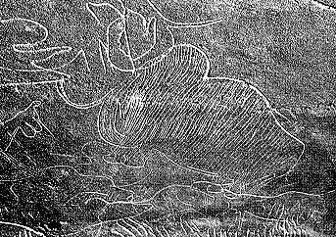
PREHISTORIC ENGRAVING STONE

Slide 4
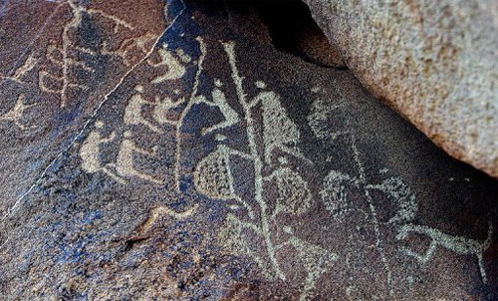
PREHISTORIC ENGRAVING CAVES

Slide 5
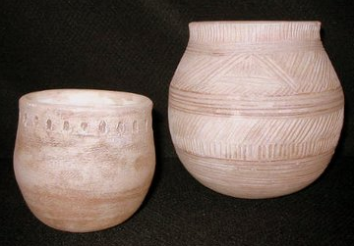
PREHISTORIC ENGRAVING EARTHENWARE (CLAY)

Slide 6
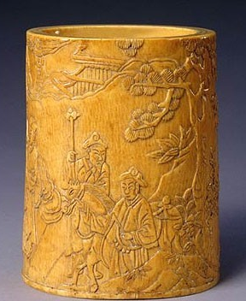
PREHISTORIC ENGRAVING IVORY

Slide 7
WOODCUT…
REPRODUCTION - ADVERTISING
With Gutenberg’s invention of the printing press in the 15th century,
the reproduction of woodcut was established.
The first medium able to print pictures and text.
Very time consuming, done in reversed image.
The wood is carved, ink rolled on the raised surface of the wood. The paper is laid on top of the wood and burnished to print the image.
Albrecht Durer is known as the master of woodcut. His works were done
with such craftsmanship and detail that they appeared as if they were
done in pen and ink.
Other great woodcutters and engravers were Winslow Homer and
Mc Escher.

Slide 8
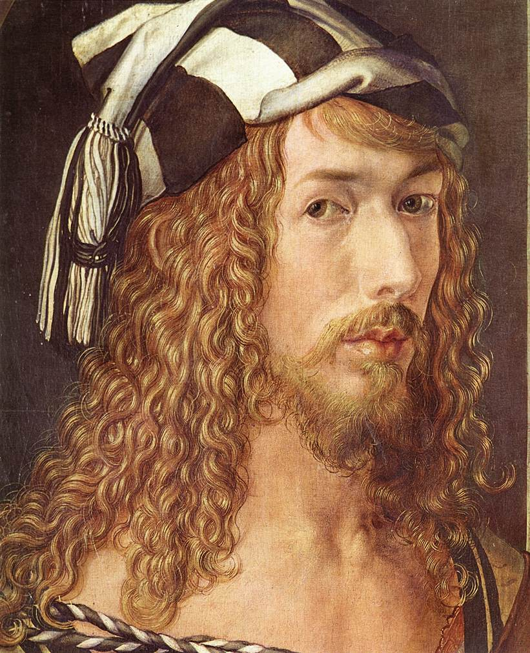
..
ALBRECT DURER 1471-1528 - GERMAN

Slide 9
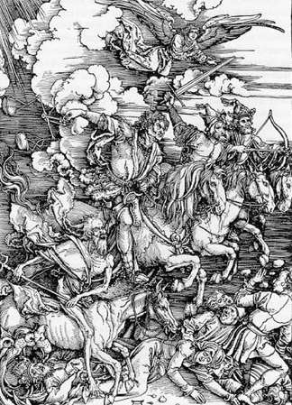
..
ALBRECT DURER WOODCUT

Slide 10
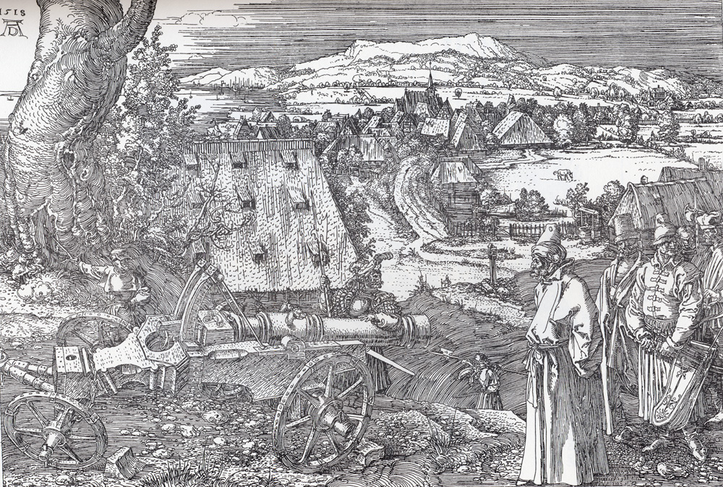
..
ALBRECT DURER WOODCUT

Slide 11
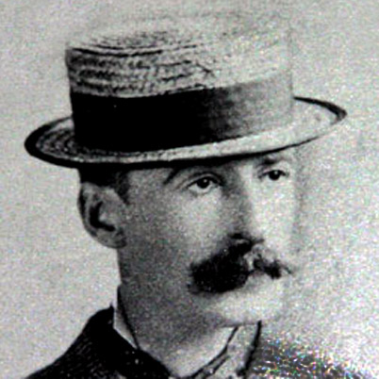
WINSLOW HOMER 1836-1910 - AMERICAN

Slide 12
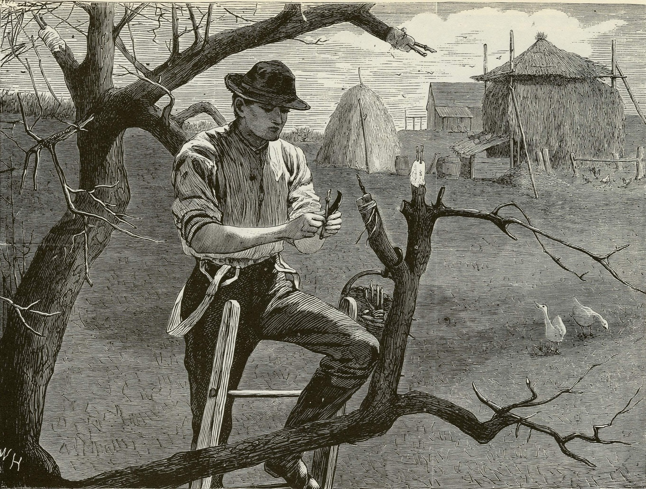
WINDSLOW HOMER WOODCUT

Slide 13
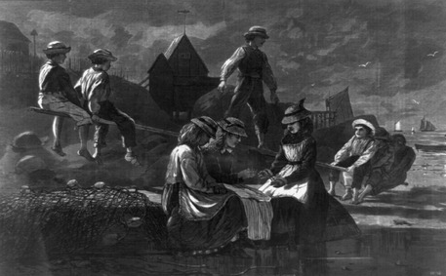
WINDSLOW HOMER WOODCUT

Slide 14
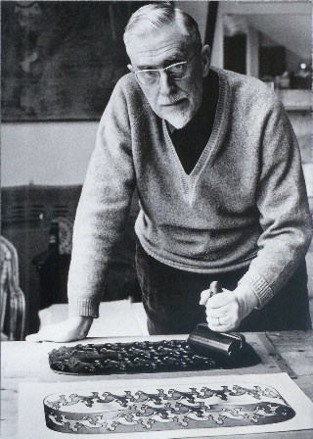
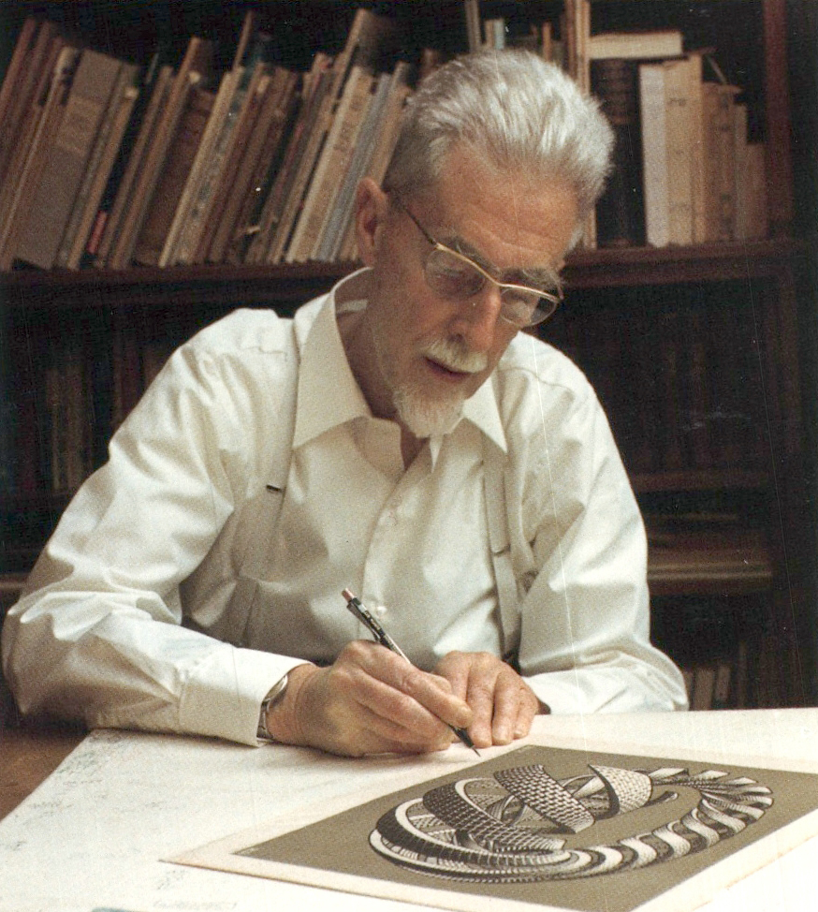
MC ESCHER 1898-1972 - DUTCH

Slide 15
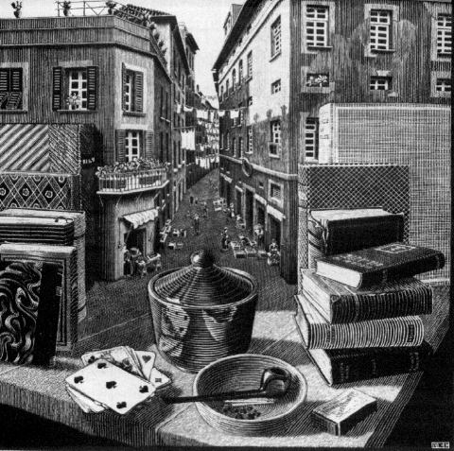
MC ESCHER WOODCUT

Slide 16
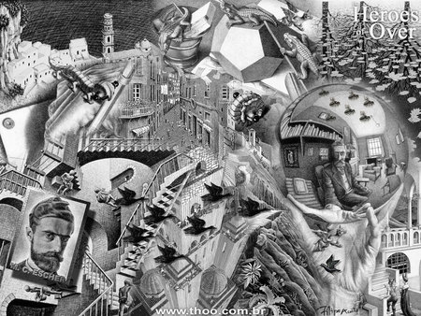
MC ESCHER WOODCUT

Slide 17
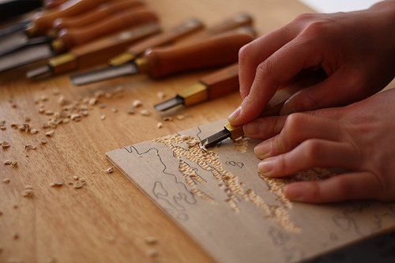
WOODCUT

Slide 18
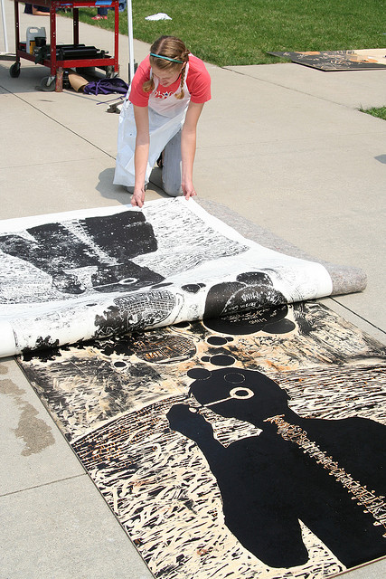
WOODBLOCK PRINTING

Slide 19
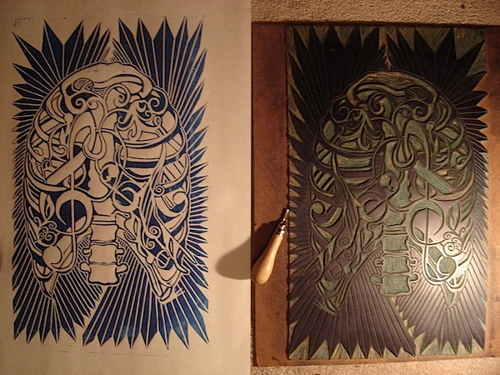
LINOLEUM BLOCK PRINT

Slide 20
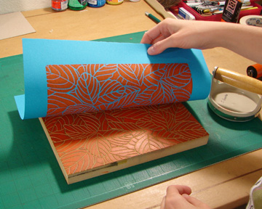

Slide 21
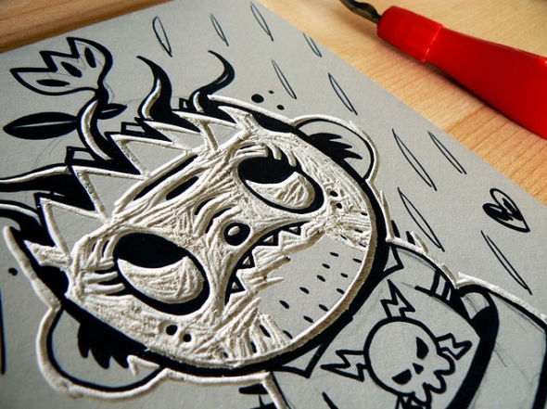

Slide 22
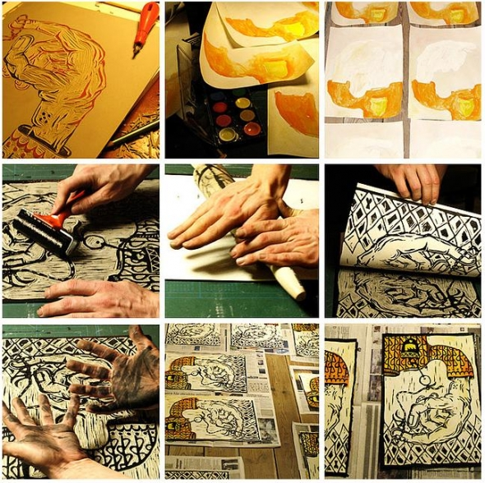

Slide 23
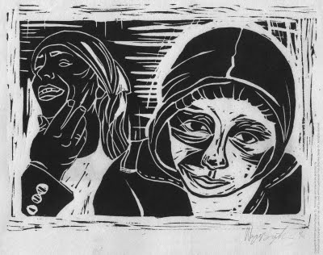
ONE COLOR PRINT

Slide 24
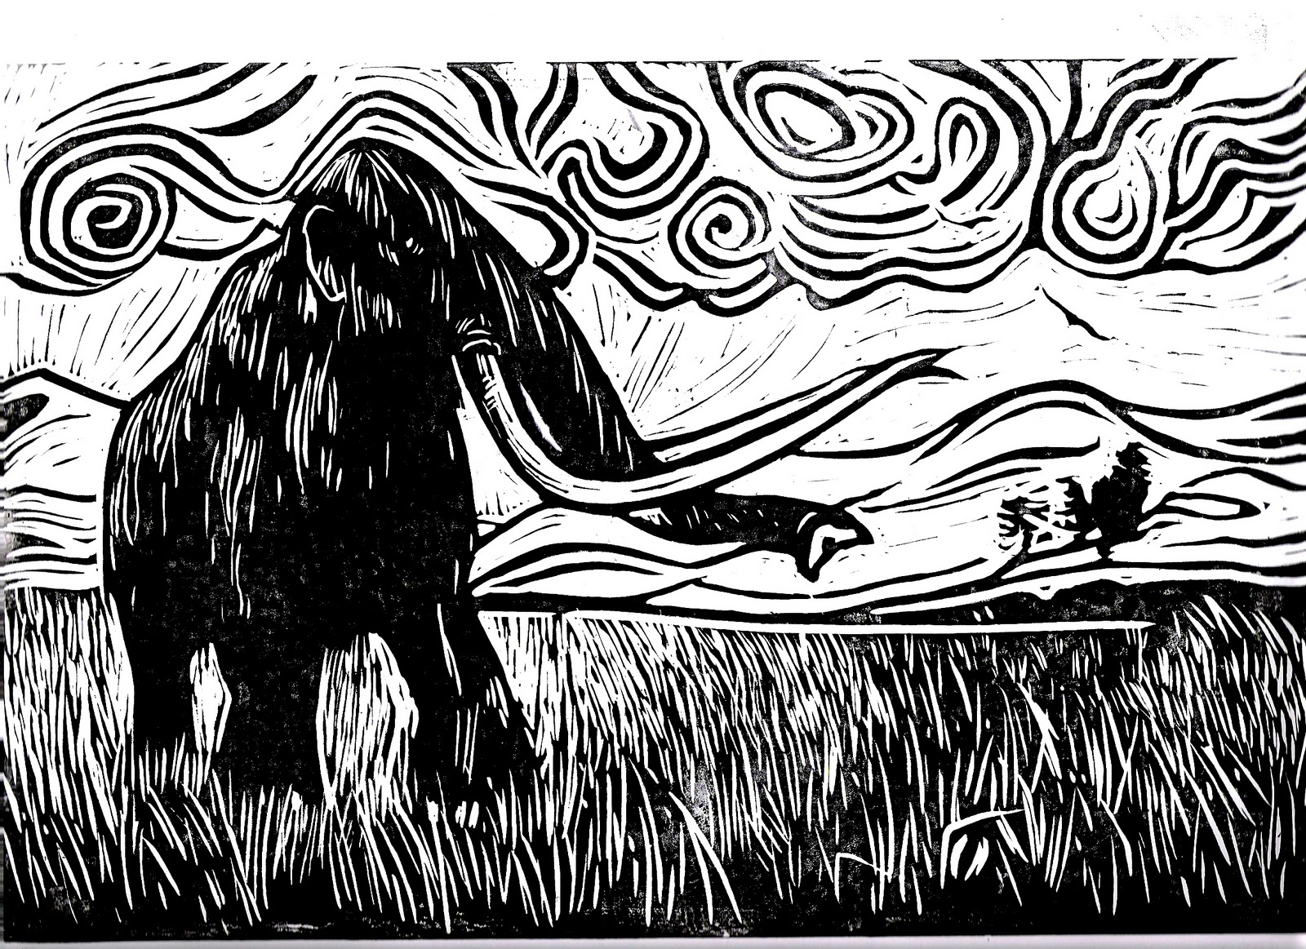

Slide 25
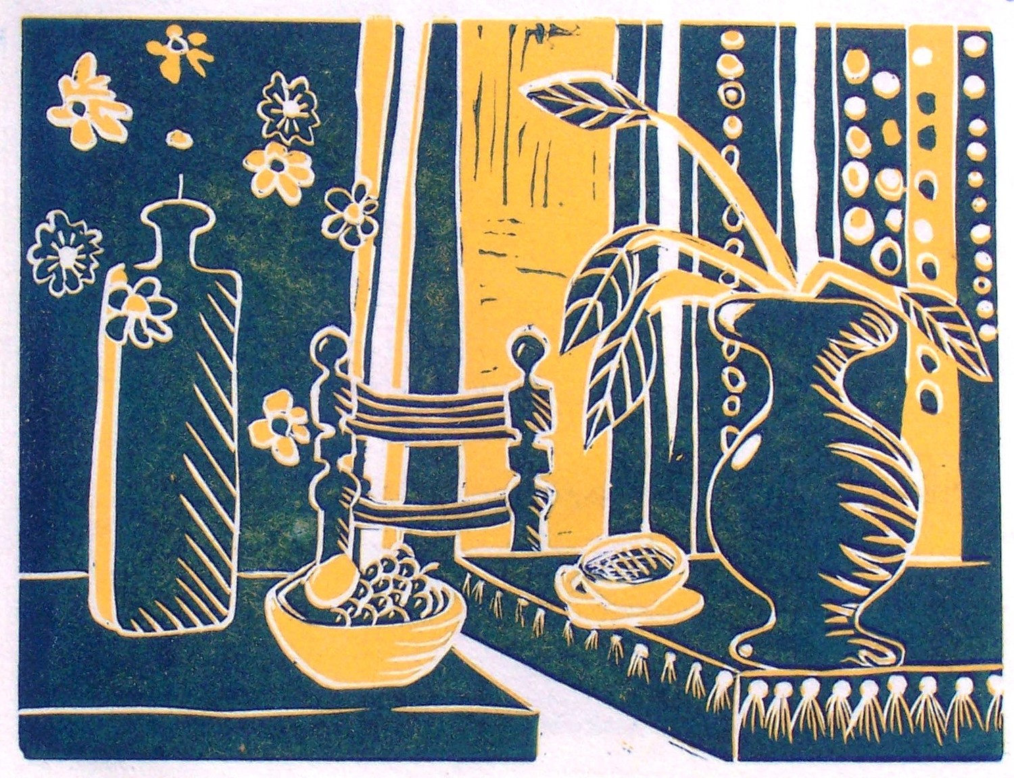
TWO COLOR PRINT CUT-AWAY

Slide 26
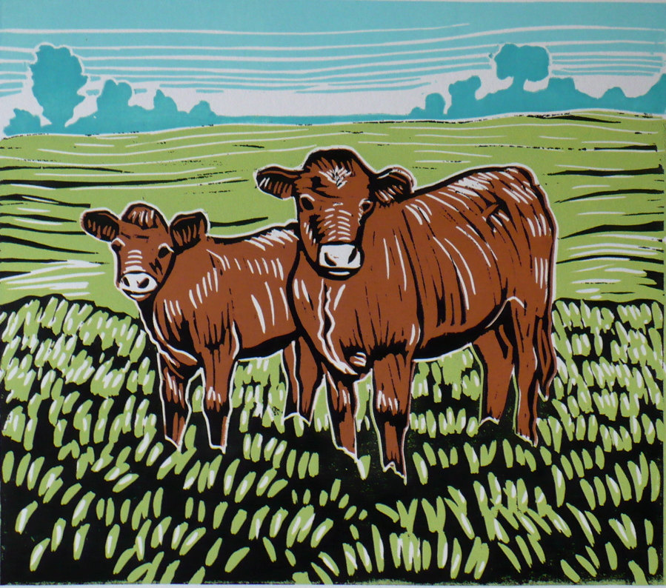
MULTI-COLOR PRINT

Slide 27
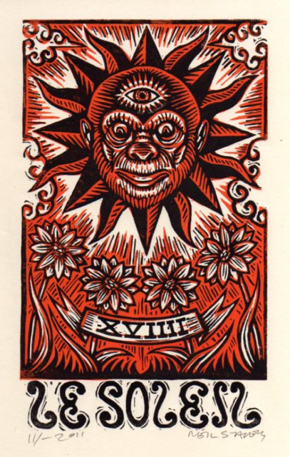
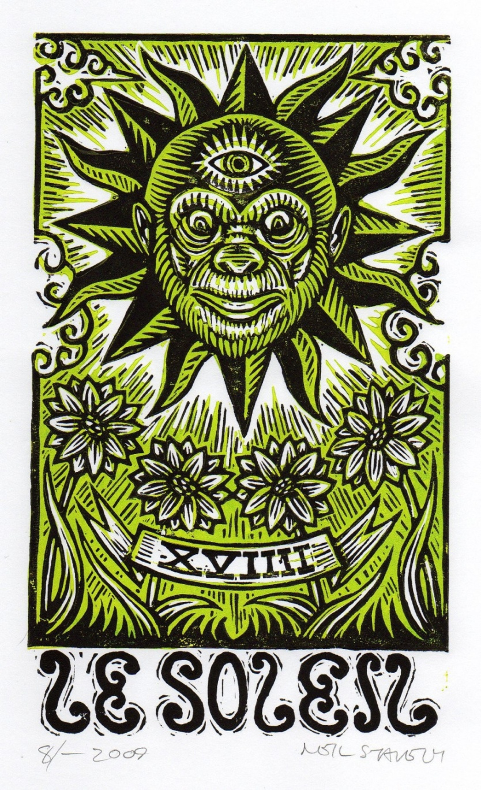

Slide 28
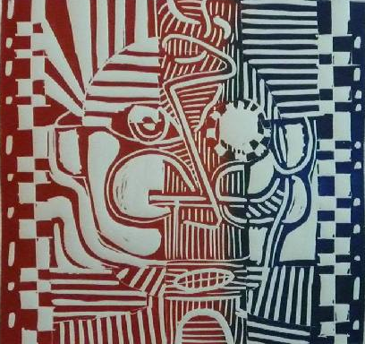
TWO COLOR BRAYER APPLICATION

Slide 29
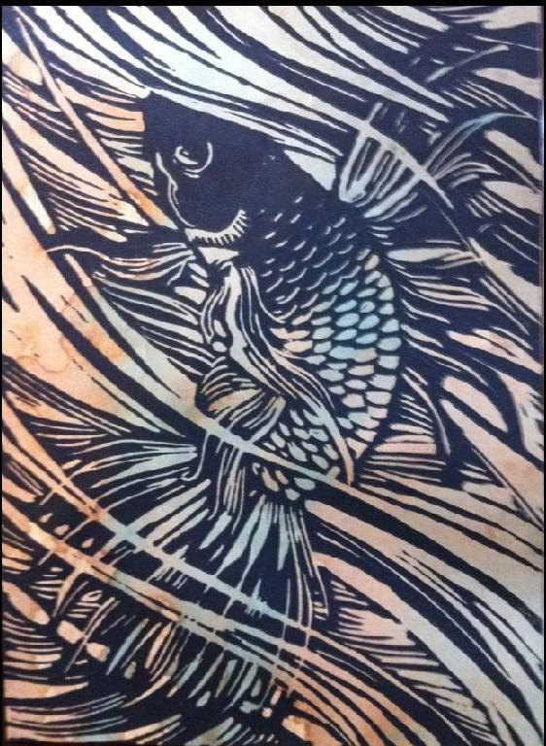
ONE COLOR PRINT WITH
WATER COLOR APPLICATION

Slide 30
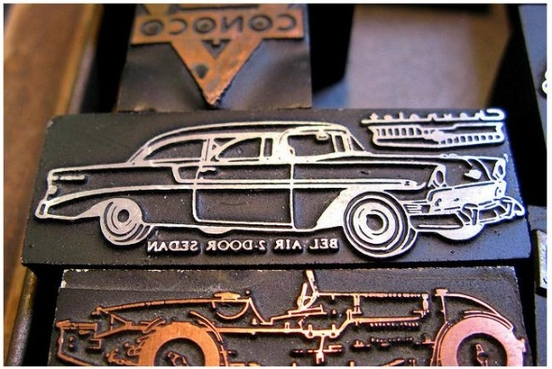
METAL PRINTING BLOCKS

