Slide 1
Careers, Colleges, Programs of Study, and Majors
ICT Class

Slide 2
What have you focused on with colleges? What did you learn?
What have you explored with occupations and careers in this class? What did you learn?

Slide 3
It all matters
Everything you do can help you learn about yourself, explore the world of careers, occupations, and work related passions.
For this session we will focus on the types of education, training, and programs that can build upon your knowledge, skills, and abilities.

Slide 4
Questions
What is a college major? Why major in something? What should I major in?
What majors lead towards a career that I am interested in?
What can I do with the major I explore?
What colleges offer that major?
What do community colleges offer? Technical/Vocational schools?

Slide 5
But first, what are the differences between the college systems?

Slide 6
CSU- California State University | UC- University of California
23 Campuses Requires 3 years of math including Alg 1, Geometry and Alg II/Trig Requires 2 years of lab science including Bio and Chemistry or Physics Requires 2 years of the same World Language Requires 1 year of an approved elective Tends to be more career focused and application based Almost always will have professors who teach the courses Tends to be larger and more diverse campuses and sometimes more affordable Only 2 campuses offer PhD programs Meant for baccalaureate education in California, and for those who seek professional training Admission may be competitive based on campus of choice. | 9 Campuses Requires 3 years of math but 4 are recommended- need Alg I, Geometry, and Alg II/Trig Requires 2 years of lab science but 3 are recommended- Bio and Chem or Physics Requires 2 years of the same World Language but 3 are recommended Requires 1 year of an approved elective. Tends to be more theory focused and research oriented Often Teacher’s Assistants will teach courses as professors often need to be conducting research. World-class educational and research opportunities Campuses offer PhD programs as well Actively involved in locations beyond its campuses, national laboratories, medical centers and neighboring communities Admission is often competitive

Slide 7
This website can be used in many ways….
http://www2.assist.org/exploring-majors/Welcome.do

Slide 8
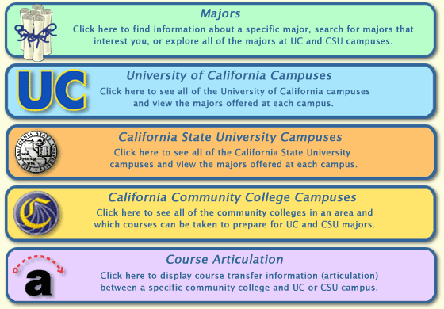
You can explore a college major or program of study at a specific California campus: UC, Cal State University, or Community College
Click on University of California Campuses:

Slide 9
This is what you will see:
Click on Irvine:

Slide 10
You should see something like this
Donald Bren School of Information and Computer Sciences
Computer Game Science, B.S. Computer Science and Engineering B.S. Computer Science B.S. Informatics B.S. Information and Computer Science B.S.
Paul Merge School of Business
Business Administration B.A. Business Information Management B.S.

Slide 11
You should see this summary:
Computer Game Science undergraduate degree
Degree Available: Major
The Computer Game Science (CGS) major combines a solid foundation in computer science with a focus on designing, building, and understanding computer games and other forms of interactive media. The fundamentals of information and computer science — along with coursework in mathematics, statistics, physics, and film and media studies — provide students with the concepts and tools to study a wide scope of computer game technologies.
CGS emphasizes design, teamwork, and the understanding of computer games and related technologies and media in a social and cultural context. The term “computer game” includes games that run on cell phones, mobile devices, PCs, consoles, Macs, web pages and even inside automobiles. CGS majors design and create games for entertainment, and also for education, training and social change.

Slide 12
Now take about 10 minutes to work with the university of California Tab

Slide 13
Go back to the Exploring Majors Home
Click on Cal State University Campuses:

Slide 14
And you should see this:
Click on San Marcos:

Slide 15
And you should see something like this:
Majors at California State University, San Marcos
College of Business Administration
Business Administration B.S. Business Administration B.S. Concentration in Accountancy Business Administration B.S. Concentration in Finance Business Administration B.S. Concentration in Global Business Management Business Administration B.S. Concentration in Marketing Management
College of Education, Health and Human Services
Human Development B.A. Human Development B.A. Concentration in Adult and Gerontology Services Human Development B.A. Concentration in Children's Services Human Development B.A. Concentration in Counseling Services Human Development B.A. Concentration in Health Services Kinesiology B.S.
Click Business Administration B.S.

Slide 16
And you should see this:
University Majors
California State University, San Marcos Business Administration B.S.
Students in the College of Business Administration (COBA) will find that their program of study is both rigorous and relevant to real world business problems. The curriculum is designed to help students develop a wide range of skills and abilities applicable to both for-profit and non-profit sectors of the economy.
Click here to read more about this major on the campus web site.

Slide 17
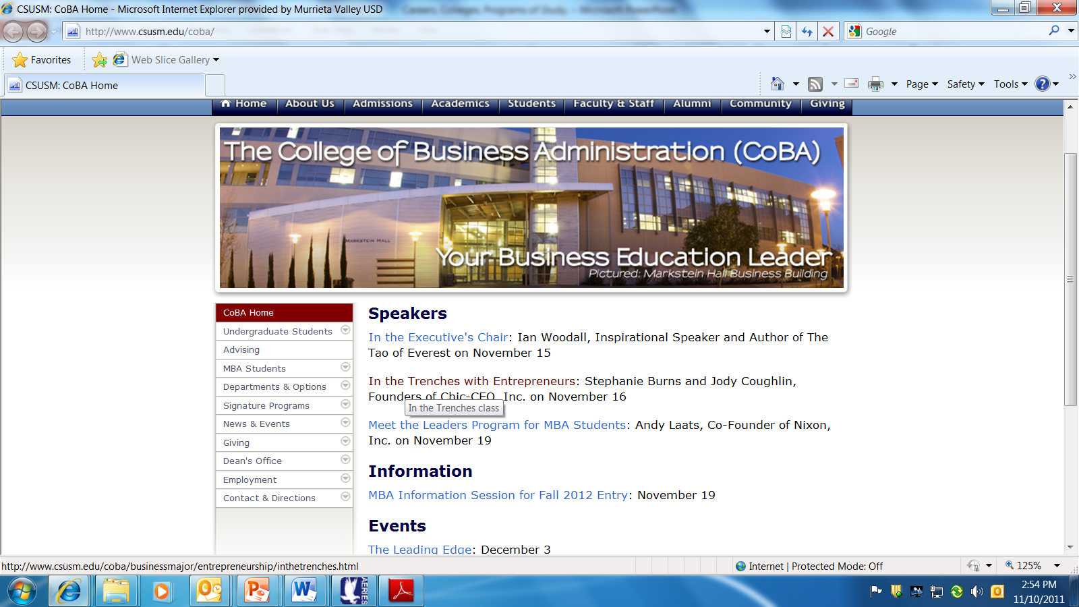
Click on: Departments & Options

Slide 18
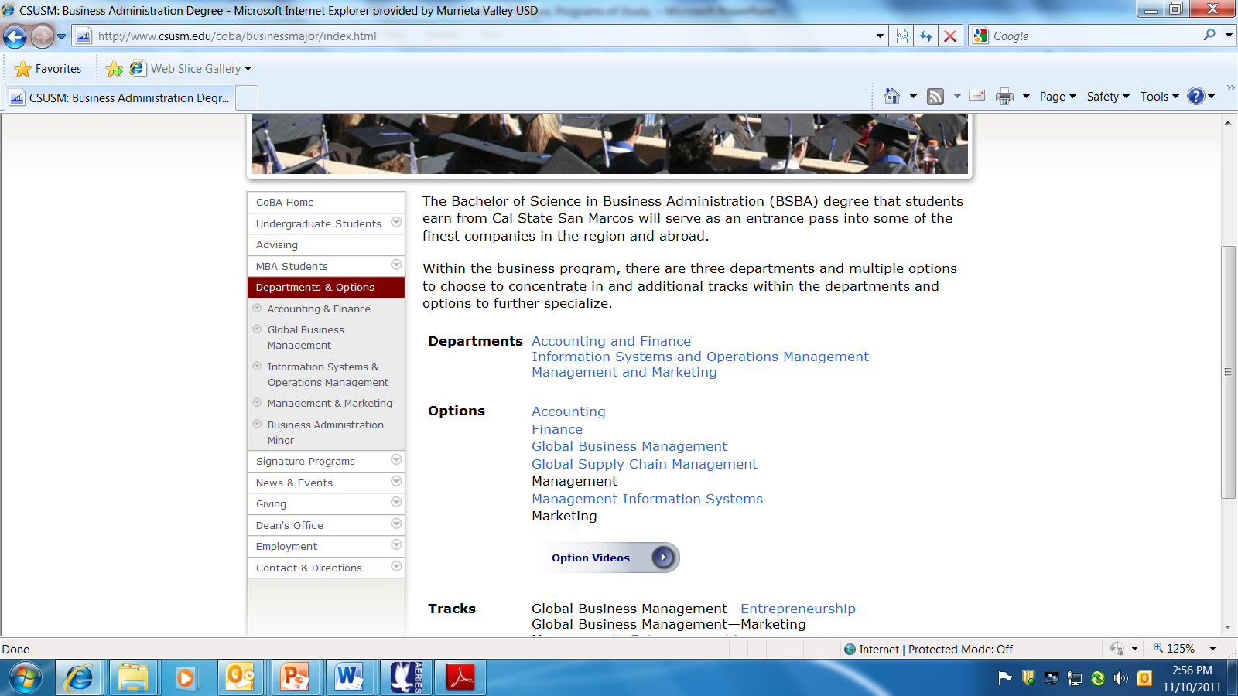
1
2

Slide 19
Take about 10 minutes to explore the California State University Tab

Slide 20
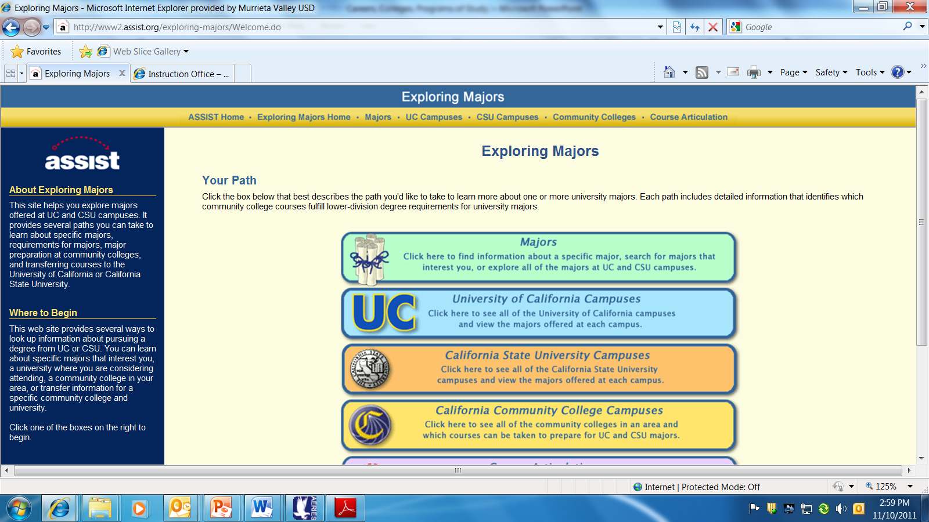
Now, go back to the Exploring Majors Home Page, on the upper tool bar

Slide 21
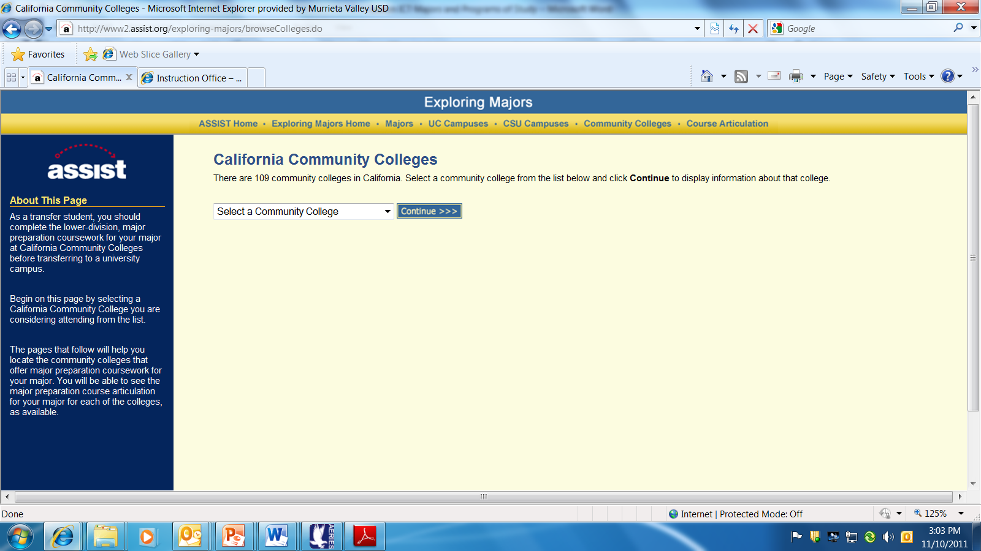
This is what you should see…
Select a Community College

Slide 22
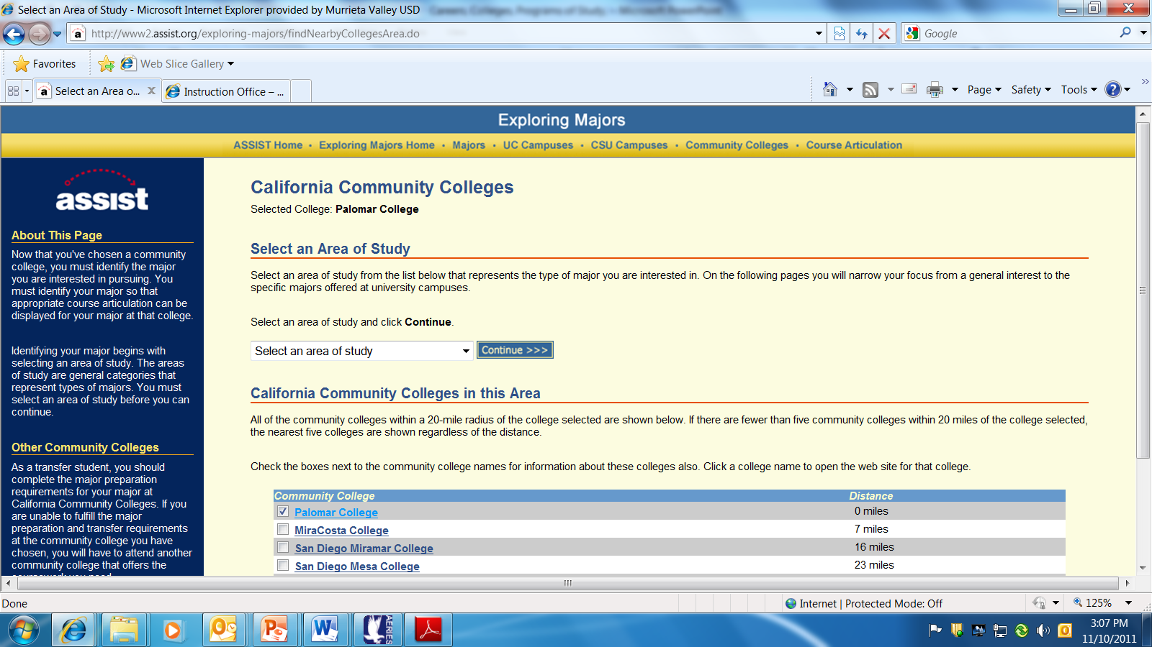
You should see this page after selecting a community college

Slide 23
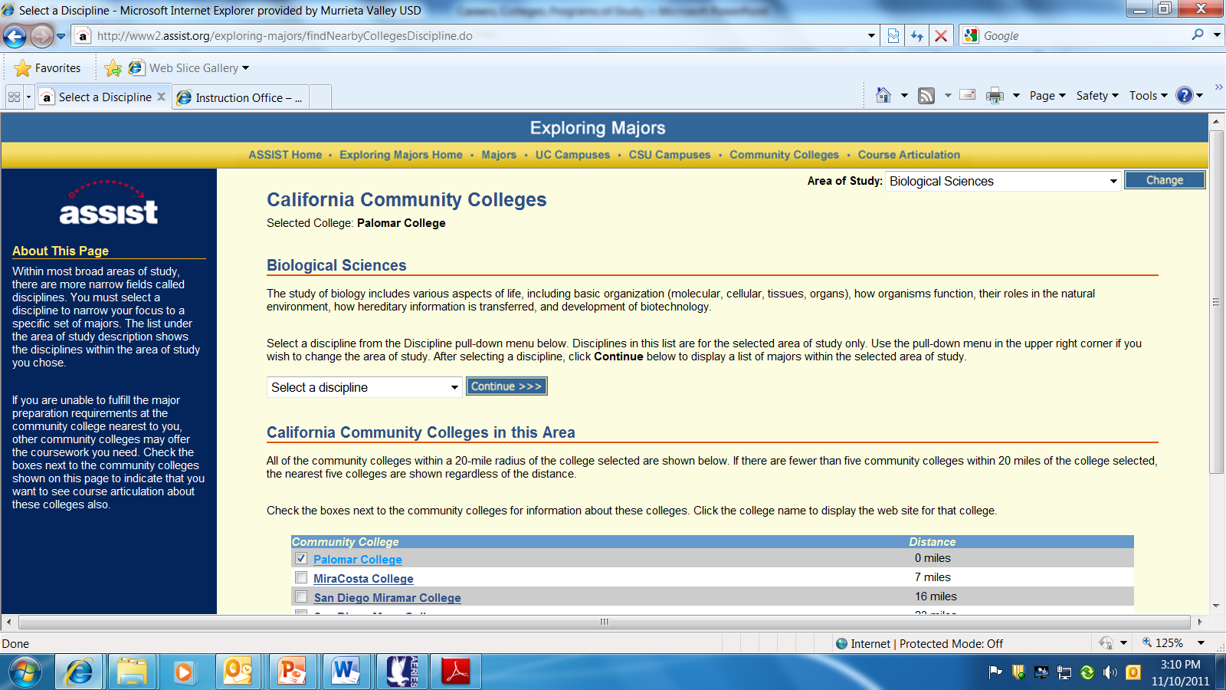
I selected Biological Sciences and now select a discipline

Slide 24
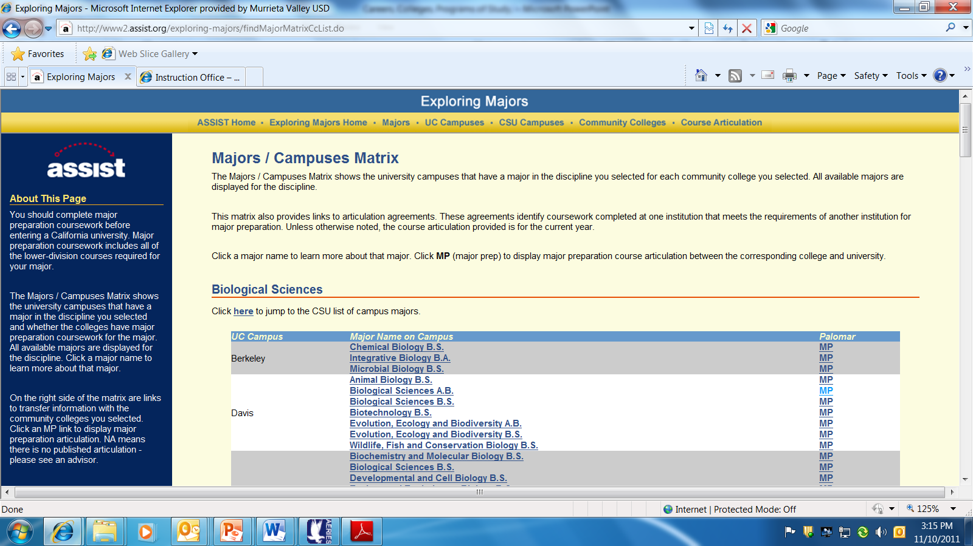
I selected Biological Science as my “Discipline”

Slide 25
Take about 10 minutes to explore the community college Tab

Slide 26
New Section
Early entry into careers
Education, majors, and matching careers
Certificate and Specialized Training

Slide 27
Certificate Programs of Study for early entry into a career:
Certificate Programs of Study for early entry into a career: http://www.sjvc.edu/
Check the left side tabs

Slide 28
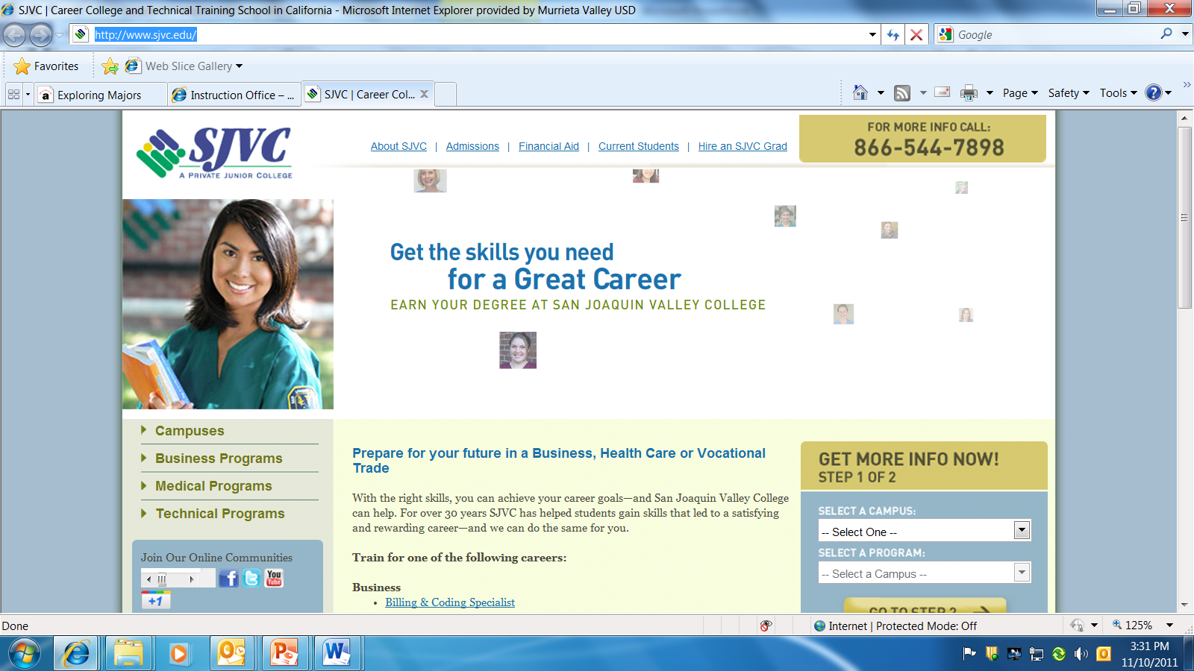
Check the left side tabs

Slide 29
University of Tennessee- Excellent site for reviewing majors and the various matching careers
http://whatcanidowiththismajor.com/major/majors/

Slide 30
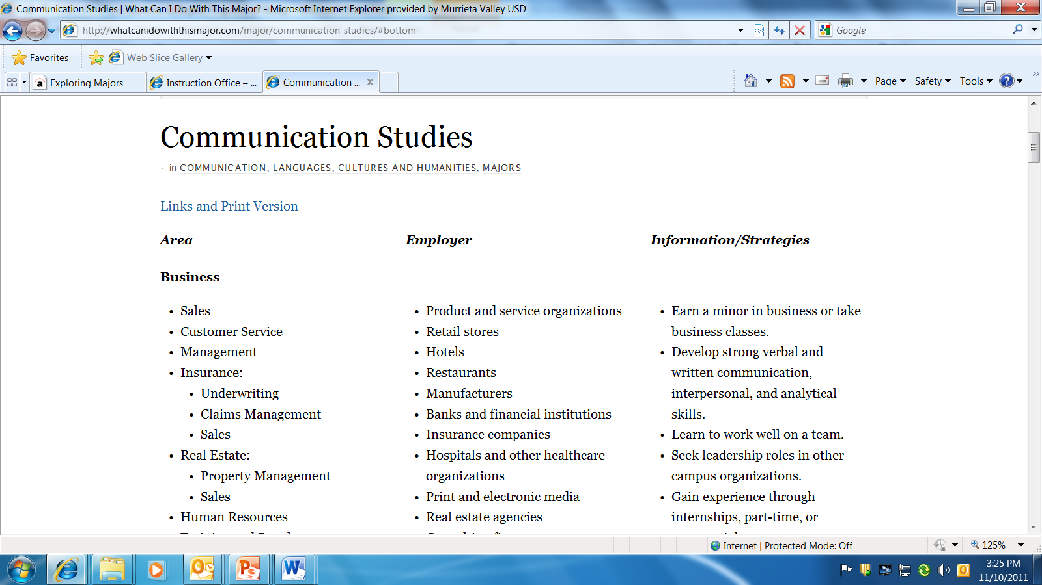
When you click on a major, review the details under areas, companies, and strategies sections

Slide 31
Connecting College Majors/Programs of Study and Careers
University of Missouri: Careers & Majors
http://www.umsl.edu/depts/career/majors/index.html
Collegeboard offers the choices of selecting a major and related careers, or career and related majors
http://www.collegeboard.com/csearch/majors_careers/profiles/
University of California: Berkeley offers a college major & career planning process on this website
https://career.berkeley.edu/Plan/Major.stm#take
For Military Careers, take a look at the descriptions and opportunites: Enlisted and Officer Job Categories:
http://www.bls.gov/oco/ocos249.htm

Slide 32
Certificates and Technical Training Early entry into the job market
Palomar CC
http://www.palomar.edu/voctechdivision/
MSJC Career Technical Programs
http://www.msjc.edu/cte/Pages/default.aspx
Mt. SAC
http://www.mtsac.edu/instruction/certificates.html

Slide 33
Options at VMHS by subject area: Science
Medical Terminology
First Responder
Nurses Assistant (off campus)
Medical Assistant/ Clinical (off campus)
Forensic Science/ CSI
Developmental Psychology of Children
Health
Psychology, AP Psychology, and Dual Enrollment Psychology
Dual Enrollment Biology
Environmental Science
Chemisty
AP Chemistry
Marine Biology
Anatomy and Physiology
Physics
Earth and Space Science
Life Science
AP Bio
AP Physics
Advanced Biomedical Science

Slide 34
Options at VMHS by subject area: Math
Algebra I
Geometry
Algebra II/Trig
Advanced Alg II/ Trig Finite Math
Technical Math
Math Analysis
Pre-Calculus
Calculus
Dual Enrollment Algebra
Dual Enrollment Pre-Calculus
Dual Enrollment Analytical Geometry and Calculus
AP Calculus
Probability and Statistics
AP Statistics

Slide 35
Electives at VMHS by subject area: English
Cinema as Literature
Creative Writing
Public Speaking
Drama
Newspaper
Expository Reading and Writing American Lit
AP English Language and Composition
Bible in Literature
Expository Reading and Writing British Literature
Dual Enrollment Composition and Critical Thinking and Writing

Slide 36
Electives at VMHS by subject area: Social Science
Dual Enrollment Introduction to Philosophy
Ethnic Studies
World Religions
Leadership. Senate
Pear Assistance Leadership (PLUS)
Academic Competitions
AP Art History
Renaissance

Slide 37
Electives at VMHS by subject area: Arts
Drama
Art and Design
Advanced Drawing and Painting
Ceramics I and II
Graphic Design I and II
Yearbook
Photojournalism
Photo I and II
AP Studio Art
Apparel Design and Construction
Fashion History and Design

Slide 38
Electives at VMHS by subject area: Business
ICT- Information, Communication & Technology
Accounting
Business and Personal Law
Business Principles and Management
Intro to Design and Media
Multimedia II
Video Gaming I & II
Drafting I
Drafting II/ Architecture

Slide 39
Electives at VMHS by subject area: Career
Law Enforcement
Sports Therapy and Fitness
Audio Technology
Television and Video Production I and II
Interactive Media Design
Automotive Technology I and II (off campus)
Cosmetology (off campus)
Retail Sales and Marketing (off campus)
Culinary Arts (off campus)
Medi cal Assisting/ Administrative Front Office (off campus)
Foods and Nutrition
Food and Beverage Production
Engineering Concepts/Applications
AFJROTC Aerospace Science I-IV

