Slide 1

Vista Murrieta High School
Senior/Junior Parent Night
#Stay Connected
Monday, September 22, 2014
www.vmhs.net

Slide 2

#senior/junior parent night
6:30 -7:15 PM Welcome/Overview
7:25 - 8:00 PM Session 1:
Beth Bowles, Mt. San Jacinto College Location: SLH
Michael Harrison, CSU Bernardino Location: PAC
Sheryl Blackshire, UC Davis Location: Pechanga Room
Marty Quisenberry, College Career Search Lab Location Library Computer Lab
8:00 - 8:30 PM Session 2:
Beth Bowles, Mt. San Jacinto College Location: SLH
Michael Harrison, CSU Bernardino Location: PAC
Sheryl Blackshire, UC Davis Location: Pechanga Room
Marty Quisenberry, College Career Search Location Library Computer Lab

Slide 3
#agenda
VMHS Graduation Requirements
UC/CSU A-G Requirements
How to Apply to College
SAT & ACT Info
Paying for College
College & Career Center
Scholarship Information
How to request your Transcript

Slide 4
#meet the Counselors
Demetrius Caldwell (A-Cn)
Marty Quisenberry (Co-Gq)
Aurora Padilla (Gr-Lh)
Diana Ruiz (Li-O)
Eric Peterson (P-Sg)
Claudia Gomez (Sh-Z)
Shonda Burrus – College & Career Center

Slide 5
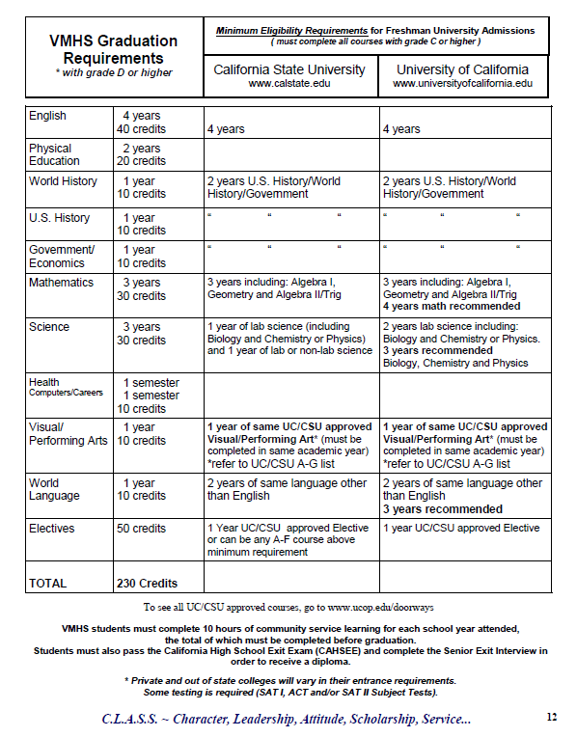
#grad reqs

Slide 6

#short on credits
Murrieta Valley Adult School
Approved Online Courses*
Credit Recovery (listed as Academic Seminar)
CTE credits after school
*For more information please
contact your student’s assigned Counselor

Slide 7
Career Tech Ed. #cte
Career & Technical Education (CTE) –program that helps students to prepare to enter the job market by developing their specific job skills.
Programs:
Act Med Des, TV/Video & Adv. TV/Video, Audio, Auto Tech, Child Care, Cosmetology, Culinary Arts, EMR, Forensic Science/CSI,
Law Enforcement, Medical Asst, Nurse’s Asst, Retail Fashion,
Sports Medicine
Contact: Sally Budnovich
sbudnovich@rcoe.us
Or every Tuesday at VMHS College Career Center.

Slide 8



Trade School #techsavy
A secondary school that offers instruction in skilled trades; and/or vocational school. For a list of California Trade School please visit, www.trade-schools.net
School of Career of Education http://www.riversidesce.org/index.php

Slide 9

Military #serveyourcountry
If interested in joining the military, speak with your parents about your interest and do your research. Visit www.military.com for more information or talk to your local recruiter.
NJROTC Scholarship Program
You could be eligible for tuition & financial
benefits up to $180,000
Commission as an officer upon graduation
Monthly Stipend
ASVAB exam scheduled for Feb. 11-12, 2015,
please sign up in the College Career Center

Slide 10

Community College #cc
What is a Community College?
A type of educational institution where students can earn an associate (2 year) degree in a subject and/or receive career & technical training.
Why select?
Associate Degree/Certifications
To transfer to a 4 year university
A more cost effective solution for some
Specific job training
Notes:
Talk TAG programs, priority enrollment for honors students , Transition Bridge Program (IEP)

Slide 11

Mt. San Jacinto/Palomar College/ R.C.C.
To Enroll you must:
Have a high school diploma or equivalent
Or be 18 years or older
Apply online:
Apply as soon as Fall 2015 application window opens
Apply for Financial Aid
(beginning Jan 2015)
Mail your official transcript
Complete your Math & Writing Assessments
(Begins February/March 2015)
Schedule a Counseling Appointment

Slide 12
#college admission process
Research your schools of interest early
Seek help early throughout the application process
Complete all application material before the published deadline
Check your email and university portals often
Order official transcripts from the guidance techs in a timely manner
Follow all instructions regarding placement tests
Call college admissions office for advice when you aren’t sure what
to do next

Slide 13

#4year college admission-testing
SAT Reasoning: Used to measure verbal, math, and writing abilities.
ACT:
Measures English, Math, Social Science, & Natural Sciences. May be used as an alternate to the SAT.
SAT2 Subject: Specific subject tests (i.e.-Social Sciences, Sciences, Foreign Languages, etc. )*
*No longer required for UC schools. May be required for a supplemental application for the major you are applying to.

Slide 14

#testing season
Vista Murrieta High School Code: 053004
PSAT Date: Oct. 15 (VMHS location) 11th Grade Only
SAT Dates: Oct. 11 and Nov. 8 (VMHS location) Dec. 6 register at http://www.collegeboard.org
ACT Dates: Oct. 25, Dec. 13 register at http://www.actstudent.org
Most schools will not
accept scores on exams
taken after the December
test date of senior year.

Slide 15
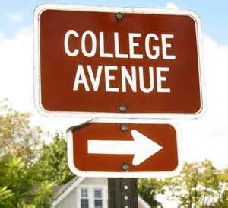
Four Year #universitybound
Are you ready to apply to a 4 year University?
Familiarize yourself with the
A-G requirements & your transcript
Sign up for SAT and/or ACT, if you haven’t already taken it
Know the difference between the requirements for
UC, CSU, Private & Community Colleges
Know the application deadlines & apply early

Slide 16


CSU & UC Application Workshops
Location: Library Computer Lab
Oct. 8-9 both lunches
Oct. 13 late start 7:30-8:30am
Oct. 20 late start 7:30-8:30am
Oct. 22 after school 2:45-4pm
Nov. 6-7 both lunches
Nov. 17 late start 7:30 – 8:30am
Nov. 19 after school 2:45–4pm

Slide 17
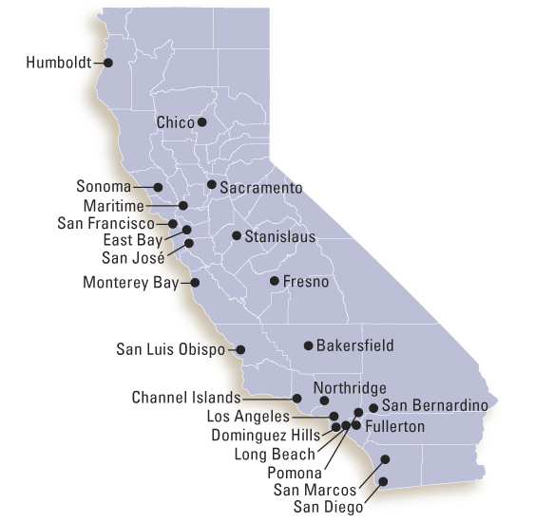
#where do I apply
California State University :
www.csumentor.edu
Application window is Oct. 1 – Nov. 30
University of California:
www.universityofcalifornia.edu
Application window is Nov. 1 – Nov. 30
Private Universities
www.commonapp.org www.send.edu
Application deadlines may vary. Research each school you are interested in applying to individually.
Early admission deadlines vary between Sept. – Nov.

Slide 18
#paying for college
Apply for Financial Aid:
1. Official name must match school records, please verify with registrar
2. School submits the Cal Grant GPA Verification electronically
3. Please apply for your FAFSA PIN as early as today
4. Complete the FAFSA, applications for 2015-16 available after
January 1, 2015. Deadline is March 2, 2015 www.fafsa.ed.gov
5. Apply for scholarships www.fastweb.com
6. Debt management tips
Financial Aid Night for Parents & Students- December 3, 2014 6:30 pm
FAFSA Presentation & Workshops– Jan 20, Feb 10, and Feb 17

Slide 19
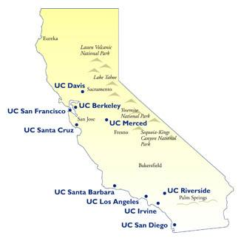
#college&career center
Get familiar with your College & Career Center
Meet Mrs. Shonda Burrus
Search Local & General Scholarships
College application assistance
FAFSA submission assistance
College & Career Presentations
Sign up for College Rep Visits
Sign up to meet with local recruiters & ASVAB
Request your official Transcript (Official Transcript requires 2-3 days notice)

Slide 20
Break Out Sessions
7:25 - 8:00 PM Session 1:
Beth Bowles, Mt. San Jacinto College Location: SLH
Michael Harrison, CSU Bernardino Location: PAC
Sheryl Blackshire, UC Davis Location: Pechanga Room
Marty Quisenberry, College Career Search Lab Location Library Computer Lab
8:00 - 8:30 PM Session 2:
Beth Bowles, Mt. San Jacinto College Location: SLH
Michael Harrison, CSU Bernardino Location: PAC
Sheryl Blackshire, UC Davis Location: Pechanga Room
Marty Quisenberry, College Career Search Location Library Computer Lab
*** In order for us to better improve our Counseling Program and to better guide our students, please respond to the survey sent to your email by Ms. Gomez. Thank you so much.

