Slide 1
The Enlightenment
Grant Foster
Period 6
10/11/11

Slide 2
Prompt
1998 – To what extent did the Enlightenment express optimistic idea in the 18th century Europe? Illustrate your answer with references to specific individuals and their works.

Slide 3
Enlightenment
What is the Enlightenment?
A. Enlightenment – An 18th century movement in European and American that emphasized the power of reason and science, unlike the traditional doctrine, to understand and reform the world.
B. The Enlightenment gained strength gradually and did not reach full development until 1750.
C. The enlightenment immersed in the generation between the publication of Newton’s Principia in 1687 and the death of Louis VIX in 1715.
D. The Enlightenment had a penetrating effect on the thought and culture or urban noble classes and the aristocracy.

Slide 4
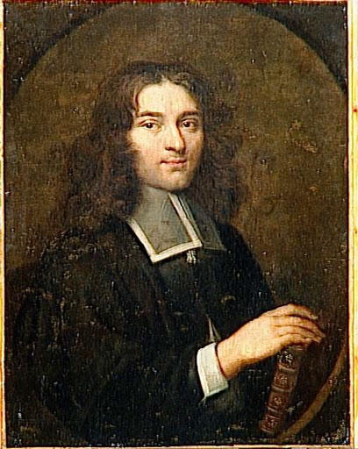
Pierre Bayle (1647 – 1706)
A French Huguenot who disliked Louis XIV and found refuge in the Netherlands
One of the most famous skeptics.
Skepticism – The philosophical doctrine that true and absolute knowledge is unattainable.
Known for publishing Historical and critical Dictionary, in which was written in French and published in the Netherland is 1697.
The denotation of this work demonstrated that the human beliefs had been extremely varied and very often mistaken and concluded that nothing can be known beyond all doubt.
Wanted to advocate and convey that humanity’s best hope was open–minded religious toleration.
Pierre’s skepticism was very influential during the Enlightenment, and his four volume Dictionary was found in more private libraries than any other book in the 18th century.

Slide 5
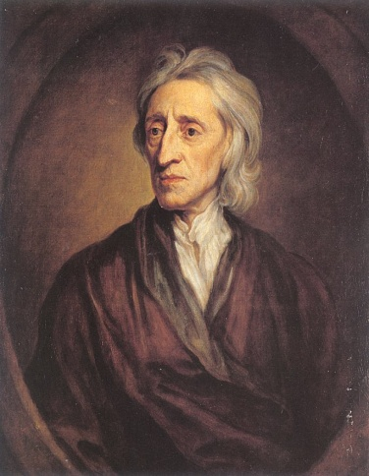
John Locke (1632 -1704)
A British philosopher of the 17th century that is widely known for his liberal, anti – authoritarian theory of the state, his empirical theory of knowledge, acceptance of religious tolerance, and theory of personal identity
Greatly known for publishing the Essay Concerning Human Understanding, and the Second Treatises of Civil Government both in 1690.
The Essay Concerning Human Understanding rejected the view of Descartes , which was all people are born with particular basic ideas and ways of thinking.
The Essay Concerning Human Understanding supported that ideas are derived from experience, and human development is essentially determined by education and social institutions, for either good or evil.
Locke’s Second Treatises for Civil Government explained in the idea of natural rights.
It advocated the right for rebellion and the purpose of the government is to protect individual rights: life, liberty, and property.
The “Glorious Revolution” in 1689 was backed behind this principle.
This works along with Newton’s Principia played as one of the dominant intellectual inspirations of the Enlightenment in the 18th century.

Slide 6
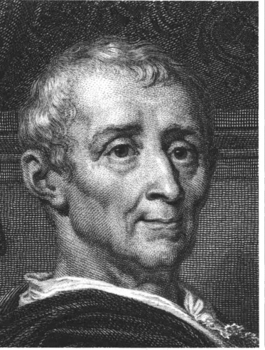
Baron de Montesquieu (1689 – 1755)
A influential political philosopher during the 18th century Enlightenment.
Published The Persian Letters in 1721 and The Spirit of Laws in 1748.
The Persian Letters were extremely influential social satires in which consisted of letters supposedly written by Persian travelers, who saw European customs in a different perspective, indirectly criticizing the existing practices and beliefs .
The Spirit of Laws explained how government was formed and shaped by history, geography, and customs. He urged that despotism could be avoided if there was a separation of powers, with political power divided and shared by a selection of classes and legal estates holding unequal rights and privileges.
According to Montesquieu, in order to prevent the abuse of power, "it is necessary that by the arrangements of things, power checks power.”
His theory of separation of powers had a great impact on France’s wealthy, well-educated elite during the Enlightenment.
The early constitutions of the United States in 1789 and France in 1791 were based upon a big part of this theory.

Slide 7
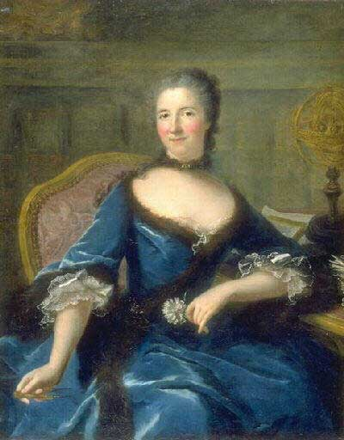
Madame du Châtelet (1706- 1749)
An intellectually gift woman that came from a high aristocracy family and had a strong passion for science.
Due to her gender, she was excluded on principle from the Royal academy of sciences and from stimulated interchange with other scientists.
Depended on private tutors for instruction and had ambivalence over her ability to make important scientific discoveries.
Translated with commentary Newton’s Principia in French.
This provided the explanation and break down of Newton’s complicated mathematical proofs to Europe’s foremost philosophe.
Unique- due to the fact that scientific contribution by females was rare during this time, as well as the limited and unequal education in females.
Wrote that if she were a ruler, “I would reform an abuse which cuts off, so to speak, half human race. I would make women participate in all rights of humankind, and above all in those of the intellect.”
This to some extent was encouraging to women’s education and to overcome adversity during the 18th century Enlightenment.

Slide 8
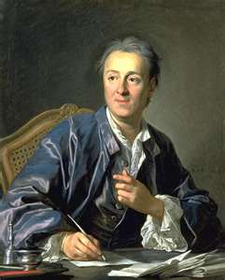
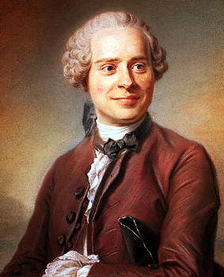
Denis Diderot (1713- 1784) and Jean le Rond d’Alembert (1717 – 1783)
Both editors of the seventeenth-volume Encyclopedia: The Rational Dictionary of the Sciences, the Arts, and the Crafts
Denise Diderot started his career as a hack writer, first acquiring attention with a skeptical tract on religion in which was burned by the judges of Paris.
Jean le Rond d’Alembert was one of Europe's leading scientists and mathematics.
Both editors faced difficult obstacles in creation of the Encyclopedia
The first volume of the Encyclopedia in 1751 contained controversial subjects such as atheism, the soul, and blind people, essentially all words beginning with a in French.
The government temporarily banned publication, and the pope placed the work on the Catholic Church’s index of forbidden works and pronounced excommunication to all who read it or bought it.
Publisher watered down some of the articles in the last ten volumes, without the editors approval to appease the authorities.
Diderot held the encyclopedists together for 15 years and completed the Encyclopedia in 1765.
In the Encyclopedia, Science and the industrial arts were brought forth, immortality and religion were questioned. Intolerance, out-of-date social institutions, and legal injustice was criticized.
The Encyclopedia expressed that human beings could use the process of reasoning to expand human knowledge.
It summed up the new-world-view of the enlightenment in the 18th century and was influential in France and throughout Western Europe.

Slide 9
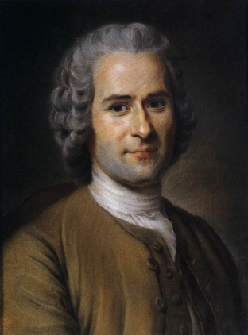
Jacques Rousseau (1712-1778)
A brilliant and difficult thinker that attacked the Enlightenment’s faith in reason, progress, and moderation.
Was born in a poor family of watchmakers in Geneva.
Went to Paris and was heavily influenced by Diderot and Voltaire.
Rousseau was devotedly committed to individual freedom.
Greatly contributed to political theory in The social Contract (1762)
The social Contact discussed two fundament concepts: the general will and popular sovereignty.
According to Rousseau, the general will is sacred and absolute, which reflected the common interests of people who displaced the monarch as the holder of sovereign power.
Although the general will was very respected and agreed upon people, it didn’t necessarily reflect the will of the majority.
Since 1789, this concept has been used by many dictators that claimed they represent the general will.

