Slide 1
US History
Semester Final Exam

Slide 2
Social Contract
Enlightenment: Age of reason and progress
* Philosophes influenced modern thinking
Thomas Hobbes: No divine right to rule, but a monarch’s power is absolute (can’t break contract)
John Locke: Natural Rights & Constitutionalism
* powers of government are limited

Slide 3
American Revolution
Thomas Paine – Common Sense
no legitimate right to hereditary monarchy
Declaration of Independence – Self-evident truths
God given natural rights (unalienable)
Government power comes from the consent of the governed
Purpose of gov’t is to protect individual rights
Abusive governments can be abolished and replaced

Slide 4
Post Revolution America
Articles of Confederation (first gov’t of the U.S.)
a. Single Branch - legislature with no
executive or judicial branches
b. equal representation (1 vote per state)
c. No power to: tax, regulate trade, and
enforce its laws
d. weak national gov’t not able to effectively
deal with post Revolutionary War financial
crisis

Slide 5
Failure of the A of C
Shay’s Rebellion – social unrest because of
growing financial crisis
a. many leaders lost faith in the Articles of
Confederation
b. calls were made for a central government with
more power
c. led to the calling of the Constitutional Convention

Slide 6
Constitutional Convention
New Jersey Plan vs. Virginia Plan
(Small States) (Large States)
* Debate over representation and power of national gov’t
a. The Great Compromise
* Representation in a Two House
Congress
- Senate: equal representation
- House of Rep.: based on size of population
b. 3/5ths Compromise – Counting
Slaves for representation in Southern States

Slide 7
Principles of the Constitution
Popular Sovereignty – people hold the power
Limited Government - constitution
Separation of Powers – 3 branches
Checks and Balances – shared powers
Federalism – State & Federal gov’t
Judicial Review – Court’s powers

Slide 8
Ratification of the Constitution
Federalist vs. Anti-Federalist
Federalist Papers – supported ratification of the Constitution
Antifederalist – wanted to strengthen the Articles
opposed ratification of the Constitution & wanted a Bill
of Rights
Bill of Rights: first 10 Amendments to the
Constitution
purpose: to protect individual liberties and
freedoms from government interference

Slide 9
Marbury v. Madison
a. precedent of Judicial Review
b. strengthened the federal government
Election of 1800
Political parties change the electoral college
- Federalists (Adams) vs. Democrat-Republican (Jefferson)
Jefferson & Burr tied – House of Reps determined the
outcome = Jefferson became President
12th Amendment: changed the electoral college by
separating the vote of Pres. & VP

Slide 10
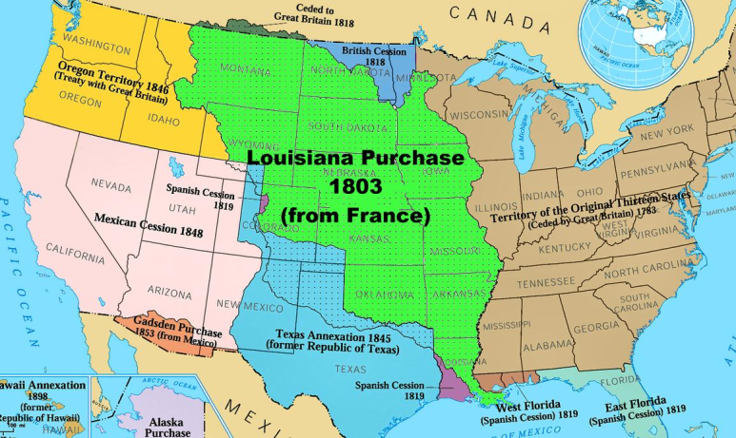
Westward Expansion
Louisiana Purchase – Pres. Jefferson from France
* Added 1/3rd of land to U.S.
Monroe Doctrine – Europe stay out of Western Hemisphere
Manifest Destiny – U.S. expansion across the continent

Slide 11
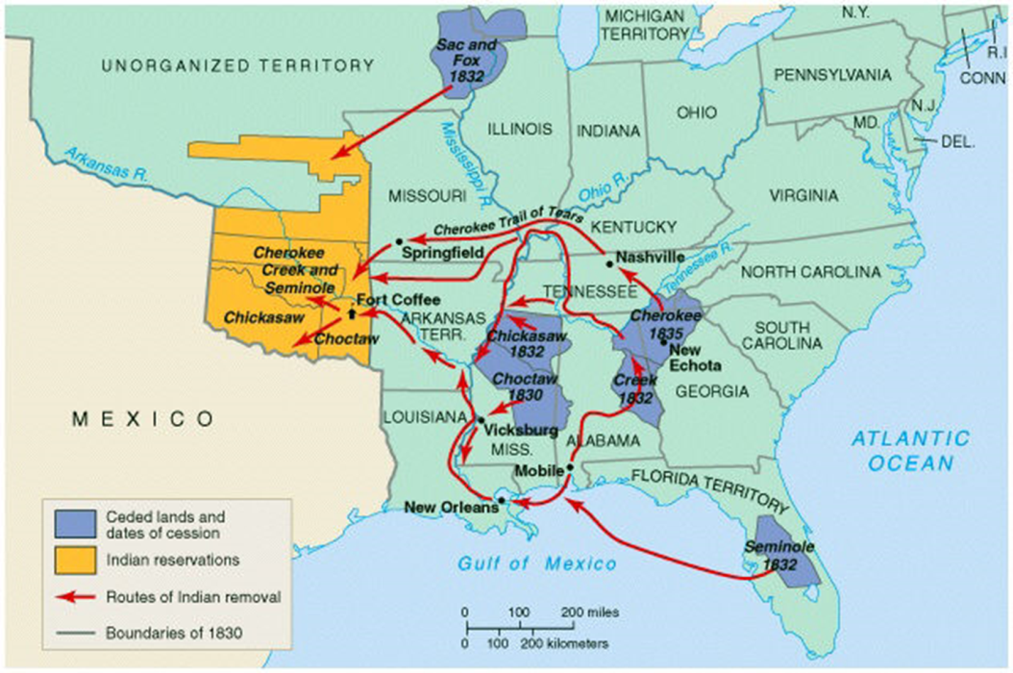
Andrew Jackson
Jacksonian Democracy – expansion of suffrage to the common man
Trail of Tears – forced migration of the Cherokee tribe to Oklahoma

Slide 12
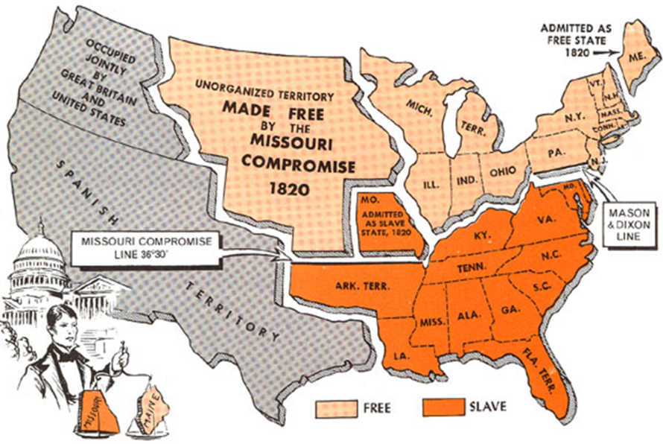
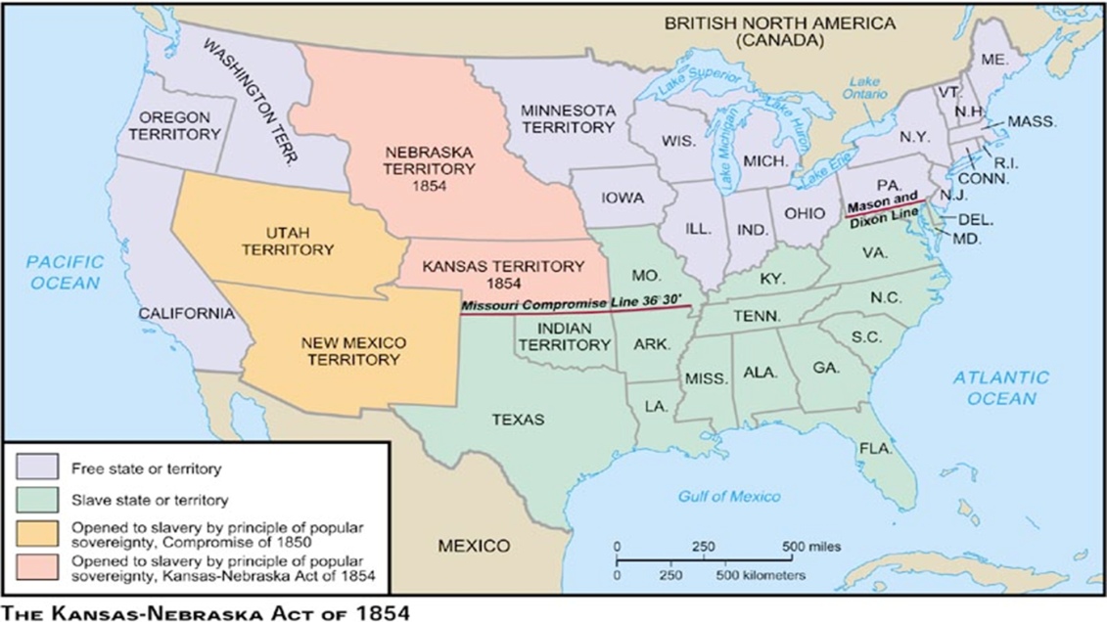
Missouri Compromise (1820) – divided the Louisiana territory into slave and non-slave
Kansas-Nebraska Act
Slavery would be
Determined by popular
Vote
Bleeding Kansas

Slide 13
Slavery
Cotton Gin – Ely Whitney
a. increased profitability of cotton and need
for slave labor
Dred Scott case – Supreme Court ruled that being in a free territory did not make a slave free

Slide 14
Abolitionist
William Lloyd Garrison – The Liberator
* called for the immediate and uncompensated
emancipation of slaves
Harriet Beecher Stowe - Uncle Tom’s Cabin
Harriet Tubman– underground railroad
John Brown– Harper’s Ferry uprising
Frederick Douglass- leader of abolitionist movement (The North Star)

Slide 15
Civil War(1860-1865)
Causes of the Civil War:
* Lincoln (Republican) elected president 1860
- Confederacy (gov’t of Southern Slave states)
* President – Jefferson Davis
* State Right’s, discriminatory tariffs, slavery
Emancipation Proclamation - Lincoln freed the slaves in Confederate territories

Slide 16
Badges of Slavery
13th Amendment – outlawed slavery in the United States
Plessy v. Ferguson – Supreme Court ruled that separate but equal was constitutional
* established precedence for Segregation

Slide 17
Reconstruction
Post Civil War period – involved the rebuilding of the South
Carpet Baggers & Scalawags
Black Codes / Jim Crow Laws – discriminatory
laws in post war South
Sharecropper System – exploited freed slaves
by through debt farming (could never afford
to pay off their debts)

Slide 18
Women
Seneca Falls Convention – women’s rights
WWI – women take on male roles in the
workplace = suffrage movement
19th Amendment – women’s right to vote
1920’s - women caught between an emerging cultural divide of tradition and empowerment

Slide 19
The Gilded Age
a period of shallow worship of wealth and sharp social class divisions in America
American Industrialism
* Corporations – limited liability
* Monopolies / Trusts – formed through
> horizontal organization
> vertical organization

Slide 20
Standard Oil Trusts

Slide 21
Late 1800s – Early 1900s Society
Social Darwinism - The laws of nature dictate the conditions of life for both rich and poor
New Immigrants – primarily from southern and eastern Europe. (Catholic & Jewish)
Great Migration – mass movement of Black Americans from the South to Northern & Western cities for industrial employment

Slide 22
Nativists
Anti immigration
new immigrants viewed as criminals,
anarchists, Red Scare (spread of communists
ideas from Europe)
Primarily white, Protestants
Ku Klux Klan – grew in popularity among nativist

Slide 23
Progressivism
a. favored government intervention
1) protect social welfare
2) create economic reform
3) efficiency in the workplace
b. Federal Actions:
1) 16th Amendment – fed. Income tax
2) 17th Amendment – direct election Senators
c. Anti-Trusts Acts
* Sherman Antitrust Act
* Clayton Antitrust Act

Slide 24
Teddy Roosevelt

Slide 25
Muckrackers
Investigative journalism that exposed the corruption of big business, dangers of the work place, and horrible living conditions in cities
Ida Tarbell – Standard Oil
Upton Sinclair – The Jungle (meat packing)
Jacob Riis – photo journalism

Slide 26
U.S. Imperialism
Motivation
* Cultural: Social Darwinism – racial superiority
* Economic: increase markets for growing U.S. industries
* Military: Mahanism - increased U.S. Navy to protect
American economic interests
President Theodore Roosevelt
“Speak softly, carry a big stick”
* negotiations always backed by military
Roosevelt Corollary & Monroe Doctrine
* American Intervention in Latin America

Slide 27
Spanish American War 1898
* Yellow Press – sensationalism
* Sinking of the Battleship Maine – blamed on
Spain
U.S. objective – take the Philippines from Spain to act as a stepping stone to China & protect American economic interest in the Pacific
* Annexation of Hawaii
Open Door Policy – all nations should have
equal trading rights in China

Slide 28
WWI
* U.S. policy - Neutrality
* US entry – 1917 because German
resumption of unrestricted submarine
warfare
* Zimmerman Note – Mexico would join
Germany against the U.S. to reclaim
territories lost in the Mexican-American War

Slide 29
The Home front during WWI
Selective Service Act – men were required
to register for the draft
African Americans during the War
a. segregated by race in military
b. migrated North for jobs and to escape
lynchings and racism in the South
Women during the war
a. increased support for right to vote
b. took jobs in industry – lesser pay

Slide 30
War Time Industry
War Industry Board (WIB)
* established precedence for increased gov’t participation in the economy through a partnership with big business
Economic boom of the 1920’s – Roaring 20s

Slide 31
1920s
Assembly line production = automobile
contributed significantly to the social and
economic development of the United States
during the Roaring Twenties

Slide 32
Culture of the 1920s
Harlem Renaissance – African American literary and artistic movement
Marcus Garvey – UNIA: immigration of African Americans to Africa
Sacco & Vanzetti
Scopes Trial – evolution

Slide 33
Prohibition
Volstead Act – established to enforce prohibition laws
* Increased criminality: Speakeasies, crime
bosses (Mob), bootleggers

