Slide 1
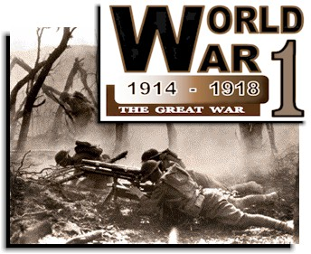
World War 1
Main Idea: In Europe, military buildup, nationalistic feelings & rival alliances set the stage for a continental war.

Slide 2
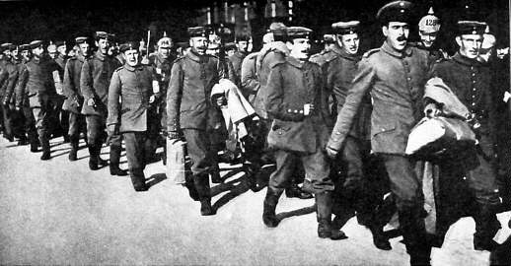
The first World War began on August 4, 1914, when German troops poured into Belgium. The U.S. wanted to stay neutral and stay out of the war, but they soon found neutrality to be difficult and the U.S. entered the war in 1917.

Slide 3
Long Term Causes of WW1
Nationalism
Imperialism
Militarism
Alliance System

Slide 4
Nationalism:
The Belief that national interests & national unity should be placed ahead of global cooperation & that a nation’s foreign affairs should be guided by its own self interest.
Imperialism:
Imperialism caused European nations to compete with one another due to industrialism & the need for raw materials. All of which created an underlying tension in Europe
Militarism: (The development of armed forces & their use as a tool of diplomacy)
Because of nationalism & imperialism European nations began building up their armed forces. Each nation wanted its armed forces to be stronger than those of any potential enemy.
By 1890, Germany was the strongest nation in Europe. They set up an army reserve system that drafted young men, trained them & then returned them to civilian life until they were needed.

Slide 5
Alliance System:
Nationalism, Imperialism & Militarism created mutual hostility, jealousy, fear & desires between the nations of Europe, which ultimately led to the signing of treaties between these various nations. These treaties committed them to support one another if they faced attack. There were two major alliances:

Slide 6
Two major mutual-defense alliances
Triple Entente
Triple Alliance
Later known as the ALLIES
Later known as the Central Powers
FRANCE
GREAT BRITAIN
RUSSIA (who also had a separate treaty with Serbia)
GERMANY
AUSTRIA-HUNGARY
ITALY (In 1915, Italy joins the ALLIES in return for promised territorial gains)
OTTOMAN EMPIRE (an empire of mostly Middle Eastern lands controlled by the Turks (Turkish people)

Slide 7
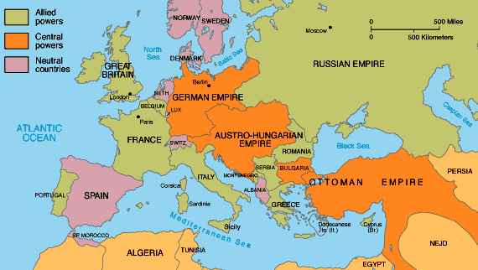
The alliances provided a measure of international security because nations were reluctant to disturb the balance of power.

Slide 8
The shot which sparked WWI
Most of the European continent’s leading powers had an interest in the Balkan Peninsula.
Russia wanted to gain an outlet to the Mediterranean Sea.
Germany wanted to extend the railroad between itself & the Ottoman Empire.
In 1908, Austria annexed (or took over) Bosnia & Herzegovina, which were two areas with large Slavic populations. And which outraged Serbian leaders because they wanted to rule these two provinces.
The possibility of war arose. Russia offered Serbia their full support because they have a treaty with Serbia; but Germany has Austria’s back. Since Russia is completely unprepared for war, both Serbia & Russia have to back down.
Furthermore, by 1914, Serbia had emerged victorious from several local conflicts, which allowed Serbia to gain additional territory & more confidence. They were eager than ever to take Bosnia & Herzegovina away from Austria.
In response, Austria-Hungary vows to crush any Serbian effort to undermine its authority in the Balkans.

Slide 9
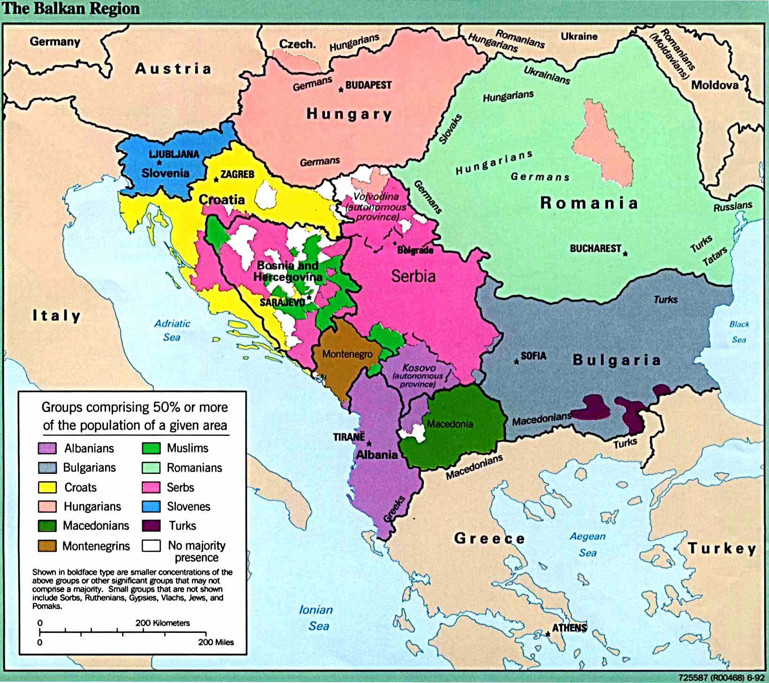
The Balkan Peninsula
AKA
The Powder Keg of Europe

Slide 10
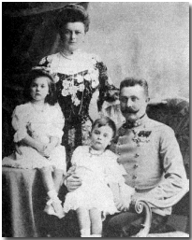
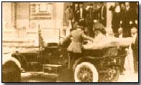
On June 28, 1914, The streets of Sarajevo (the capital of Bosnia) were lined with people who had gathered to see Archduke Franz Ferdinand (the nephew of Emperor Franz Joseph & the heir to the Austrian throne).
He along with his wife Sophie waved to the crowds of people as their car moved along.

Slide 11
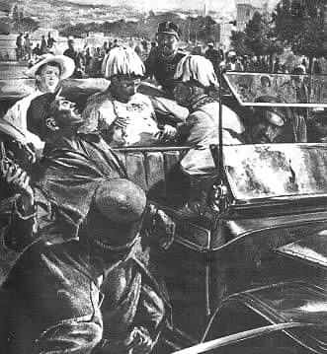
Suddenly, a young man leaped toward them from the curb & before the guards could react, he fired a series of shots, killing the Archduke & his wife.

Slide 12
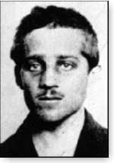
The killer was a 19 year-old member of the BLACK HAND. A secret society committed to ridding Bosnia of Austrian rule & unite all Serbs including those living in Bosnia under one government
Princip's act gave Austria-Hungary the excuse that it had sought for opening hostilities against Serbia and thus precipitated World War I. Today's bridge in Sarajevo, nearby the place where the actual assassination took place, is named after this hero.
Gavrilo Princip

Slide 13
On July 23, Austria presented Serbia with an ultimatum (a list of demands that if not met, will led to serious consequences):
End all anti-Austrian activity
Serbian leaders would have to allow Austrian officials into their country to conduct an investigation in the assassinations.
Serbia knew that refusing the ultimatum would lead to war, so they agreed to most of Austria’s demands. Serbia wanted to have several other demands settled by an international conference.
Austria was in no mood to negotiate anything, so on July 28, 1914, Austria declared war on Serbia.
On the same day, Serbia’s ally, Russia took action & ordered the mobilization of troops toward the Austrian border.

Slide 14
Austria-Hungary’s declaration of war against Serbia set off a chain reaction within the alliance system. The countries of Europe followed through on their numerous & complex pledges to support one another. As a result, nearly all the nations of Europe soon were drawn into the war.
Triple Alliance/Central Powers
Triple Entente/Allies
Austria-Hungary
Declares War
Serbia
Russia (Serbia’s ally) moves its army toward the Russian- Austrian border. Russia also mobilized along the German border
Germany
Russia
As a result of Russia mobilization to the Russian-German border, Germany declares war on Russia on Aug. 1st.
Russia looked to France for help. 2 days later (Aug 3) not waiting for France to react, Germany declares war on France
France
Great Britain
Britain who is linked to France, declares war on Germany & Austria-Hungary on Aug 4th after Germany invades Belgium (a neutral country) to get to France.

Slide 16
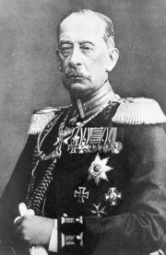
The Schlieffen Plan- The plan was named after its designer, General Alfred Graf von Schlieffen (SHLEE-fuhn)
In 1905, He was given instructions to devise a strategy that would be able to counter a joint attack or a war on two fronts. The plan called for a quick drive through the Belgian lowlands to Paris, then after France had fallen, the two German armies would join to defeat the Russians. And after the defeat, Britain & Russia would be unwilling to carry on fighting. Schlieffen calculated that it would take Russia 6 weeks to organize its large army for an attack on Germany. Therefore, it was vitally important to force France to surrender before Russia was ready to use all its forces.

Slide 17
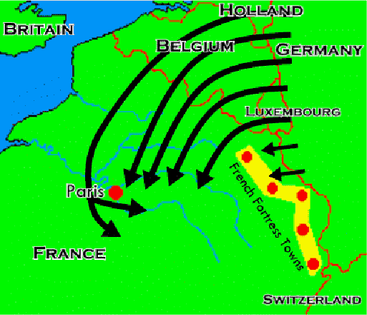
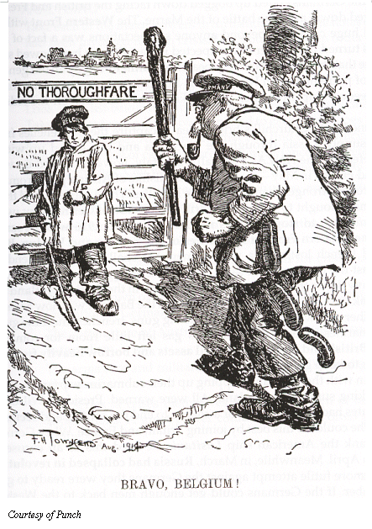
On Aug. 2nd, 1914, the Schlieffen Plan was put into operation when the German Army invaded Luxembourg & Belgium. However, the Germans were held up by the Belgian Army & were shocked by the Russian Army's advance into East Prussia. The Germans were also surprised by how quickly the British Expeditionary Force reached France and Belgium.

Slide 18
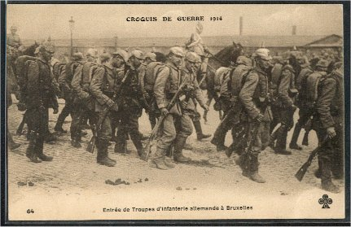
As the German troops swept through Belgium, thousands of Belgium refugees fled in terror. The U.S. war correspondent Richard Harding Davis described the scene in Belgium: “We found the streets blocked with their carts. Into these they had thrown mattresses, or bundles of grain, & heaped upon them were families of three generations. Old men in blue smocks, white-haired & bent, old women in caps, the daughters dressed in their one best frock & hat. All that was left to them, all they could stuff into a pillow case or flour sack…Heart broken, weary, hungry, they passed in an unending caravan.”

Slide 19
The French 6th Army attacked the German Ist Army at the Marne on the morning of 6th September. General Alexander von Kluck wheeled his entire force to meet the attack, opening a 50km gap between his own forces and the German 2nd Army led by General Karl von Bulow. The British forces and the French 5th Army now advanced into the gap that had been created splitting the two German armies.
For the next three days the German forces were unable to break through the Allied lines. This deadlocked region in northern France became known as the Western Front. At one stage the French 6th Army came close to defeat and were only saved by the use of Paris taxis to rush 6,000 reserve troops to the front line. On 9th September, General Helmuth von Moltke, the German Commander in Chief, ordered General Karl von Bulow and General Alexander von Kluck to retreat. The British and French forces were now able to cross the Marne.
Although it was only the first major clash on the Western Front, the First battle of the Marne was perhaps the single most important event of the war because the defeat of the Germans left the Schlieffen Plan in ruins.

Slide 20
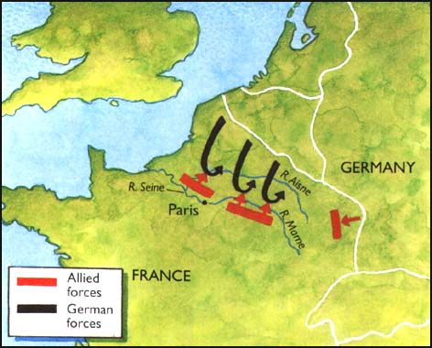
The plan had not succeeded. The German hopes of a swift and decisive victory had been frustrated. However, the German Army had not been beaten & its successful retreat & the building of trenches between the North Sea to the Swiss Frontier ended all hope of a short war.

Slide 21
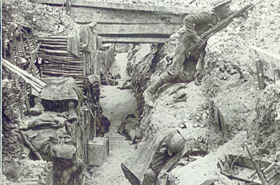
Germany was going to have to fight a long war on 2 fronts. Realizing this, the German command sent thousands of troops from France to aid its forces in the east. Meanwhile, the war on the Western Front settled into a stalemate.
By early 1915, opposing armies on the Western Front had dug miles of parallel trenches to protect themselves from enemy fire. This set the stage for what became known as trench warfare.
The German commander, General Erich von Falkenhayn, decided that his troops must at all costs hold onto those parts of France and Belgium that Germany still occupied.

Slide 22
General Erich von Falkenhayn ordered his men to dig trenches that would provide them with protection from the advancing French and British troops. The Allies soon realized that they could not break through this line and they also began to dig trenches. After a few months these trenches had spread from the North Sea to the Swiss Frontier. As the Germans were the first to decide where to stand fast and dig, they had been able to choose the best places to build their trenches. The possession of the higher ground not only gave the Germans a tactical advantage, but it forced the British and French to live in the worst conditions. Most of this area was rarely a few feet above sea level. As soon as soldiers began to dig down they would invariably find water two or three feet below the surface. Water-logged trenches were a constant problem for soldiers on the Western Front.

Slide 23
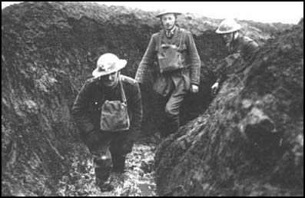
Along the whole line, trench life involved a never-ending struggle against water and mud. Duck-boards were placed at the bottom of the trenches to protect soldiers from problems such as trench foot. Much of the land where the trenches were dug was either clay or sand. The water could not pass through the clay and because the sand was on top, the trenches became waterlogged when it rained. The trenches were hard to dig and kept on collapsing in the waterlogged sand. As well as trenches the shells from the guns and bombs made big craters in the ground. The rain filled up the craters and then poured into the trenches.
Officers walking through a flooded communication trench.

Slide 24
TRENCH DESIGN
Frontline trenches were usually about seven feet deep and six feet wide. The front of the trench was known as the parapet. The top two or three feet of the parapet and the parados (the rear side of the trench) would consist of a thick line of sandbags to absorb any bullets or shell fragments. In a trench of this depth it was impossible to see over the top, so a two or three-foot ledge known as a fire-step, was added.
Duck-boards were also placed at the bottom of the trenches to protect soldiers from problems such as trench foot. Soldiers also made dugouts and funk holes in the side of the trenches to give them some protection from the weather and enemy fire.

Slide 25
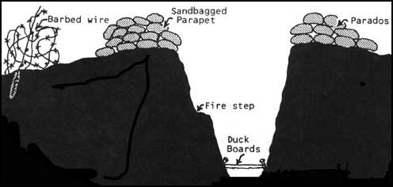

Slide 26
TRENCH EXTENSIONS
The front-line trenches were also protected by barbed-wire entanglements & machine-gun posts. Short trenches called saps were dug from the front-trench into No-Man's Land. The sap-head, usually about 30 yards forward of the front-line, were then used as listening posts. Small groups of soldiers were sent to the sap-head & were given the task of finding out about the enemy. This included discovering information about enemy patrols, wiring parties, or sniper positions. After a heavy bombardment soldiers would be ordered to seize any new craters in No Man's Land which could then be used as listening posts. Front-line trenches were not dug in straight lines. Otherwise, if the enemy had a successive offensive, and got into your trenches, they could shoot straight along the line. The French tended to build zigzag trenches. However, the British Army preferred a system where each trench was dug with alternate fire-bays and traverses. Whereas fire-bays were straight sections of trenches, traverses were built at angles. This limited the effect of enfilade fire or shell-burst.

Slide 27
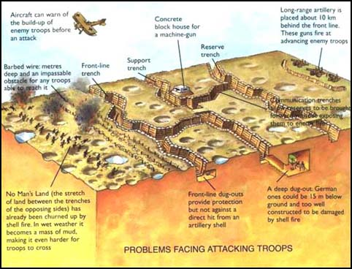

Slide 28
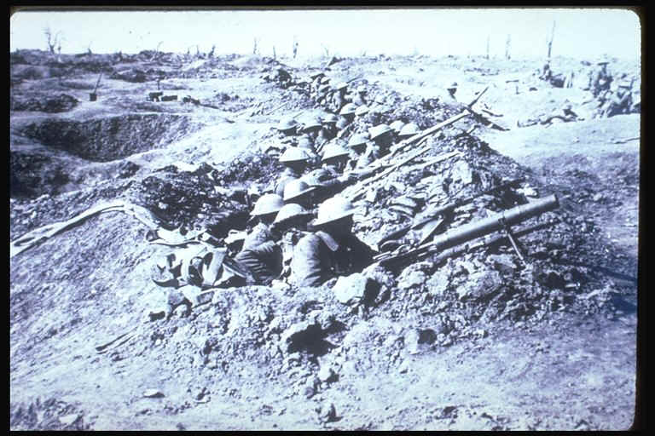
Soldiers occupying a trench extension

Slide 29
BARBED WIRE
Trenches on the Western Front were protected by thick barbed-wire entanglements. Being a member of a wiring party was one of the most unpopular duties experienced by soldiers. This involved carrying out 6 ft. steel pickets and rolls of wire. The pickets were knocked into place by muffled mallets. When fastened to the pickets, the wire was pulled out to make what was known as an apron. Barbed-wire was usually placed far enough from the trenches to prevent the enemy from approaching close enough to lob grenades in. Sometimes barbed-wire entanglements were set up in order to channel attacking infantry into machine-gun fire. Barbed-wire entanglements were virtually impassable. Before a major offensive soldiers were sent out to cut a path with wire-cutters. Another tactic was to place a Bangalore Torpedo (a long pipe filled with explosive) and detonate it under the wire.

Slide 30
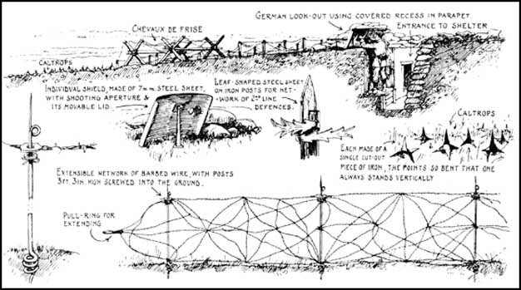
Heavy bombardment was necessary to destroy the barbed-wire. However, this always removed the crucial element of surprise. Many soldiers disputed the fact that shelling was capable of creating a gap in the wire. Arthur Coppard, who observed attempts to destroy barbed-wire entanglements at the Somme remarked: "Who told them that artillery fire would pound such wire to pieces, making it possible to get through? Any Tommy could have told them that shell fire lifts wire up and drops it down, often in a worse tangle than before."
Drawings made by an allied spy of German barbed-wire

Slide 31
NO MAN’S LAND
No Man's Land is the term used by soldiers to describe the ground between the two opposing trenches. Its width along the Western Front could vary a great deal. The average distance in most sectors was about 250 yards (230 meters). However, at Guillemont it was only 50 yards (46 meters) whereas at Cambrai it was over 500 yards (460 meters). The narrowest gap was at Zonnebeke where British and German soldiers were only about seven yards apart. No Man's Land contained a considerable amount of barbed wire. In the areas most likely to be attacked, there were ten belts of barbed wire just before the front-line trenches. In some places the wire was more than a 100 feet (30 meters) deep. If the area had seen a lot of action No Man's Land would be full of broken and abandoned military equipment. After an attack No Man's Land would also contain a large number of bodies. Advances across No Man’s Land were always very difficult. Not only did the soldiers have to avoid being shot or blown-up, they also had to cope with barbed wire and water-filled, shell-holes.

Slide 32
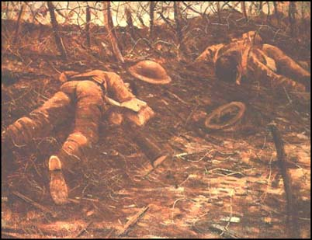
Soldiers were only occasionally involved in a full-scale attack across No Man's Land. However, men were sometimes ordered into No Man's Land to obtain information about the enemy. When an artillery shell had landed just in front of an enemy trench, soldiers were often ordered to take control of the shell-hole and to try and spy on the enemy. Small patrols were also sent out to obtain information about the enemy. These patrols would go out at night. They would have to crawl forward on their stomachs in an attempt to get close enough to find out what the enemy was up to. If possible, they would try and capture a sentry and bring him back for interrogation. To stop British night patrols the Germans used a light-shell rocket. Suspended from a small parachute, the flare blazed brightly for a minute giving the defending troops a chance to kill the soldiers who had advanced into No Man's Land.

Slide 33
Soldiers faced various problems while fighting in the trenches. Problems such as low moral, claustrophobia, despair & Shell shock (mental) They also faced Lice, Trench foot, Dysentery & Rats (physical):
LICE
Men in the trenches suffered from lice. One soldier writing after the war described them as "pale fawn in colour, and they left blotchy red bite marks all over the body." They also created a sour; stale smell. Various methods were used to remove the lice. A lighted candle was fairly effective but the skill of burning the lice without burning your clothes was only learnt with practice. Where possible the army arranged for the men to have baths in huge vats of hot water while their clothes were being put through delousing machines. Unfortunately, this rarely worked. A fair proportion of the eggs remained in the clothes and within two or three hours of the clothes being put on again a man's body heat had hatched them out. As well as causing frenzied scratching, lice also carried disease. This was known as pyrexia or trench fever. The first symptoms were shooting pains in the shins and were followed by a very high fever. Although the disease did not kill, it did stop soldiers from fighting and accounted for about 15% of all cases of sickness in the British Army.

Slide 34
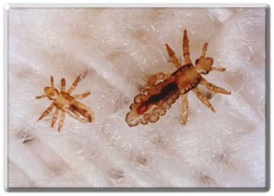
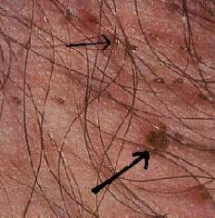
Lice are about the size of a sesame seed, about as long as a hyphen -. They have six legs with claws that they use to pull themselves along hair and clothing. They do not fly or jump. They take on the color of the surrounding background much like a chameleon, so they may be black, yellow, brown, whitish, or reddish.

Slide 35
TRENCH FOOT
Many soldiers fighting in the First World War suffered from trench foot. This was an infection of the feet caused by cold, wet and unsanitary conditions. In the trenches men stood for hours on end in waterlogged trenches without being able to remove wet socks or boots. The feet would gradually go numb and the skin would turn red or blue. If untreated, trench foot could turn gangrenous and result in amputation. Trench foot was a particular problem in the early stages of the war. For example, during the winter of 1914-15 over 20,000 men in the British Army were treated for trench foot. The only remedy for trench foot was for the soldiers to dry their feet and change their socks several times a day. By the end of 1915 British soldiers in the trenches had to have three pairs of socks with them and were under orders to change their socks at least twice a day. As well as drying their feet, soldiers were told to cover their feet with a grease made from whale-oil. It has been estimated that a battalion at the front would use ten gallons of whale-oil every day.

Slide 36
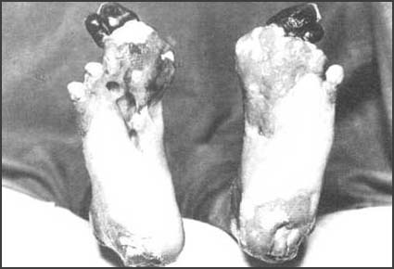
A photograph of a man suffering from trench foot
Sergeant Harry Roberts, Lancashire Fusiliers, interviewed after the war. If you have never had trench feet described to you. I will tell you. Your feet swell to two or three times their normal size and go completely dead. You could stick a bayonet into them and not feel a thing. If you are fortunate enough not to lose your feet and the swelling begins to go down. It is then that the intolerable, indescribable agony begins. I have heard men cry and even scream with the pain and many had to have their feet and legs amputated.

Slide 37
DYSENTERY
Dysentery is a disease involving the inflammation of the lining of the large intestines & it strips the lining from the stomach. The inflammation causes stomach pains and diarrhea. Some cases involve vomiting and fever. The bacteria enter the body through the mouth in food or water, and also by human feces and contact with infected people. The diarrhea causes people suffering from dysentery to lose important salts and fluids from the body. This can be fatal if the body dehydrates. This disease struck the men in the trenches as there was no proper sanitation. Latrines in the trenches were pits four to five feet deep. When they were within one foot they were supposed to be filled in and the soldiers had the job of digging a new one. Sometimes there was not time for this and men used a nearby shell-hole. Dysentery caused by contaminated water was especially a problem in the early stages of the war. The main reason for this was that it was some time before regular supplies of water to the trenches could be organized. Soldiers were supplied with water bottles that could be refilled when they returned to reserve lines. However, the water-bottle supply was rarely enough for their needs and soldiers in the trenches often depended on impure water collected from shell-holes or other cavities. Later, to purify it, chloride of lime was added to the water. This was not popular with the soldiers as they disliked the taste of the purified water.

Slide 38
Rats
Rats became a problem in trenches during World War 1. They were attracted by the despicable smell and damp conditions. Rats would eat men's uniforms & generally just run around in the trenches. Sometimes they would bite soldiers, in desperation of hunger, which would cause extreme pain & often lead to infection. In extreme cases, a wounded or unprotected soldier could be eaten alive by a large group of rats. Dead corpses would often be eaten by the rats. One soldier described the rats as `small dogs' that would attack and eat anything. Wounded men were often afraid to go to sleep in their beds and men tried to secure their food during the night to stop rats from getting it.

Slide 39
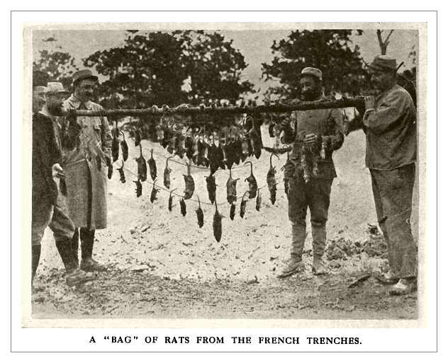

Slide 40
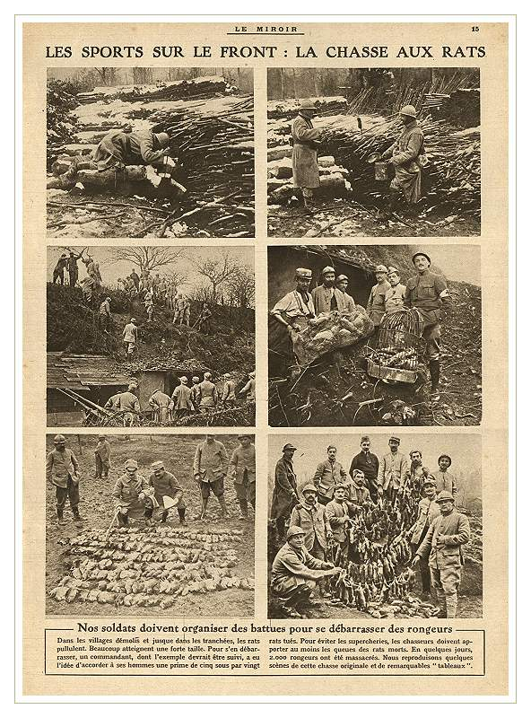
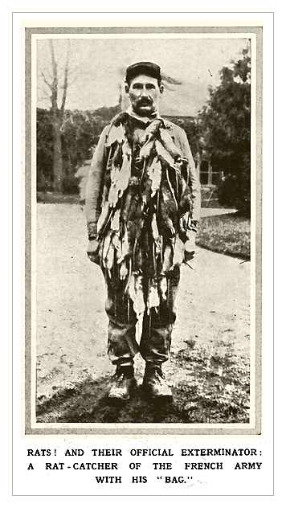

Slide 41
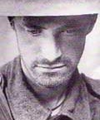
Shell Shock
Shell shock was the result of the stress and trauma of war. Soldiers would contract it by living in the frontline for a time and becoming unstable from being exposed to the constant shelling and general stress of war which magnified the horror of it. The affects of shell shock varied depending on the case, mostly it lead to extreme panic and losing control mentally. Eventually a soldier would not be able to concentrate at all and would lead to a complete mental breakdown.
Some men would not respond to anything or anyone while in hospital except (for example) the word bomb or death. Others would be in constant spasm reenacting an experience such as ducking or hiding. Others would just become unable to control themselves as a result of the trauma. The condition would affect different men in different ways, but all the same it would affect almost everyone who lived long enough to go through it.

Slide 42
World War One also brought about new weapons of war as well as a new kind of warfare: Weapons such as flame throwers, poisonous gas, machine guns, tanks and air planes were employed
FLAME THROWERS
The German Army first began experimenting with flame-throwers in 1900 and they were issued to special battalions eleven years later. The flame-thrower used pressurized air, carbon dioxide or nitrogen to force oil through a nozzle. Ignited by a small charge, the oil became a jet of flame. Flame-throwers were first used at the Western Front in October 1914. Operated by two men, they were mainly used to clear enemy soldiers from front-line trenches. At first they had a range of 25 meters but later this was increased to 40 meters. This meant they were only effective over narrow areas of No Man's Land. Another problem was that the flame-thrower was difficult to move around and only contained enough oil to burn 40 seconds at the time. Soldiers who operated flame-throwers had a short-life span because as soon as they used them they were the target of rifle and machine-gun fire.

Slide 43
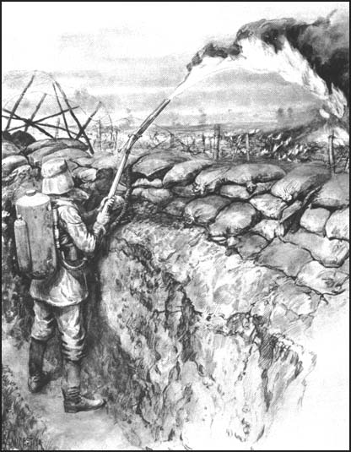

Slide 44
Gas
Chlorine gas was a very deadly substance. The German army came up with the idea and first used it against the French. Yellow-green clouds came toward the French and had a smell similar to a mixture of pineapple and pepper. They thought the German were hiding behind a smokescreen, ready to attack. After they felt a burning in their chests and throats, however, they noticed they were being gassed. An hour later a four-mile gap was in the French line. Chlorine gas led its victims to a slow death, as it destroyed their respiratory organs. Unfortunately doctors could not find a cure. Certain weather conditions were needed for a gas attack as the British found out. On September 25, 1915 the wind blew gas back into the British's faces when they attempted to launch a gas attack. Later gas shells were produced which increased their range and protected them under bad weather conditions. Later, Allied forces began wearing gas masks. The masks were made of pads soaked in urine, which repelled the chlorine. Some soldiers preferred using handkerchiefs dampened with a solution of bicarbonate of soda, and later more efficient gas masks were made. Also, a stronger and more effective gas using phosgene instead of chlorine was later developed. Some armies even used a gas containing a mixture of both substances.

Slide 45
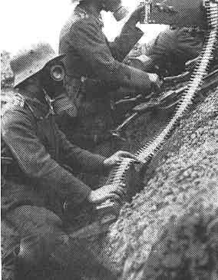
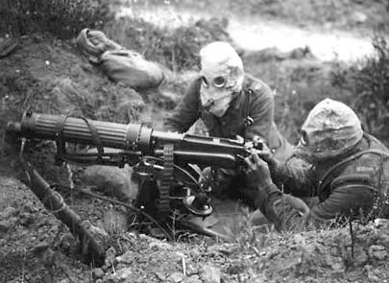

Slide 46
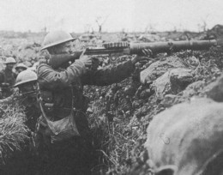
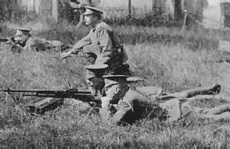
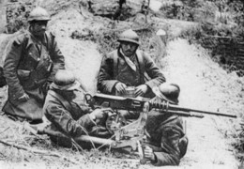
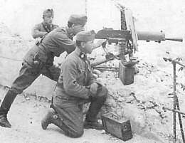
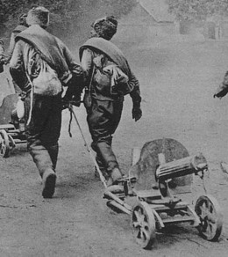
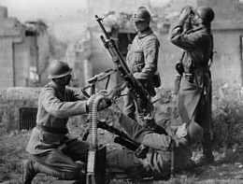
Machine Guns:
The machine gun, which fires ammunition automatically, was much improved by the time of World War I. As a result, it saw wide use in combat. Because the gun could wipe out waves of attackers & make it difficult for forces to advance, it helped create a stalemate

Slide 47
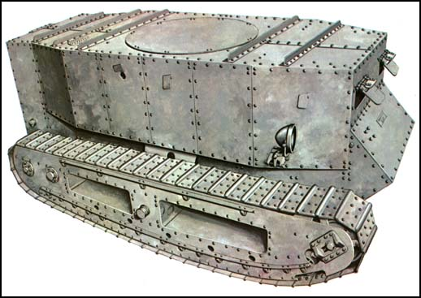
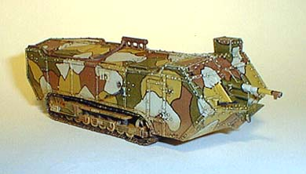
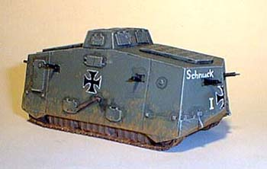
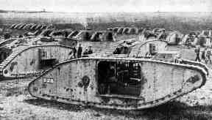
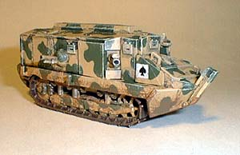
Tank:
The tank was an armored combat vehicle that moved on chain tracks. It was introduced by the British in 1916 at the Battle of the Somme. The early tanks were slow & clumsy & they could not cross many trenches. They eventually improved & thus aided the Allies in their war effort.

Slide 48
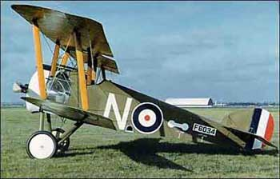
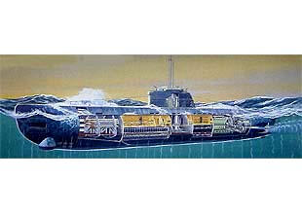
Airplane
WWI signaled the first time in history that planes were used in a combat role. At first, nations used planed for taking photographs of enemy lines. Soon, both sides used them to drop bombs. Guns soon were attached to the planes & pilots fought each other in the air.
Submarine
In 1914, the Germans introduce the submarine as an effective warship. German subs known as U-boats eventually waged unrestricted warfare on Allied ships.
The subs primary weapon was the torpedo, a self-propelled underwater missile

Slide 49
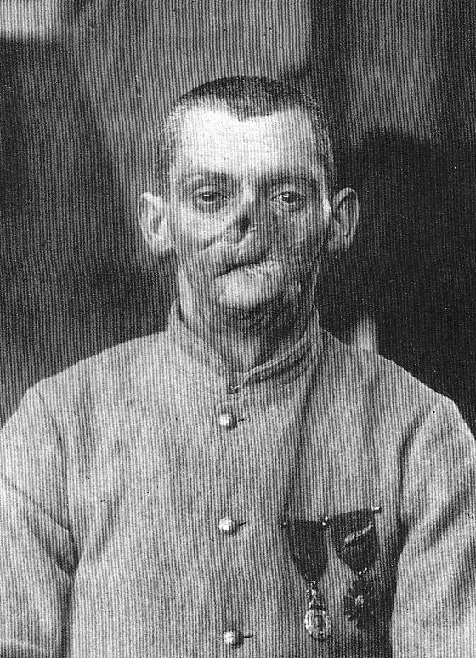
France had more than its share of maimed survivors of the great war. Thousands of French veterans returned home from the trenches as men unrecognizable to their families. It is astounding the amount of punishment and mutilation that could be meted out to a man by the weapons and technology of the great war and still leave him alive to deal with it for the rest of his years.

Slide 50
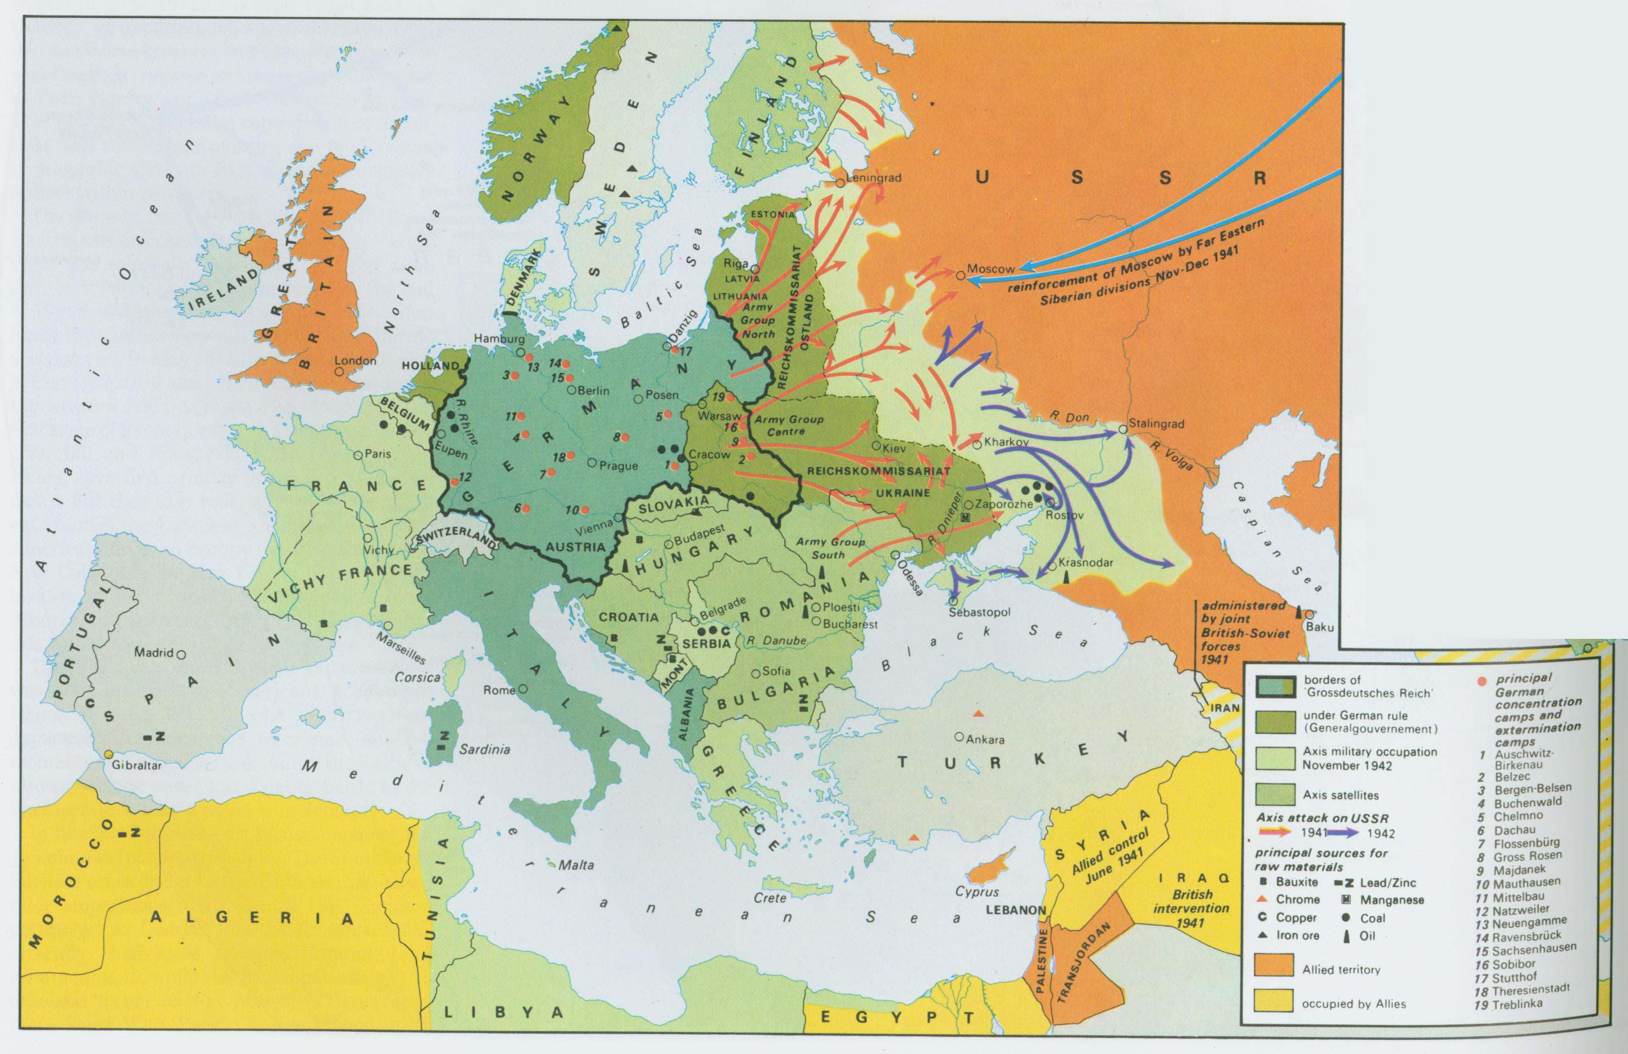
Battle on the Eastern Front
The Eastern Front was a stretch of battlefield along the German & Russian border. Here, Russians & Serbs battled Germans, Austrians & Turks

Slide 51
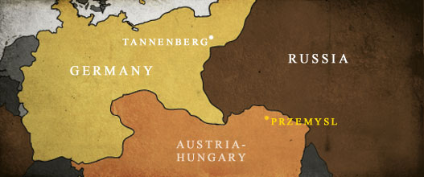
At the beginning of the war, Russian forces launched an attack into both Austria & Germany. By the end of August, Germany counterattacked near the town of Tannenberg. During the four day battle that followed, the Germans crushed the invading Russian army & drove it into full retreat. Germany regained East Prussia & seized numerous guns & horses from the enemy. More than 30,000 Russian soldiers were killed.
Russian forces defeated the Austrians twice in Sept. 1914 driving them deep into Austria. Not until Dec. with German assistance did the Austrians defeat the Russians & drive them eastward pushing the Russians out of Austria-Hungary.

Slide 52
By 1916 (2 years later) Russia’s war effort was near collapse.
Russia was not yet industrialized like the western European nations
As a result they were constantly short on food, guns, ammo, clothes, boots & blankets.
Furthermore, the Allies were not able to ship supplies to Russia’s ports in the north because the German naval fleet blocked the Baltic Sea. In the south, the Ottomans controlled the straits leading from the Mediterranean to the Black sea.

Slide 53
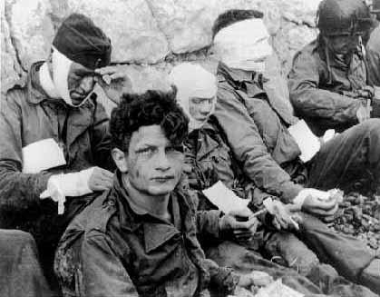
The Russian army had only one asset, it’s enormous population. The Russian’s suffered huge battlefield losses. More than 2 million Russian soldiers were killed, wounded, or captured in 1915 alone. But the army continually rebuilt its ranks from the population.
Although the Russian army suffered many losses, they managed to tie up hundreds of thousands of German troops on the eastern front, which prevented the Germans from launching its full fighting force in the west.

Slide 54
The War becomes Global
The Ottoman Turks & Bulgaria ally themselves with Germany & The Central Powers
Japan & Italy join the war on the side of the Allies
None of these alliances gave an advantage to either side, but they did give military leaders more war zones in which to try to secure victory.
Allies attack Dardanelles, (a region in the Ottoman Empire) a narrow sea strait, which was the gateway to the Ottoman capital, Constantinople.
The Allies believed that they could take Constantinople, defeat the Turks & establish a supply line to Russia.
This battle began in February 1915 & it was known as The Gallipoli Campaign
British, Australian, New Zealand & French troops made repeated attacks on the western side of the strait
Turkish troops, some commanded by German officers defended the region, which turned into another stalemate, due to trench warfare.
By December, the Allies suffer about 250,000 casualties and began to evacuate.

Slide 55
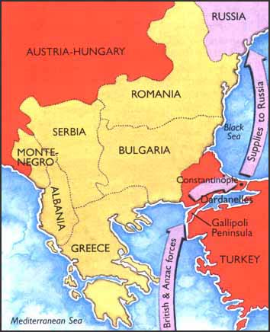
Dardanelles

Slide 56
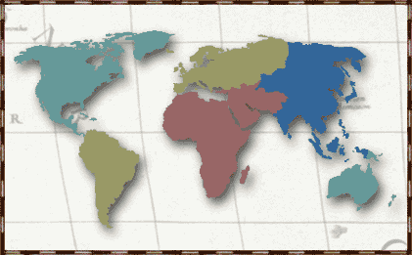
Global War Continues
The Japanese overrun German outposts in China, they also capture Germany’s Pacific island colonies
The United States enters the war on the side of the Allies in 1917
Europe
Main fighting of war occurs on Western & Eastern fronts
North America
Asia
Japan
Southwest Asia
Both countries fight on the side of the Allies & give troops to fight in the Gallipoli campaign
Atlantic Ocean
Africa
India
Pacific Ocean
In Africa, European colonies become battlefields as the warring parties strike at one another’s colonial possessions
South America
Australia
In Southwest Asia, The British help Arab nationalists rise up against their Turkish rulers
New Zealand
Brazil (the only South American country to enter the war) supports the Allies with warships & personnel
India provides about 1.3 million men to fight & labor alongside their British rulers throughout Europe

Slide 57
The U.S. Enters The Great War
By 1917, the focus of the war shifted to the sea. That year the Germans intensified the submarine warfare. Earlier in 1915, the Germans sank the British liner the Lusitania off the coast of Ireland, which killed 1,198 persons including 128 Americans. The American public was outraged. President Woodrow Wilson sends a strong protest to Germany & they agree to stop attacking neutral & passenger ships, but two months later the Germans sink another British liner & a year later in 1916, the Germans sink a French passenger steamer killing or injuring about 80 passengers.
By 1917, failed crops, as well as a British naval blockade, along the German coast to prevent weapons, food & other military goods from getting through, caused severe food shortages in Germany. An estimated 750,000 Germans starved to death as a result of the blockade.
In response, Germany decided to establish its own naval blockade around Britain.
In Jan. 1917, the Germans announce that their subs would sink without warning, any ship found in the waters around Britain – this policy was called unrestricted submarine warfare.

Slide 58
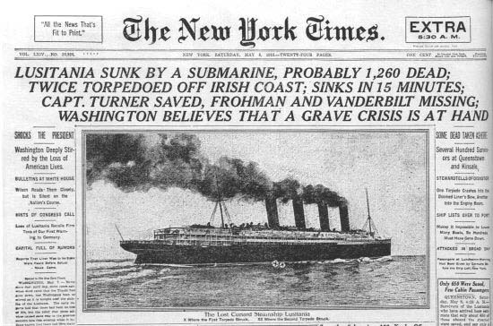

Slide 59
In February 1917, the British intercepted a telegram from Germany’s foreign secretary, Arthur Zimmerman, to the German ambassador in Mexico, which said that Germany would help Mexico obtain the land it had lost to the U.S. if Mexico would ally itself with Germany. The British decoded the message & gave it to the U.S. government.
When the note was made public, Americans called for war against Germany.
On April 2, 1917, President Wilson asked Congress to declare war. Thus the U.S. entered the war on the side of the Allies.
The telegram had such an impact on American opinion that, according to David Kahn, author of The Codebreakers, "No other single cryptanalysis has had such enormous consequences.“
It is his opinion that "never before or since has so much turned upon the solution of a secret message."

Slide 60
By the time the U.S. joined the war on the side of the Allies, the war had been going on for nearly three years. In those three years, Europe had lost more men in battle than in all the wars of the previous three hundred years!
WWI soon became a total war; meaning that countries devoted all their resources to the war effort.
Because the demand of the war was so great, every able bodied person, men & women was put to work. Thousands of women built tanks & munitions, plowed fields, paved streets & ran hospitals. They also kept troops supplied with food, clothing & weapons.
Unemployment in Many European countries disappeared & they even enlisted the help of foreign workers.
So many goods were in short supply that governments turned to a system of rationing out a wide range of goods including butter to shoe leather.

Slide 61
Russia withdraws from the War!
By March 1917, civil war breaks out in Russia and brings the czar’s government to the brink of collapse, because of war-related shortages of food & fuel.
Czar Nicholas abdicates (to do away with, to discard) his throne on March 15th
In his place, a new government was established & they pledge to keep fighting the war.
By 1917, nearly 5.5 million Russian soldiers had been wounded, killed, or taken prisoner, thus the Russian army refuses to fight any longer.
Eight months later another revolution takes place where Communist leader Vladimir Lennin seizes power & he insists on ending his country’s involvement in the war.
He offers Germany a truce & in March of 1918, Germany & Russia sign the Treaty of Brest-Litovsk, which ends the war between them.

Slide 62
On July 17, 1918, the Czar Nicholas, his wife, Alexandra, their five children and four family attendants were herded into a cellar room by their Bolshevik captors and killed in fusillade of bullets and stabs of bayonets. According to a report by the Czar's chief executioner, two of the bodies taken from the Yekaterinburg cellar were burned, and the rest buried. The missing bodies belonged to the Romanov heir, Alexei, who was 13 when he was killed, and one of his sisters, either Maria, then 19, or her 17-year-old sister Anastasia.

Slide 63
Vladimir Lenin
The treaty was hard on Russia. It required the Russian government to surrender lands to Germany that now include Finland, Poland, Ukraine, Estonia, Latvia & Lithuania.

Slide 64
As a result of Russia withdrawing from the war, Germany sent nearly all of its forces to the Western Front.
In March 1918, the Germans mounted one final attack on the Allies in France, using more than 6,000 German cannons, which was the largest artillery attack of the entire war.
Artillery was the type of weapon that killed more people than any other between 1914 and 1918. The biggest guns used in the Great War could fire shells as large as a soldier.
Big Bertha
Big Bertha was a German cannon that could hurl an 1800 lb shell a distance of 75 miles. It was named after Bertha Krupp, the wife of German munitions king Gustav Krupp.

Slide 65
The Germans managed to crush everything in their path. Within two months of the final attack, the Germans managed to come within 40 miles of Paris (The Marne River). But by this time, the German military had weakened, because their men were exhausted and supplies were low.
Sensing the weakness, the Allies, along with 140,000 fresh U.S. troops, launched a counter attack. The French commander of the Allied Forces, Ferdinand Foch used the Americans to fill the gaps in his ranks.
Ferdinand Foch

Slide 66
In July 1918, the Allies & Germans clash again at the Marne River. The Allies use some 350 tanks and smash through the German lines. With 2 million more U.S. troops, the Allied forces began to advance toward Germany.
The Central Powers began to crumble. First the Bulgarians and then the Ottoman Turks surrender.
In October, a revolution in Austria-Hungary brought that empire to an end.
In Germany, soldiers mutinied, and the public turned on Kaiser Wilhelm II and he was forced to step down. Germany declared itself a republic.
Kaiser Wilhelm II

Slide 67
A representative of the new German government met with Marshal Foch. In a railway car in a forest near Paris, the two signed an armistice (an agreement to stop fighting).
On November 11, 1918, World War I came to an end.
Leaders of the victorious nations gathered outside Paris to work out the terms of peace, but the peace settlement left many feeling bitter & betrayed.

Slide 68
News of the Armistice brought great relief. On both sides of no-man’s land, trenches erupted, they threw their helmets in the air, discarded their guns, waved their hands, then the two groups of men all up and down the fronts began edging toward each other, hesitantly at first, but when they met up, they began hugging each other, dancing, jumping, passing out cigarettes and chocolate. The French & the Germans were not only hugging each other but kissing each other on both cheeks as well.
The final toll of the war was staggering. It lasted 4 years, involved more than 30 nations & was the bloodiest war in history to that time. Deaths numbered about 26 million, half of them civilians who died as a result of disease, starvation or exposure. In addition, 20 million more people were wounded & an additional 10 million became refugees. Historians estimate the direct economic cost of the war to have been about $350 billion.
Total casualties: Russia = 9,300,000 Germany = 7,209,413
France = 6,220,800 Austria-Hungary = 4,650,200 Britain = 3,428,535
U.S. = 325,236

Slide 69
Before the war was over President Wilson presented his plan for world peace, known as the Fourteen Points:
The first 5 points included an end to secret treaties, freedom of the seas, free trade & reduced national armies & navies.
The fifth goal was the adjustment of colonial claims with fairness toward colonial peoples.
The sixth through thirteenth points were specific suggestions for changing borders & creating new nations, which was based on “Self Determination” – allowing people of different ethnic identities to decide for themselves under what government they wished to live.
The fourteenth point proposed a “general association of nations or League of Nations that would protect great & small states alike.” This league would provide a forum for nations to discuss & settle their differences without going to war.

Slide 70
As the Paris peace conference opened, Britain & France showed little sign of agreeing to Wilson’s vision of peace.
Both nations were concerned with national security & they also wanted to strip Germany of its war-making power.
The French in particular, were determined to punish Germany because France was where much of the fighting had occurred.
Georges Clemenceau of France (The French Premier) wanted Germany to pay for the suffering the war had caused.
After many heated arguments, a compromise was reached between Germany & the Allied powers. The peace conference did not include the defeated Central Powers, Russia or smaller Allied nations.
The Treaty of Versailles was signed on June 28, 1919 in the Palace of Versailles.

Slide 71
The “Big Four” worked out the treaty’s details among themselves. Wilson conceded on most of his 14 points in return for the establishment of the League of Nations
The British Prime Minister David Lloyd George
Wilson
Clemenceau
The Italian Prime Minister Vittorio Orlando

Slide 72
The League of Nations consisted of the 5 Allied powers:
The U.S., Britain, France, Italy & Japan – the permanent members of the leagues Executive Council
Its General Assembly would consist of representatives of 32 Allied & neutral nations. Germany was deliberately excluded. Also left out was Russia because of their early withdrawal from the war & its revolutionary leadership, which made them outcasts among the other Allies.

Slide 73
The Treaty punished Germany:
Germany returns Alsace-Lorraine to France
Germany surrenders all of its overseas colonies in Africa & the Pacific
Limits are set on the size of the German army
Germany is prohibited from importing or manufacturing weapons or war material
Germany is forbidden to build or buy submarines or have an air force
Article 231: AKA “War Guilt” clause:
Sole responsibility for the war was placed on Germany’s shoulders
Germany was forced to pay the Allies $33 billion in reparations over 30 years.
The Versailles treaty with Germany was just one of five treaties negotiated by the Allies. The Western powers signed separate peace treaties in 1919 & 1920 with each of the other defeated nations: Austria-Hungary, Bulgaria & the Ottoman Empire, which led to huge land losses for the Central Powers. Several new countries were created out of the Austro-Hungarian Empire: Austria, Hungary, Czechoslovakia & Yugoslavia were all recognized as independent nations.

