Slide 1
Are Gifted People Easily Identified?
You have been asked to select a student, based on the three biographies below, to enroll in a new program for gifted students. Look over the three biographies and decide which student you would choose.
Candidate 1 Candidate 2 Candidate 3
Name Bill Brown Alvin Lane Allen Erickson
Appearance Average Plain Homely
I.Q. 180+ 112 82
School Behavior Aloof, Organizer Well-liked Unsociable, disturbed
Physical Health Excellent Large for age Sickly
Emotional Health Excellent Easygoing, poor self-concept Had emotional breakdown
Interests Chess, Math Sports, reading, telling jokes Withdraws to fantasy world
Career Goals None mentioned Work in a retail store None mentioned
Personal Goals None mentioned Businessman Independence from family
Talents Photographic Good debater Plays violin, likes to read memory, published alone.
original math formula
at age 10
Which student did you select and why?

Slide 2
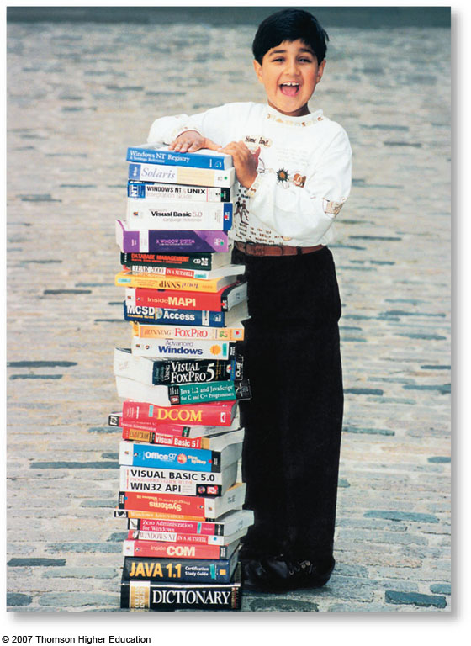
Intelligence
Do we have an inborn
general mental capacity
(intelligence)? If so,
can we quantify this
capacity as a
meaningful number?

Slide 3
What is Intelligence?
Intelligence (in all cultures) is the ability to learn from experience, solve problems, and use our knowledge to adapt to new situations.
In research studies, intelligence is whatever the intelligence test measures. This tends to be “school smarts.”
Notes:
OBJECTIVE 1| Discuss the difficulty of defining intelligence, and explain what it means to “reify intelligence.”.

Slide 4
Street Smart

Slide 5
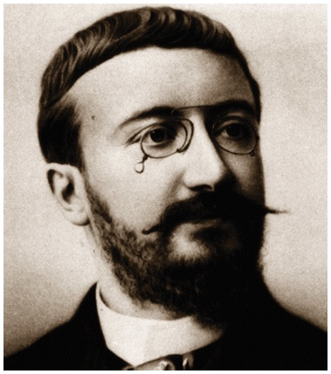
Origins of Intelligence Testing
Intelligence Test
a method of assessing an individual’s mental aptitudes and comparing them to those of others, using numerical scores

Slide 6
Conceptual Difficulties
Psychologists believe that intelligence is a concept and not a thing.
When we think of intelligence as a trait (thing) we make an error called reification — viewing an abstract immaterial concept as if it were a concrete thing.

Slide 7
Francis Galton
Started the “Eugenics” movement
Galton wanted to breed superior people
and create a master race.
Phrenology

Slide 8
Alfred Binet
Alfred Binet and his colleague Théodore Simon practiced a more modern form of intelligence testing by developing questions that would predict children’s future progress in the Paris school system.

Slide 9
Origins of Intelligence Testing
Alfred Binet (1857–1911)
Intelligence—collection of higher-order mental abilities loosely related to one another
Did not rank “normal” students according to the scores
Intelligence is nurtured
Binet-Simon Test developed in France, 1905

Slide 10
Origins of Intelligence Testing
Mental Age
a measure of intelligence test performance devised by Binet
chronological age that most typically corresponds to a given level of performance
child who does as well as the average 8-year-old is said to have a mental age of 8

Slide 11
Mental Age
Binet used the term mental age to describe the level of intellectual functioning. The average five-year-old should pass most items on a test designed for that age.
Intelligence Quotient (I.Q.) is a measure that compares mental age with physical age. A seven-year-old child with a mental age of eight will have an IQ of 114.

Slide 12
Lewis Terman
In the US, Lewis Terman adapted Binet’s test for American school children and named the test the Stanford-Binet Test. The following is the formula of Intelligence Quotient (IQ), introduced by William Stern:

Slide 13
Calculating I.Q.
Mental Age
X 100 =
I.Q.
I.Q.
Chronological Age
7
Examples:
X 100 =
100
7
8
X 100 =
114
7
What is the I.Q. of a 16-year-old girl with a mental age of 20?

Slide 14
Calculating I.Q.
Mental Age
X 100 =
I.Q.
I.Q.
Chronological Age
7
Examples:
X 100 =
100
7
8
X 100 =
114
7
What is the I.Q. of a 16-year-old girl with a mental age of 20?
20
= 12.5 X 100 = 125
16

Slide 15
The Stanford-Binet Intelligence Test
Constructed in the early 1900s by Alfred Binet
Described four elements of intelligence

Direction = the ability to work toward a goal

Adaptability = making necessary adjustments to solve a problem

Comprehension = understanding the basic problem

Self-evaluation = knowing if the problem has been solved correctly

Slide 16
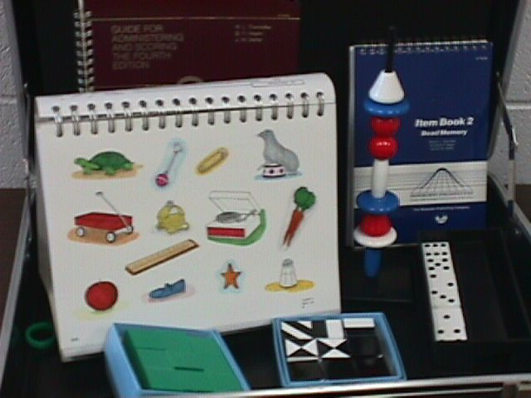
Items Used in the Stanford-Binet Test

Slide 17
Controversies About Intelligence
Despite general agreement among psychologists about the nature of intelligence, two controversies remain:
Is intelligence a single overall ability or is it several specific abilities?
With modern neuroscience techniques, can we locate and measure intelligence within the brain?

Slide 18
Intelligence: Ability or Abilities?
Have you ever thought that since people’s mental abilities are so diverse, it may not be justifiable to label those abilities with only one word, intelligence?
You may speculate that diverse abilities represent different kinds of intelligences. How can you test this idea?

Slide 19
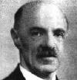
What is Intelligence?
Factor Analysis
statistical procedure that identifies clusters of related items (called factors) on a test
used to identify different dimensions of performance that underlie one’s total score
General Intelligence (g)
factor that Spearman and others believed underlies specific mental abilities
measured by every task on an intelligence test

Slide 20
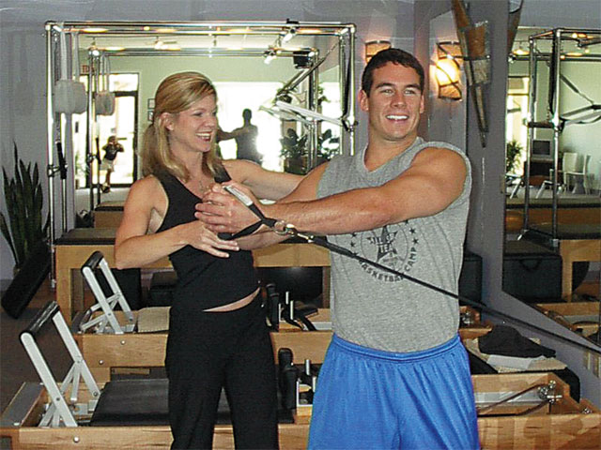
General Intelligence
The idea that general intelligence (g) exists comes from the work of Charles Spearman (1863-1945) who helped develop the factor analysis approach in statistics.
Athleticism, like intelligence, is many things
Notes:
OBJECTIVE 2| Present arguments for and against considering intelligence as on general mental ability.

Slide 21
General Intelligence
Spearman proposed that general intelligence (g) is linked to many clusters that can be analyzed by factor analysis.
For example, people who do well on vocabulary examinations do well on paragraph comprehension examinations, a cluster that helps define verbal intelligence. Other factors include a spatial ability factor, or a reasoning ability factor.

Slide 22
General Intelligence
L. L. Thurstone, a critic of Spearman, analyzed his subjects NOT on a single scale of general intelligence, but on seven clusters of primary mental abilities, including:
Word Fluency
Verbal Comprehension
Spatial Ability
Perceptual Speed
Numerical Ability
Inductive Reasoning
Memory

Slide 23
General Intelligence
Later psychologists analyzed Thurstone’s data and found a weak relationship between these clusters, suggesting some evidence of a g factor.

Slide 24
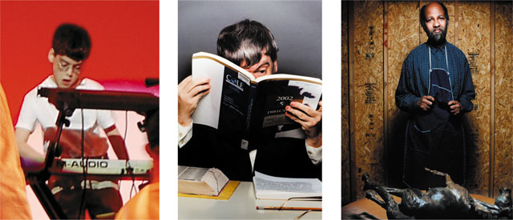
Contemporary Intelligence Theories
Howard Gardner (1983, 1999) supports Thurstone’s idea that intelligence comes in multiple forms. Gardner notes that brain damage may diminish one type of ability but not others.
People with savant syndrome excel in abilities
unrelated to general intelligence.
Notes:
OBJECTIVE 3| Compare Gardner’s and Sternberg's theories of intelligence.

Slide 25
Are There Multiple Intelligences?
Savant Syndrome
condition in which a person otherwise limited in mental ability has an exceptional specific skill
computation
drawing

Slide 26
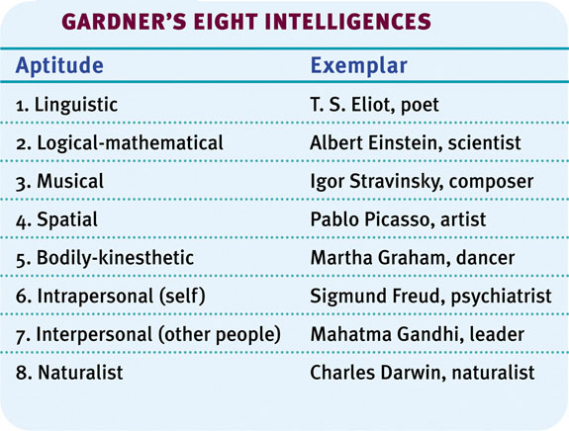
Howard Gardner
Gardner proposes eight types of intelligences and speculates about a ninth one — existential intelligence. Existential intelligence is the ability to think about the question of life, death and existence.

Slide 27
Robert Sternberg
Sternberg (1985, 1999, 2003) also agrees with Gardner, but suggests three intelligences rather than eight.
Analytical Intelligence: Intelligence that is assessed by intelligence tests.
Creative Intelligence: Intelligence that makes us adapt to novel situations, generating novel ideas.
Practical Intelligence: Intelligence that is required for everyday tasks (e.g. street smarts).

Slide 28
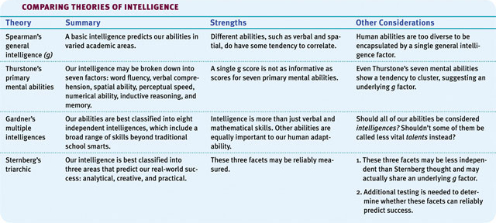
Theories: Comparison

Slide 29
Robert Sternberg
Analytic intelligence— mental processes used in learning how to solve problems
Creative intelligence— ability to deal with novel situations by drawing on existing skills and knowledge
Practical intelligence— ability to adapt to the environment (street smarts)

Slide 30
Are There Multiple Intelligences?
Social Intelligence
the know-how involved in comprehending social situations and managing oneself successfully

Slide 31
Emotional Intelligence
Emotional intelligence is the ability to perceive, understand, and use emotions (Salovey and colleagues, 2005). The test of emotional intelligence measures overall emotional intelligence and its four components.
Notes:
OBJECTIVE 4| Describe the four aspects of emotional intelligence, and discuss criticisms of this concept.

Slide 32
Emotional Intelligence: Components
Component | Description
Perceive emotion | Recognize emotions in faces, music and stories
Understand emotion | Predict emotions, how they change and blend
Manage emotion | Express emotions in different situations
Use emotion | Utilize emotions to adapt or be creative

Slide 33
Daniel Goleman’s Theory of Emotional Intelligence
The ability to feel, deal with, and recognize emotions makes up its own kind of intelligence.
Aspects of this theory include:
Emotional self-awareness: knowing what we are feeling and why
Managing and harnessing emotions: knowing how to control and respond to feelings appropriately
Empathy: knowing what another person is feeling

Slide 34
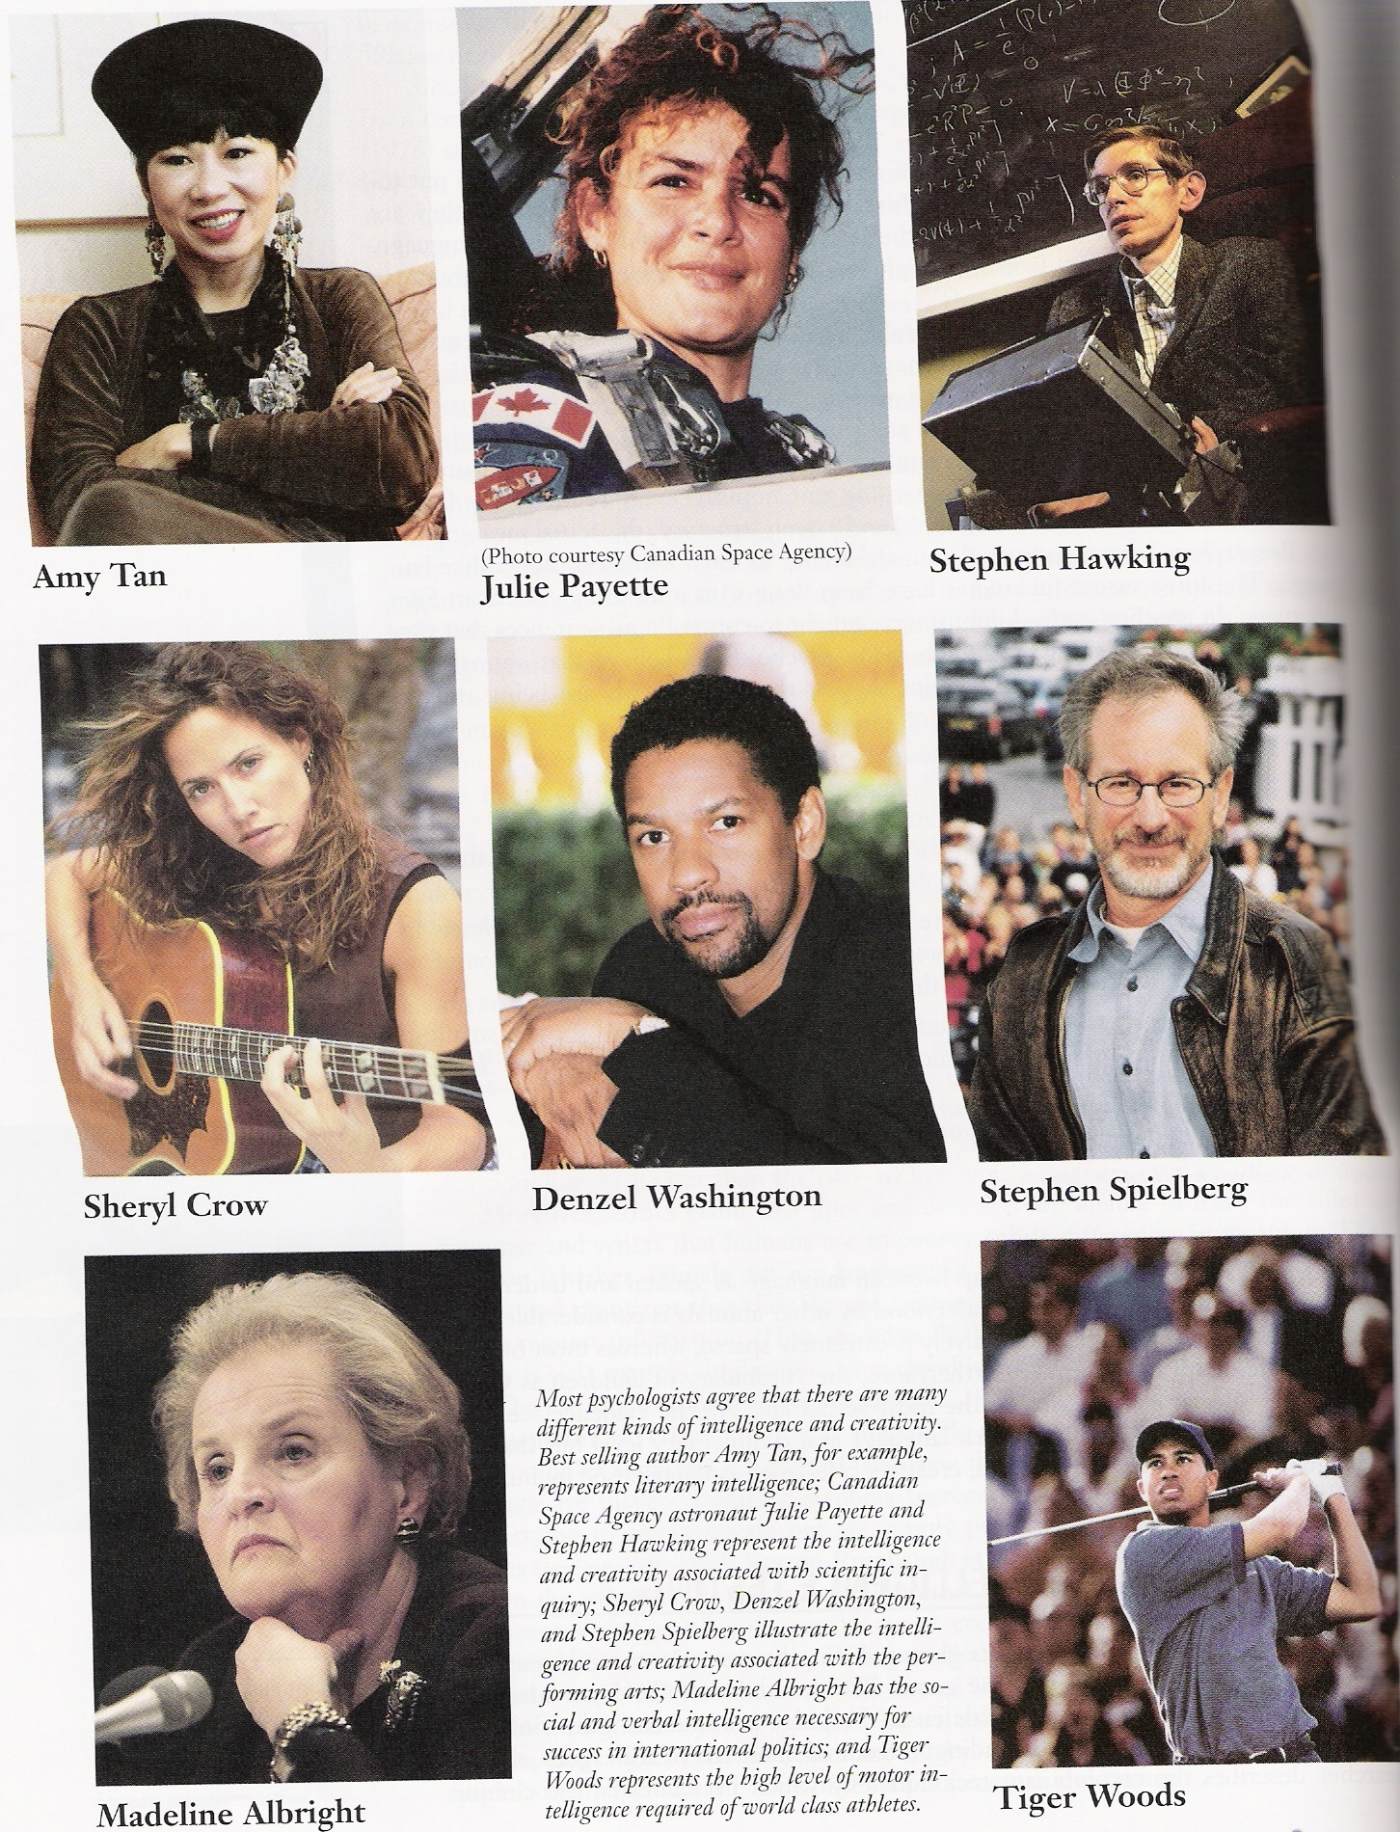

Slide 35
Emotional Intelligence: Criticism
Gardner and others criticize the idea of emotional intelligence and question whether we stretch this idea of intelligence too far when we apply it to our emotions.

Slide 36
Intelligence and Creativity
Creativity is the ability to produce ideas that are both novel and valuable. It correlates somewhat with intelligence.
Expertise: A well-developed knowledge base.
Imaginative Thinking: The ability to see things in novel ways.
Adventuresome Personality: A personality that seeks new experiences rather than following the pack.
Intrinsic Motivation: A motivation to be creative from within.
A Creative Environment: A creative and supportive environment allows creativity to bloom.
Notes:
OBJECTIVE 5| Identify the factors associated with creativity, and describe the relationship between creativity and intelligence.

Slide 37
Is Intelligence Neurologically Measurable?
There is a positive correlation between intelligence and the brain’s neural processing speed. College students with unusually high levels of verbal intelligence are most likely to retrieve information from memory at an unusually rapid speed.

Slide 38
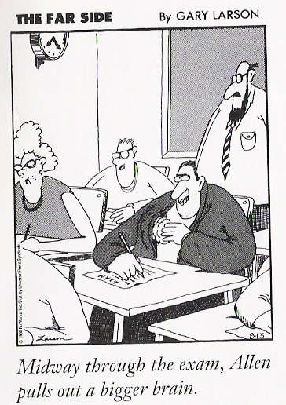
Brain Size and Complexity
There is a slight correlation
between head size
(relative to body size)
and intelligence score.

Slide 39
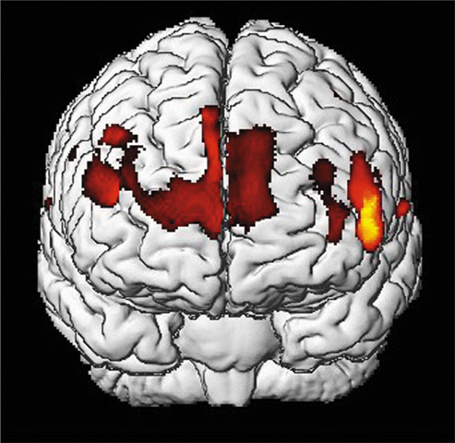
Is Intelligence Neurologically Measurable?
Recent Studies indicate some correlation (about +.40) between brain size and intelligence. As brain size decreases with age, scores on verbal intelligence tests also decrease.
Gray matter concentration in people with high intelligence.
Notes:
OBJECTIVE 6| Describe the relationship between intelligence and brain anatomy.

Slide 40
Brain Function
Studies of brain functions show that people who score high on intelligence tests perceive stimuli faster, retrieve information from memory quicker, and show faster brain response times.
People with higher intelligence respond correctly and quickly to
the above question.
Notes:
OBJECTIVE 7| Discuss the findings on the correlations between perceptual speed, neural processing speed, and intelligence.

Slide 41
Processing Speed
Earl Hunt found that verbal intelligence scores are predictable from the speed with which people retrieve information from memory.

Slide 42
Perceptual Speed
The correlation between intelligence score and the speed of taking in perceptual information tends to be about +.4 to +.5. Those who perceive quickly tend to score somewhat higher on intelligence tests, particularly tests based on perceptual rather than verbal problem solving.

Slide 43
Neurological Speed
Repeated studies have found that highly intelligent people’s brain waves register a simple stimulus more quickly and with greater complexity.
(New testing being done)

Slide 44
Aptitude and Achievement Tests
Aptitude tests are intended to predict your ability to learn a new skill and achievement tests are intended to reflect what you have already learned.
Notes:
OBJECTIVE 9| Distinguish between aptitude and achievement tests, and describe the modern test of mental abilities, such as the WAIS.

Slide 45
David Wechsler
Wechsler developed the Wechsler Adult Intelligence Scale (WAIS) and later the Wechsler Intelligence Scale for Children (WISC), an intelligence test for preschoolers.

Slide 46
WAIS
WAIS measures overall intelligence and 11 other aspects related to intelligence that are designed to assess clinical and educational problems.

Slide 47
Modern Intelligence Tests
Wechsler Adult Intelligence Scale (WAIS)
most widely used intelligence test -- used more widely now than Stanford-Binet
subtests
verbal
performance (nonverbal)
modeled after Binet’s, also made adult test
WISC-III for children
WAIS-III for adults

Slide 48
Principles of Test Construction
For a psychological test to be acceptable it must fulfill the following three criteria:
Standardization
Reliability
Validity

Slide 49
Standardization
Standardizing a test involves administering the test to a representative sample of future test takers in order to establish a basis for meaningful comparison.
Notes:
OBJECTIVE 10| Discuss the importance of standardizing psychological tests, and describe the distribution of scores in a normal curve.

Slide 50
Normal Curve
Standardized tests establish a normal distribution of scores on a tested population in a bell-shaped pattern called the normal curve.

Slide 51
Flynn Effect
In the past 60 years, intelligence scores have risen steadily by an average of 27 points. This phenomenon is known as the Flynn effect.

Slide 52
Reliability
A test is reliable when it yields consistent results. To establish reliability researchers establish different procedures:
Split-half Reliability: Dividing the test into two equal halves and assessing how consistent the scores are.
Reliability using different tests: Using different forms of the test to measure consistency between them.
Test-Retest Reliability: Using the same test on two occasions to measure consistency.
Notes:
OBJECTIVE 11| Explain what it means to say that a test is reliable.

Slide 53
Validity
Reliability of a test does not ensure validity. Validity of a test refers to what the test is supposed to measure or predict.
1. Content Validity: Refers to the extent a test measures a particular behavior or trait.
(driving test that samples driving tasks)
2. Predictive Validity: Refers to the function of a test in predicting a particular behavior or trait( also called criterion-related validity)
3. Criterion Validity--behavior (such as college grades) that a test (such as the SAT) is designed to predict
Notes:
OBJECTIVE 12| Explain what it means to say that a test is valid, and describe two types of validity.

Slide 54
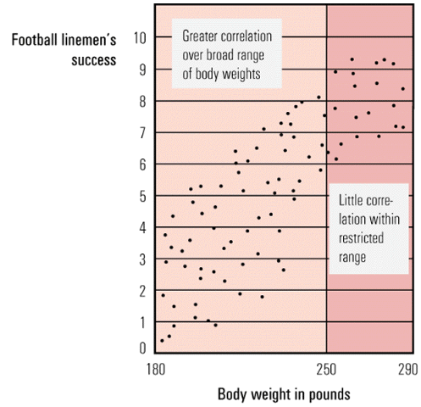
Assessing Intelligence
Football linemen’s
success
10
9
8
7
6
5
4
3
2
1
0
Greater correlation
over broad range
of body weights
As the range of data under consideration narrows, its predictive power diminishes
Little corre-
lation within
restricted
range
180 250 290
Body weight in pounds

Slide 55
The Dynamics of Intelligence
Does intelligence remain stable over a lifetime or does it change? Are individuals on the two extremes of the intelligence scale really that different?

Slide 56
Stability or Change?
Intelligence scores become stable after about seven years of age. In numerous studies, stability of intelligence scores have been determined (Angoff, 1988; Deary et al., 2004).
Notes:
OBJECTIVE 13| Describe the stability of intelligence scores over the life span.

Slide 57
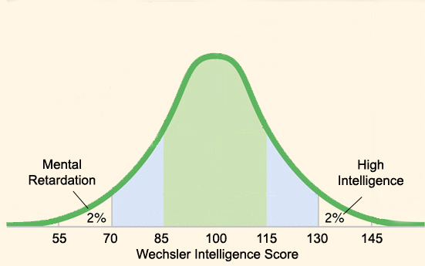
Extremes of Intelligence
A valid intelligence test divides two groups of people into two extremes: the mentally retarded (IQ 70) and individuals with high intelligence (IQ 135). These two groups are significantly different.
Notes:
OBJECTIVE 14| Discuss the two extremes of the normal distribution of intelligence.

Slide 58
The Dynamics of Intelligence
Mental Retardation
a condition of limited mental ability
indicated by an intelligence score below 70
produces difficulty in adapting to the demands of life
varies from mild to profound
Down Syndrome
retardation and associated physical disorders caused by an extra chromosome in one’s genetic makeup

Slide 59
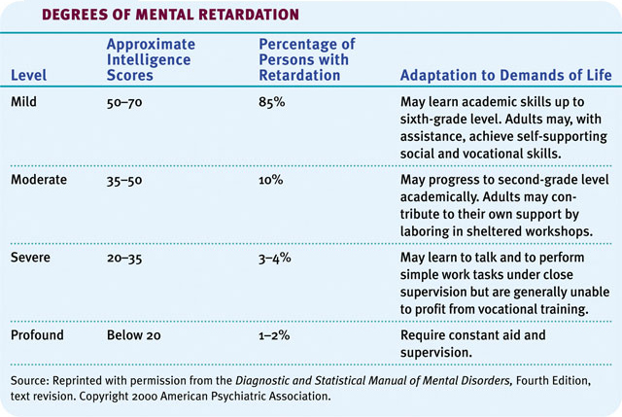
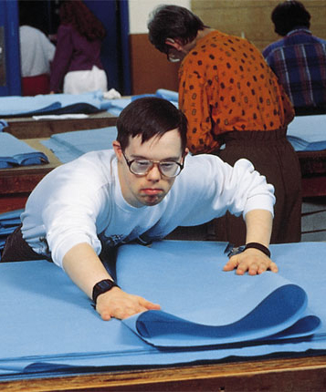
Mental Retardation
Mentally retarded individuals required constant supervision a few decades ago, but with a supportive family environment and special education they can now care for themselves.

Slide 60
High Intelligence
Contrary to popular belief, people with high intelligence test scores tend to be healthy, well adjusted, and unusually successful academically.

Slide 61
Genetic and Environmental Influences on Intelligence
No other topic in psychology is so passionately followed as the one that asks the question, “Is intelligence due to genetics or environment?”

Slide 62
Genetic Influences
Studies of twins, family members, and adopted children together support the idea that there is a significant genetic contribution to intelligence.
Notes:
OBJECTIVE 15| Discuss the evidence for the genetic contribution to individual intelligence, and explain what psychologists mean by the heritability of intelligence.

Slide 63
Adoption Studies
Adopted children show a marginal correlation in verbal ability to their adopted parents.

Slide 64
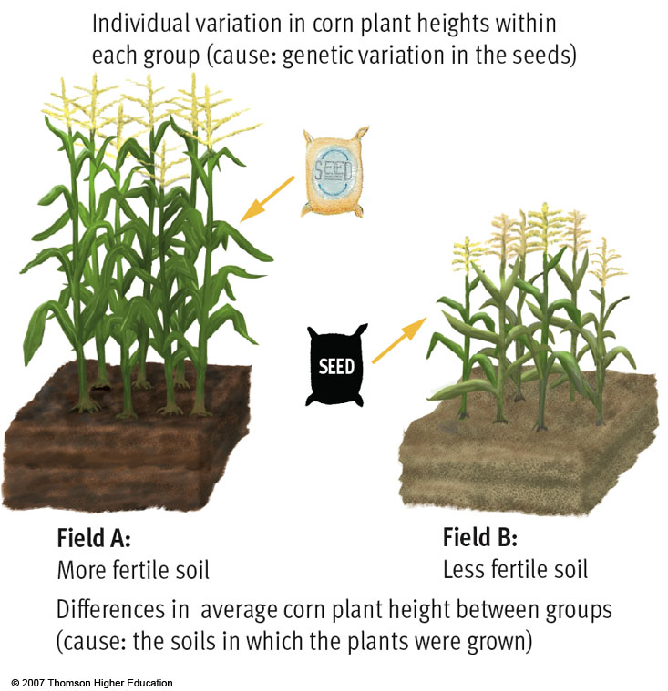
Environmental Effects
Differences in
intelligence
among these groups
are largely environmental,
as if one environment is
more fertile in developing
these abilities than
another
(Heritability).

Slide 65
Within and Between Group Differences
Each corn field planted from same package of genetically diverse seeds
One field is quite fertile, the other is not
Within each field, differences due to genetics
Between each field, differences due to environment (fertility)

Slide 66
Early Intervention Effects
Early neglect from caregivers leads children to develop a lack of personal control over the environment, and it impoverishes their intelligence.
Romanian orphans with minimal
human interaction are delayed in their development.

Slide 67
Environmental Influences
Early Intervention Effects
If children are disadvantaged, malnutritioned, sensory deprived, or socially isolated, early intervention with responsive caregiving can help. However, if you are trying to give your baby extra instruction to create a “superbaby”, you are most likely wasting your time.

Slide 68
Schooling Effects
Schooling is an experience that pays dividends, which is reflected in intelligence scores. Increased schooling correlates with higher intelligence scores. Research indicates that Head Start programs are most beneficial to participants from disadvantaged home environments.
To increase readiness for schoolwork,
projects like Head Start facilitate leaning.

Slide 69
Group Differences in Intelligence Test Scores
Why do groups differ in intelligence?
How can we make sense of these differences?

Slide 70
Ethnic Similarities and Differences
To discuss this issue we begin with two disturbing but agreed upon facts:
Racial groups differ in their average intelligence scores.
High-scoring people (and groups) are more likely to attain high levels of education and income.
Notes:
OBJECTIVE 17| Describe ethnic similarities and differences in intelligence test scores, and discuss some genetic and environmental factors that might explain them.

Slide 71
Racial (Group) Differences
If we look at racial differences, white Americans score higher in average intelligence than black Americans (Avery and others, 1994). European New Zealanders score higher than native New Zealanders (Braden, 1994).
White-Americans | Black-Americans
Average IQ = 100 | Average IQ = 85
Hispanic Americans

Slide 72
Other Influences on IQ Scores
Cross cultural studies show that average IQ of groups subject to social discrimination are often lower than socially dominant group even if there is no racial difference
Tests reflect the culture in which they are developed; cultural factors also influence test taking behavior (culture bias)

Slide 73
Issues in Intelligence Testing
Individual vs. group testing: Group I.Q. testing can give fairly accurate results, but relies on verbal testing only.
The average range of error in I.Q. scores is about seven points.
The Supreme Court has ruled that I.Q. test results cannot determine placement of children in schools.
Cultural bias in the creation of test questions may discriminate against minority populations.

Slide 74
Reasons Why Environment Affects Intelligence
Races are remarkably alike genetically.
Race is a social category.
Asian students outperform North American students on math achievement and aptitude tests.
Today’s better prepared populations would outperform populations of the 1930s on intelligence tests.
White and black infants tend to score equally well on tests predicting future intelligence.
Different ethnic groups have experienced periods of remarkable achievement in different eras.

Slide 75
Gender Similarities and Differences
There are seven ways in which males and females differ in various abilities.
1. Girls are better spellers
2. Girls are verbally fluent and have large vocabularies
3. Girls are better at locating objects
4. Girls are more sensitive to touch, taste, and color
5. Boys outnumber girls in counts of underachievement
6. Boys outperform girls at math problem solving, but under perform at math computation
7. Women detect emotions more easily than men do
Notes:
OBJECTIVE 18| Describe gender differences in abilities.

Slide 76
Gender Differences
Three people were hiking through a forest when they came upon a large, raging violent river.
Needing to get on the other side, the first man prayed, "God, please give me the strength to cross the river."
Poof! God gave him big arms and strong legs and he was able to swim across in about 2 hours, having almost drowned twice.
After witnessing that, the second man prayed, "God, please give me strength and the tools to cross the river."
Poof! God gave him a rowboat and strong arms and strong legs and he was able to row across in about an hour after almost capsizing once.
Seeing what happened to the first two men, the third man prayed, "God, please give me the strength, the tools and the intelligence to cross river."
Poof! He was turned into a woman. She checked the map, hiked one hundred yards up stream and walked across the bridge.

Slide 77
Group Differences
Math & Spatial Aptitudes
In math grades, the average girl typically equals or surpasses the average boy. And on math tests given to 3 million people, males and females obtained nearly identical scores. Although females have an edge in math computation, males in various cultures score high in math problem solving. Traditionally, math and science have been considered masculine subjects. Females are pushed more toward English.

Slide 78
Group Differences
Emotional-Detecting Ability
Women are better at detecting emotions than men.

Slide 79
The Question of Bias
Aptitude tests are necessarily biased in the sense that they are sensitive to performance differences caused by cultural differences.
However, aptitude tests are not biased in the sense that they accurately predict performance of one group over the other.
Notes:
OBJECTIVE 19| Discuss whether intelligence test are biased, and describe the stereotype threat phenomenon.

Slide 80
The Chitling Test
1. A “hankerchief head” is
a. a cool eat
b. a porter
c. an Uncle Tom
d. a hoddi
e. a preacher
2. Which word is most out of place here?
a. slib.
b. blood.
c. gray.
d. spook.
e. black.
3. A ”gas head” is a person who has a
a. fast-moving car.
b. stable of “lace.”
c. “process”.
d. habit of stealing cars.
e. long jail record for arson.
4. Bo Diddley is a
a. game for children.
b. down-home cheap wine.
c. down-home singer.
d. new dance.
e. Mojoe call.
5. If a pimp is up tight with a woman who gets state aid, what does he mean when he talks about “Mother’s Day”?
a. second Sunday in May.
b. third Sunday in June.
c. first of every month.
d. none of these.
e. first and fifteenth of every month.
6. T-Bone Walker got famous for playing
a. trombone.
b. piano.
c. T-flute.
d. guitar.
e. ham-bone.

Slide 81
Stereotype Threat
A stereotype threat is a self-confirming concern that one will be evaluated based on a negative stereotype.
This phenomenon appears in some instances in intelligence testing among African-Americans and among women of all colors.
Notes:
OBJECTIVE 19| Discuss whether intelligence test are biased, and describe the stereotype threat phenomenon.

