Slide 1
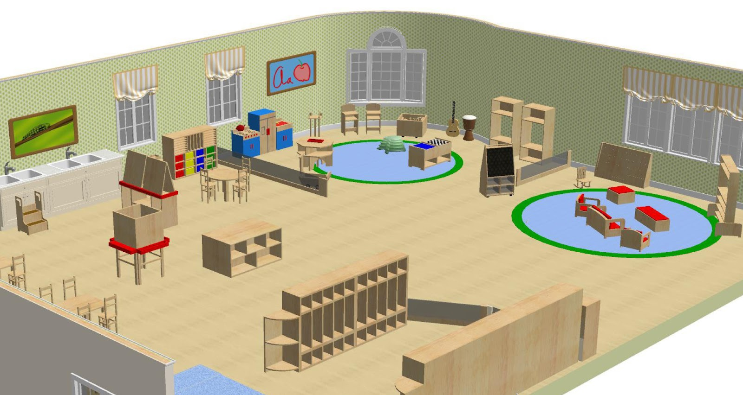
The Preschool Classroom

Slide 2
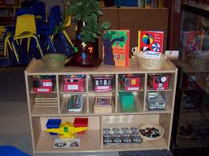
Learning Centers
Block center, language center, art center, dramatic play center, small motor/sensory center, large open space for circle time activities.
Centers should be separated by shelves, tape, or colored carpet to show where one area stops and the next begins.
You may set restrictions such as only 3 children can be in the block area at once
Separate noisy centers from quiet centers.

Slide 3
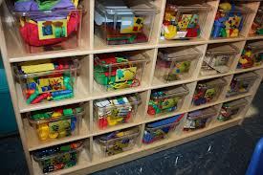
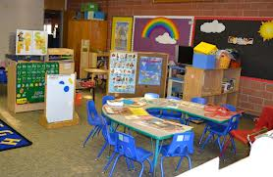
Child Size
All furniture and shelving should be child sized
Children should be able to sit in a chair and have their feet touch the ground.
Shelves that hold all materials should be able to easily be reached by the child.
This allows kids to choose their own activities and to clean up after themselves.
Promotes independence.
Adults should sit in child sized furniture when working with kids.
Shows kids that you are working with them and not just telling them what to do.

Slide 4
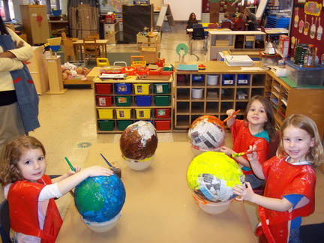
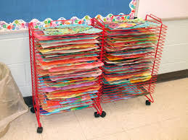
Art Center
Creative Development
Should have:
Paint, paper, chalk, crayons, pencils, glue, glitter, hard pasta, coffee filters, egg cartons, etc…
Child sized tables and chairs
Floor should not be carpet (needs to be able to be easily cleaned and can get wet)
Needs to be near a sink
Needs storage for supplies that only teacher can get to (locked or high)
Needs place for smocks
Needs place for finished products to dry
Number of children should be limited by number of chairs

Slide 5
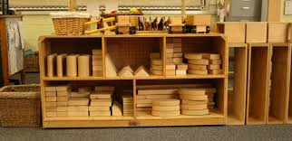
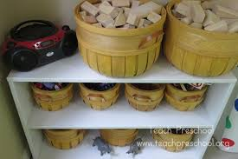
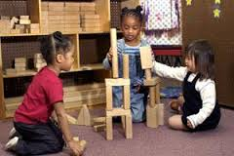
Block Center
Small Motor Skills, Intellectual Development
Should be carpeted
Open space to work with blocks
Blocks need to be easily accessible on a shelf
Blocks need to be organized by size and/or shape
Blocks can be wooden or soft. Should be different sizes and shapes so they can build many things.

Slide 6
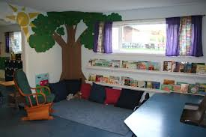
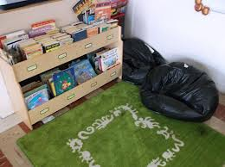
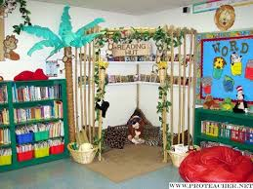
Language Center
Intellectual Development
Books, soft places to sit (kid couches or chairs, bean bags, giant stuffed animals)
Needs to be in a quiet corner of the room so children can read
Can have books on CD’s with headphones
Need variety of books at different levels
Change books often

Slide 7
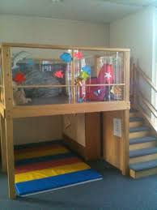
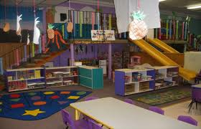
Dramatic Play Center
Emotional Development
Needs to change weekly
Needs to go with the weekly theme
Birthday party, post office, camping, grocery store, school, house, fire department…)
Can get noisy so keep separate from quiet areas

Slide 8
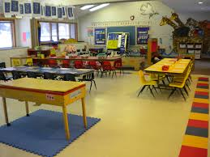
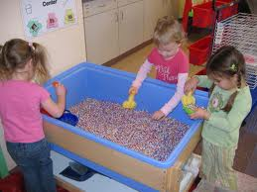
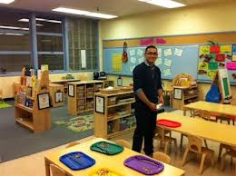
Small Motor/Sensory Center
Small Motor Development
Sensory Development
Table activities
Child sized tables and chairs
Tables should have different small motor or sensory activities each day.
Playdough with cookie cutters, lacing beads on strings, puzzles, building with popsicle sticks, cotton balls and tongs.
Should have a couple of tables with different activities on them daily
Teacher decides before children arrive what will be on each table and sets it up
Number of children should be limited by number of chairs at each table.
Sensory table (big tub) should be up daily with themed items in it
Sand and shells, farm animals and hay, dirt and tractors, water and boats
Stand up at the table

Slide 9
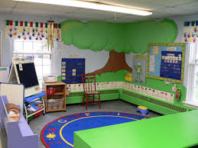
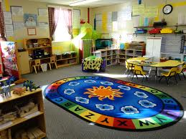
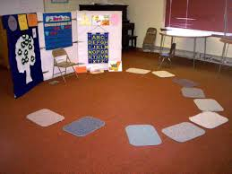
Circle Time
Need a designated area in the classroom.
Spots for each child (letter/color rug, squares, carpets).
Will include calendar, daily jobs, etc.

Slide 10
