Slide 1
Anatomy, physiology, and Disease
Ch. 9: The Nervous System:
The Body's Control Center

Slide 2
Basic Operations
Central Nervous System (CNS): Brain and spinal cord; controls total nervous system
Peripheral Nervous System (PNS): Everything outside brain and spinal cord, ie. nerves and neurons
Sensory System: input side of nervous system
Motor System: output side of nervous system

Slide 3
Basic Operations (cont.)
Somatic Nervous System: controls skeletal muscle and mostly voluntary movements
Autonomic Nervous System: controls smooth muscle, cardiac muscle, and several glands
Autonomic system is divided into 2 systems: Parasympathetic system- deals with normal body functioning and maintenance of homeostasis
Sympathetic nervous system controls “fight or flight” response system

Slide 4
Organization of the Nervous System

Slide 5
Nervous Tissue
Specialized cells called neuroglia, or glial cells, perform specialized functions
CNS has four types of glial cells:
Astrocytes: metabolic and structural support cells
Microglia: remove debris
Ependymal cells: cover and line cavities of nervous system
Oligodendrocytes: make lipid insulation called myelin

Slide 6
Specialized Cells (cont.)
PNS has two types of glial cells:
Schwann cells: make myelin for the PNS
Satellite cells: support cells

Slide 7
Glial cells and their functions.

Slide 8
Neurons
All control functions of nervous system carried out by group of cells called neurons
Each part of neuron has specific function:
Body: cell metabolism
Dendrites: receive information from the environment
Axon: generates and sends signals to other cells
Axon terminal: where signal leaves cell
Synapse: where axon terminal and receiving cell combine

Slide 9
Neuron connecting to skeletal muscle.

Slide 10
Neurons (cont.)
Neurons are classified by how they look (structure) or what they do (function)
Input neurons = sensory neurons
Output neurons = motor neurons
Neurons which carry information between neurons are called interneurons

Slide 11
How Neurons Work
Neurons are called excitable cells that can carry a small electrical charge
Each time charged particles flow across cell membrane, a tiny charge is generated
All 3 muscle types and gland cells are excitable cells
Cells are able to generate tiny currents by changing permeability of their membranes

Slide 12
How Neurons Work (cont.)
An unstimulated cell= a resting cell; it is said to be polarized; it is more negative inside than outside the cell
When stimulated, sodium gates in cell membrane open, allowing sodium to travel across membrane
Sodium (Na+) is positively charged, so cell becomes more positive as they enter

Slide 13
How Neurons Work (cont.)
A more positive cell = depolarized
Sodium gates close and potassium gates open; potassium (K+) leaves cell, taking its positive charge with it
This is called repolarization
Action potential (AP) = cell moving through depolarization, repolarization, and hyperpolarization
Cell cannot accept another stimulus until it returns to its resting state; this is called refractory period

Slide 14
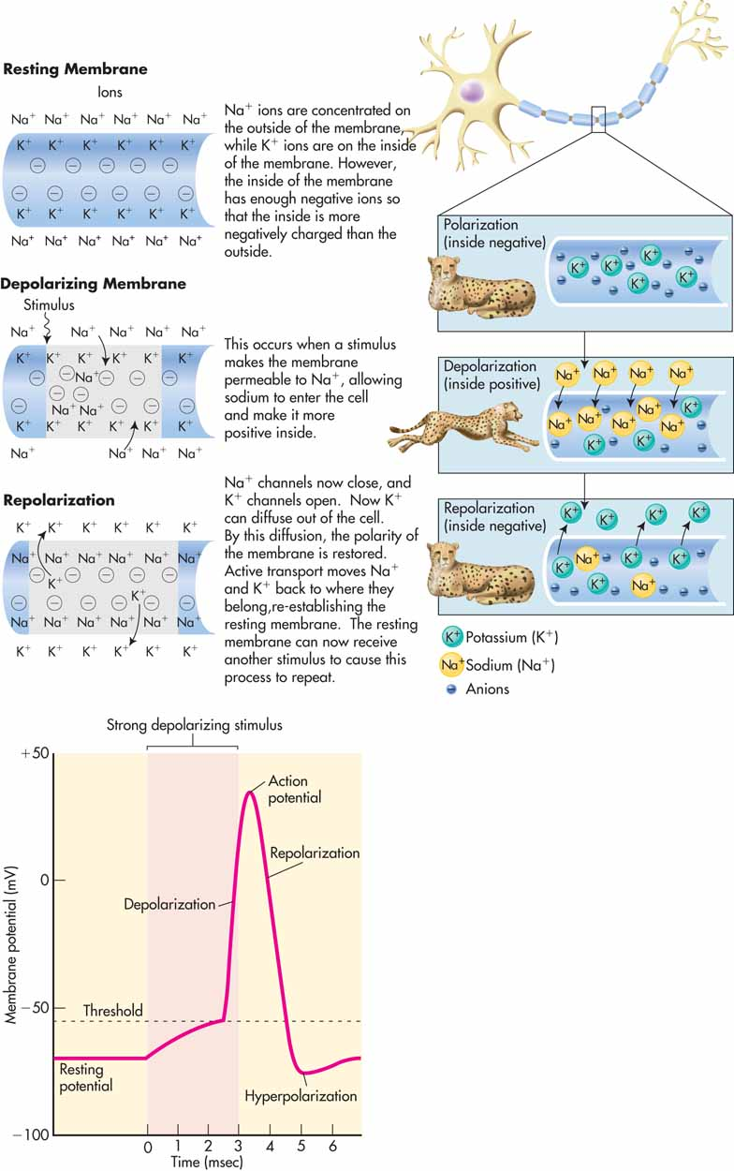

Slide 15
How Neurons Work (cont.)
Neurons can send, receive, and interpret signals
Ex. You hit your thumb with a hammer
Dendrites are stimulated
Na+gates open
Na+ flows into dendrites and cell becomes depolarized
# of cells affected depends on how hard you hit your thumb

Slide 16
How Neurons Work (cont.)
Dendrites carry depolarization to sensory neuron cell body
Speed of impulse conduction is determined by amount of myelin and diameter of axon
Myelinated nerves are white
Unmyelinated nerves are gray

Slide 17
How Neurons Work (cont.)
Myelin is essential for speedy flow of AP’s down axons
Unmyelinated axon: impulse travels slower
Myelinated axons: impulse travels quickly

Slide 18
Pathology Connection: Myelin Disorders
Multiple Sclerosis (MS): disorder where myelin in CNS is destroyed
Less myelin= slow or no impulse conduction
Damaged myelin often have plaques or scarred areas
Etiology: probably auto-immune attack
S/S: vary depending on where patient’s myelin has been damaged; include disturbances in vision, balance, speech, and movement

Slide 19
Multiple Sclerosis (cont.)
Epidemiology: more common in women; diagnosed most often in people under age 50
DX: based upon hx of s/s flare-ups, and presence of plaques on MRI; no definitive diagnosis
TX: no cure; TX used to slow progression and control symptoms in acute flare: steroids, plasma exchange, or IV immunoglobulin G; immunosuppressant drugs.

Slide 20
Types of MS
Relapsing-remitting: has symptomatic flare-ups (called relapses), followed by periods of no symptoms (called remissions)
Chronic progressive: has no remission periods; patients become steadily more disabled
Most patients initially diagnosed with relapsing-remitting, but at least 50% will progress to chronic progressive form

Slide 21
MS Animation

Slide 22
Guillain-Barré Syndrome
Etiology: unknown, may be from viral infection; autoimmune attack on myelin and/or axons in PNS.
S/S: weakness and ascending paralysis of limbs, face and diaphragm
DX: based hx of ascending paralysis after viral infection: Electromyography (EMG ) and Cerebral Spinal fluid (CSF) shows high protein and no WBC
TX: supportive care until symptoms improve/resolve; ventilation support, prevention of blood clots and bed sores, pain meds; PT after their PNS recovers

Slide 23
Guillain-Barré Syndrome (cont.)
Course of disease has three phases
Acute phase: initial onset of disease; pt becomes steadily worse
Plateau phase: period of days to weeks; pt condition is stable
Recovery phase: period of time that pt recovers function; can take up to 2 years and may not recover fully

Slide 24
How Synapses Work
When AP arrives at axon terminal, terminal depolarizes, Calcium (Ca+) gates open; Ca+ flows into cell
Tiny sacs in terminal called vesicles release their contents from cell when calcium flows in
Vesicles contain molecules called neurotransmitters that send signals from neuron to neuron
Neurotransmitters can excite the cell or calm it down

Slide 25
Synapses

Slide 26
Neurosynapses Animation

Slide 27
Common Neurotransmitters

Slide 28
Electrical Synapses
Do not need chemicals to transmit info from one cell to another
Called electrical synapses: transfers info freely through connections called gap junctions
Found in intercalated disks between cardiac muscle fibers

Slide 29
Spinal Cord and Spinal Nerves
Hollow tube running inside vertebral column, from foramen magnum to the 2nd lumbar vertebrae
Has 31 segments, each with pair of spinal nerves, named for corresponding vertebrae
Ends at L2 in pointed structure called conus medullaris; hanging from conus medullaris is cauda equine (horses tail), which dangles loosely and floats in bath of cerebral spinal fluid (CSF)
Has 2 widened areas, cervical and lumbar enlargements; contain neurons for upper and lower limbs

Slide 30
Spinal Cord

Slide 31
Meninges
Protective covering of brain and spinal cord
Act as cushioning and shock absorbers
3 layers
Outer layer is thick fibrous tissue called dura mater
Middle layer is delicate, resembles spider web= arachnoid mater, composed of collagen and elastic fibers, acts as shock absorber, transports gases, nutrients, chemical messengers and waste products
Innermost layer, fused to neural tissue= pia mater, contain blood vessels that serve brain and spinal cord

Slide 32
Meninges
Spaces associated with meninges
Between dura mater and vertebral column= space filled with fat and blood vessels called epidural space
Between dura mater and arachnoid mater = subdural space filled with tiny bit of fluid
Between arachnoid mater and pia mater = large subarachnoid space filled with CSF that acts as fluid cushion

Slide 33
Meninges

Slide 34
Epidural Placement Video

Slide 35
Spinal Cord
Divided in half by anterior median fissure and posterior median sulcus
Interior of spinal cord is then divided into:
sections of white matter columns and gray matter horns
Types of horns (regions where neuron’s cell bodies reside)
Dorsal horn: involved in sensory functions
Ventral horn: involved in motor function
Lateral horn: dealing with autonomic functions

Slide 36
Spinal Cord (cont.)
Columns: areas of white matter (which contain axons running up and down spinal cord, to and from brain)
Ascending pathways: carry sensory info up to brain
Descending pathways: carry motor information down from brain
Left and rt. halves of spinal cord connected by commissures (gray and white); allows two sides of CNS to communicate
Center of spinal cord is CSF-filled cavity called central canal

Slide 37
Spinal Cord (cont.)
Spinal roots project from both sides of spinal cord in pairs; fuse to form spinal nerves
Dorsal root: collection of sensory neurons that carry sensory information
Ventral root is motor

Slide 38
Spinal Cord

Slide 39
Pathology Connection: Polio
Paralysis caused by poliomyelitis virus
Epidemiology: common prior to large-scale vaccinations in the 1950s; now rare
S/S
99% of patients have mild upper resp. or digestive illness for a few days
1% of patients develop paralytic form; virus kills motor neurons in ventral horn of spinal cord; cell death = paralysis; sensory neurons unaffected = sensation remains

Slide 40
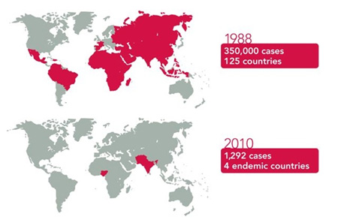
Polio (cont.)
RX
No cure; if pt. survives, needs extensive rehab. (PT)
25% of patients with paralytic polio suffer permanent disability

Slide 41
Polio

Slide 42
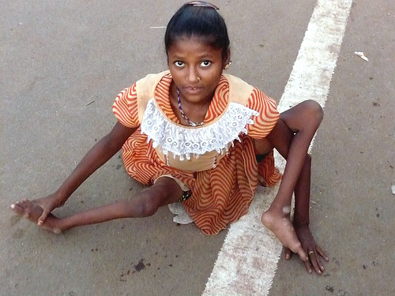
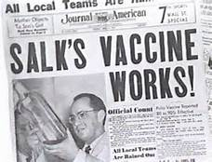
Polio

Slide 43
Post-Polio Syndrome
Post-polio syndrome (PPS): progressive weakness that appears several decades after polio infection
Affects 25-40% of patients with paralytic polio
Cause may be related to damage left by polio virus
Areas of spinal cord damaged by original infection, neurons are destroyed
Patients recover function by using few surviving motor neurons to power all muscles
Surviving neurons are overworked and begin to die themselves

Slide 44
Post-Polio Syndrome (cont.)
DX: rule out other causes of progressive muscle weakness in polio survivors
RX:
Unable to stop progression
Exercise can improve muscle function in some patients

Slide 45
Spinal Nerves
Part of PNS
Consist of bundles of axon, blood vessels, and connective tissue
Run between CNS and organs or tissues, carrying information into and out of CNS
Connected to spinal cord; named for spinal cord segment where they are attached
Carry both sensory and motor info

Slide 46
Spinal Nerves (cont.)
Nerves from thoracic spinal column project to thoracic body wall without branching
All other nerves branch extensively; are called plexuses

Slide 47
Spinal Cord Plexuses

Slide 48
Reflexes
Simplest form of motor output you can make
Protective, keeping you from harm
Involuntary
Can occur without brain being involved, involving only spinal cord

Slide 49
Reflex Animation

Slide 50
Pathology Connection: Peripheral Neuropathy
Caused by damage to peripheral nerves
S/S
Because peripheral nerves are involved in sensory, motor, and autonomic functions, s/s can vary
Muscle weakness, decreased reflexes, numbness, tingling, paralysis, pain, difficulty controlling blood pressure, abnormal sweating, digestive abnormalities
Causes
Trauma

Slide 51
Peripheral Neuropathy (cont.)
Systemic disease
Diabetes (most common systemic cause of peripheral neuropathy)
Kidney disorders
Hormonal imbalance
Alcoholism
Vascular damage
Repetitive stress
Chronic inflammation
Toxins
Tumors

Slide 52
Peripheral Neuropathy (cont.)
Infection & autoimmune causes
Shingles
Epstein-Barr virus
Herpes
HIV
Lyme disease
Polio
Genetic: Charcot Marie Tooth

Slide 53
Peripheral Neuropathy (cont.)
DX: hx of s/s
Diagnostic tests: CT, MRI, electromyogram (EMG)
RX: underlying cause is treated; symptoms are managed with meds and therapy

Slide 54
Spinal Cord Injury
Causes
Car accidents
Violence
Falls
Work injuries
Disease
Epidemiology
50% of spinal cord injuries occur in people between ages 16 and 30
Most injuries are in males
10,000 spinal cord injuries occur in U.S. per year

Slide 55
Spinal Cord Injury (cont.)
Types of injury
Severing of spinal cord (partial or complete)
Crushing
Bruising
Expected outcome
Bruises may resolve with time and rehab
Severed or crushed spinal cord usually results in permanent injury

Slide 56
Spinal Cord Injury (cont.)
Mechanism of tissue injury
Initial injury traumatizes spinal cord
Body’s response to injury causes further tissue damage
Spinal cord swells, decreasing its blood flow
Immune system removes and demyelinates some of surviving tissue
Excess neurotransmitter release kills cells
Damaged neurons self-destruct

Slide 57
Spinal Cord Injury (cont.)
S/S
Paralysis and sensory loss below injury
Extent of body affected depends on location of injury
Cervical: pts become quadriplegic (paralyzed in all four limbs); some can have paralysis of diaphragm, and require assistance to breathe (ventilator)
Thoracic and lumbar injuries: pts become paraplegic (paralyzed in legs); if paralysis of abd. muscles may have difficulty coughing or taking deep breaths

Slide 58
Spinal Cord Injury (cont.)
DX
Neurological exam testing sensory and motor function
Imaging studies
MRI
X-ray
CT scan
Myelography (X-ray of spinal cord using dye)

Slide 59
Spinal Cord Injury (cont.)
RX
Acute stage: prevent further damage
Immobilization
Respiration is aided
Low blood pressure or cardiac problems are treated
Steroids to reduce damage caused by inflammation
Stabilize injury using surgical techniques

Slide 60
Spinal Cord Injury (cont.)
After acute stage: treat or prevent long term problems such as:
Respiratory difficulties
Blood pressure abnormalities
Pneumonia
Blood clots
Organ dysfunction
Pressure sores
Pain
Bladder and bowel dysfunction

Slide 61
Spinal Cord Injury (cont.)
Rehab
Extensive rehab can help spinal cord injury patients recover some function
Other aspects of rehab include learning to cope with the injury

Slide 62
Spinal Injury Video

Slide 63
Brain
Main processor and director of nervous system
At top of spinal cord, beginning at level of foramen magnum and filling skull
Divided into several anatomical and functional sections
Brain consists of:
Cerebrum
Cerebellum
Brain stem

Slide 64
Cerebrum
Largest part of brain
Divided into right and left hemispheres by longitudinal fissure and divided from cerebellum by transverse fissure
Surface not smooth; broken by ridges (gyri) and grooves (sulci) collectively known as convolutions
Convolutions increase surface area of brain, so you can pack more brain in smaller space

Slide 65
Cerebrum: Lobes
Lobes named for skull bones that cover them, occur in pairs (one in each hemisphere)
Anterior lobes, separated from the rest of brain by central sulci = frontal lobes; responsible for motor activities, conscious thought, and speech
Posterior to frontal lobes = parietal lobes; involved with body sense perception, primary taste, and speech
Posterior to parietal lobes = occipital lobes, responsible for vision

Slide 66
Lobes (cont.)
Most inferior lobes, separated by lateral sulci = temporal lobes; involved in hearing and integration of emotions
Information coming into brain is contralateral = the right side of body is controlled by left side of cerebral cortex and left side of body is controlled by right side of cerebral cortex

Slide 67
The Brain

Slide 68
Cerebellum
Posterior to cerebrum
Divided into hemispheres by raised ridge called vermis
Surface is convoluted like the cerebrum
Involved in sensory collection, motor coordination, and balance

Slide 70
PET Scan Animation

Slide 71
Brain Stem
Stalk-like structure inferior to, and partially covered by cerebrum
Divided into three sections
Medulla oblongata: continuous with spinal cord, responsible for heartbeat, respirations, and blood vessel diameter
Pons: just superior to medulla oblongata
Midbrain: most superior portion of brain stem and is completely covered by cerebrum

Slide 72
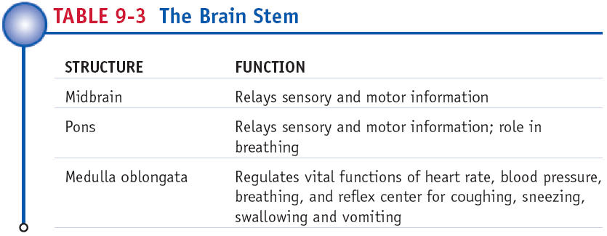

Slide 73
Brain Stem (cont.)
Contains reticular system; responsible for “waking up” cerebral cortex
General anesthesia inhibits reticular system, causing unconsciousness
Injury to reticular system can lead to coma

Slide 74
Brain Stem and Meninges

Slide 75
Brain and Meninges
Covered with protective membranes = meninges
Meninges continuous with spinal cord meninges
Meningitis is infection of meninges; possibly fatal condition; can rapidly spread; affects brain and spinal cord

Slide 76
Pathology Connection: Brain Injury
Traumatic Brain Injury (TBI)
Occurs when force is applied to skull, causing damage to brain tissue
Common causes
Vehicle accidents (most common cause)
Falls
Violence
Sports injuries
Other causes: lack of oxygen to brain, strokes, or hemorrhage

Slide 77
Pathology Connection: Brain Injury (cont.)
Epidemiology
100 cases per 100,000 people in U.S. each year
50% of TBIs involve alcohol
Riskiest ages for TBI are under 5, 15-24 (males), over 75
Types of TBI
Closed: skull is not open
Penetrating: skull is punctured by an object

Slide 78
Brain Injury: Stroke
Stroke (CVA)
Etiology: disruption of blood flow to portion of brain; if oxygen disrupted for long enough, brain tissue will die
S/S: occur suddenly and vary depending on location involved; can include sensory, language, motor, and memory difficulties; can be permanent; unilateral weakness or paralysis, aphasia, slurred speech, confusion, numbness
DX: S/S, CT, MRI
RX: possible surgery, blood thinners (if clot based), PT, OT, ST

Slide 79
Brain Injury: TIA
Transient Ischemic Attack (TIA)
Known as “mini-stroke”
Pts have stroke-like symptoms that are temporary
Can be precursor to major stroke

Slide 80
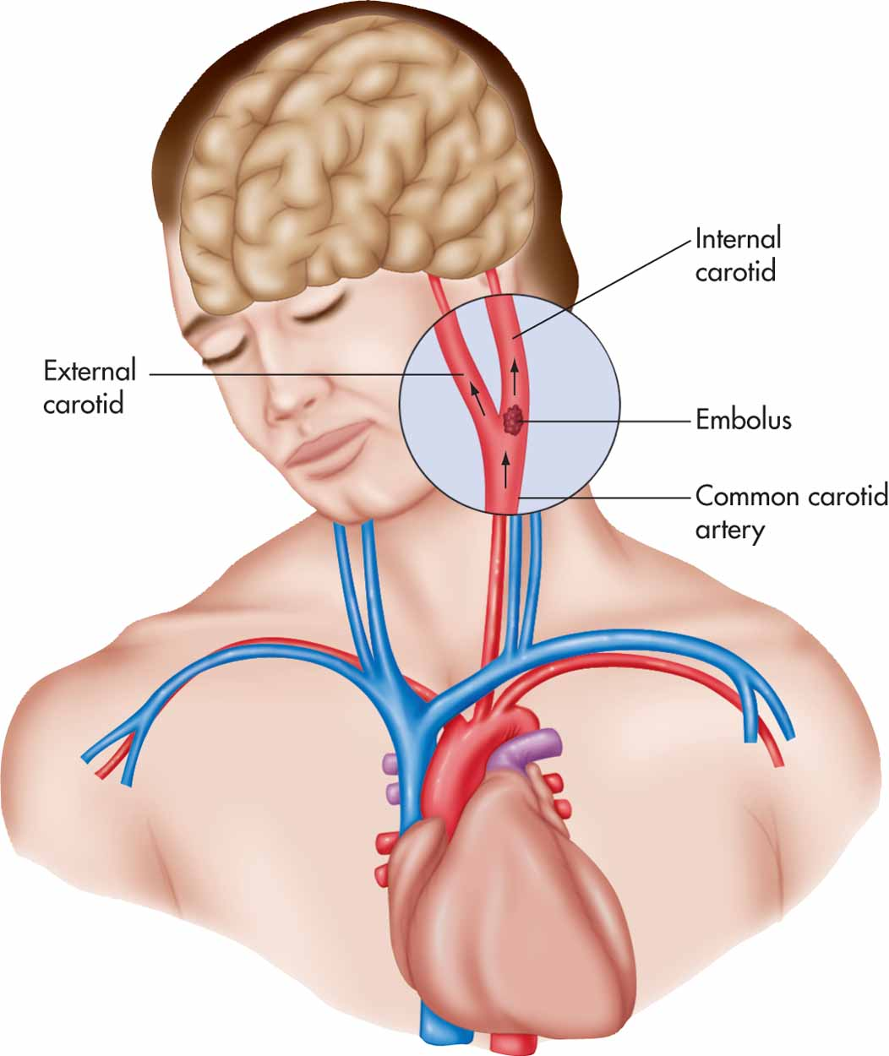
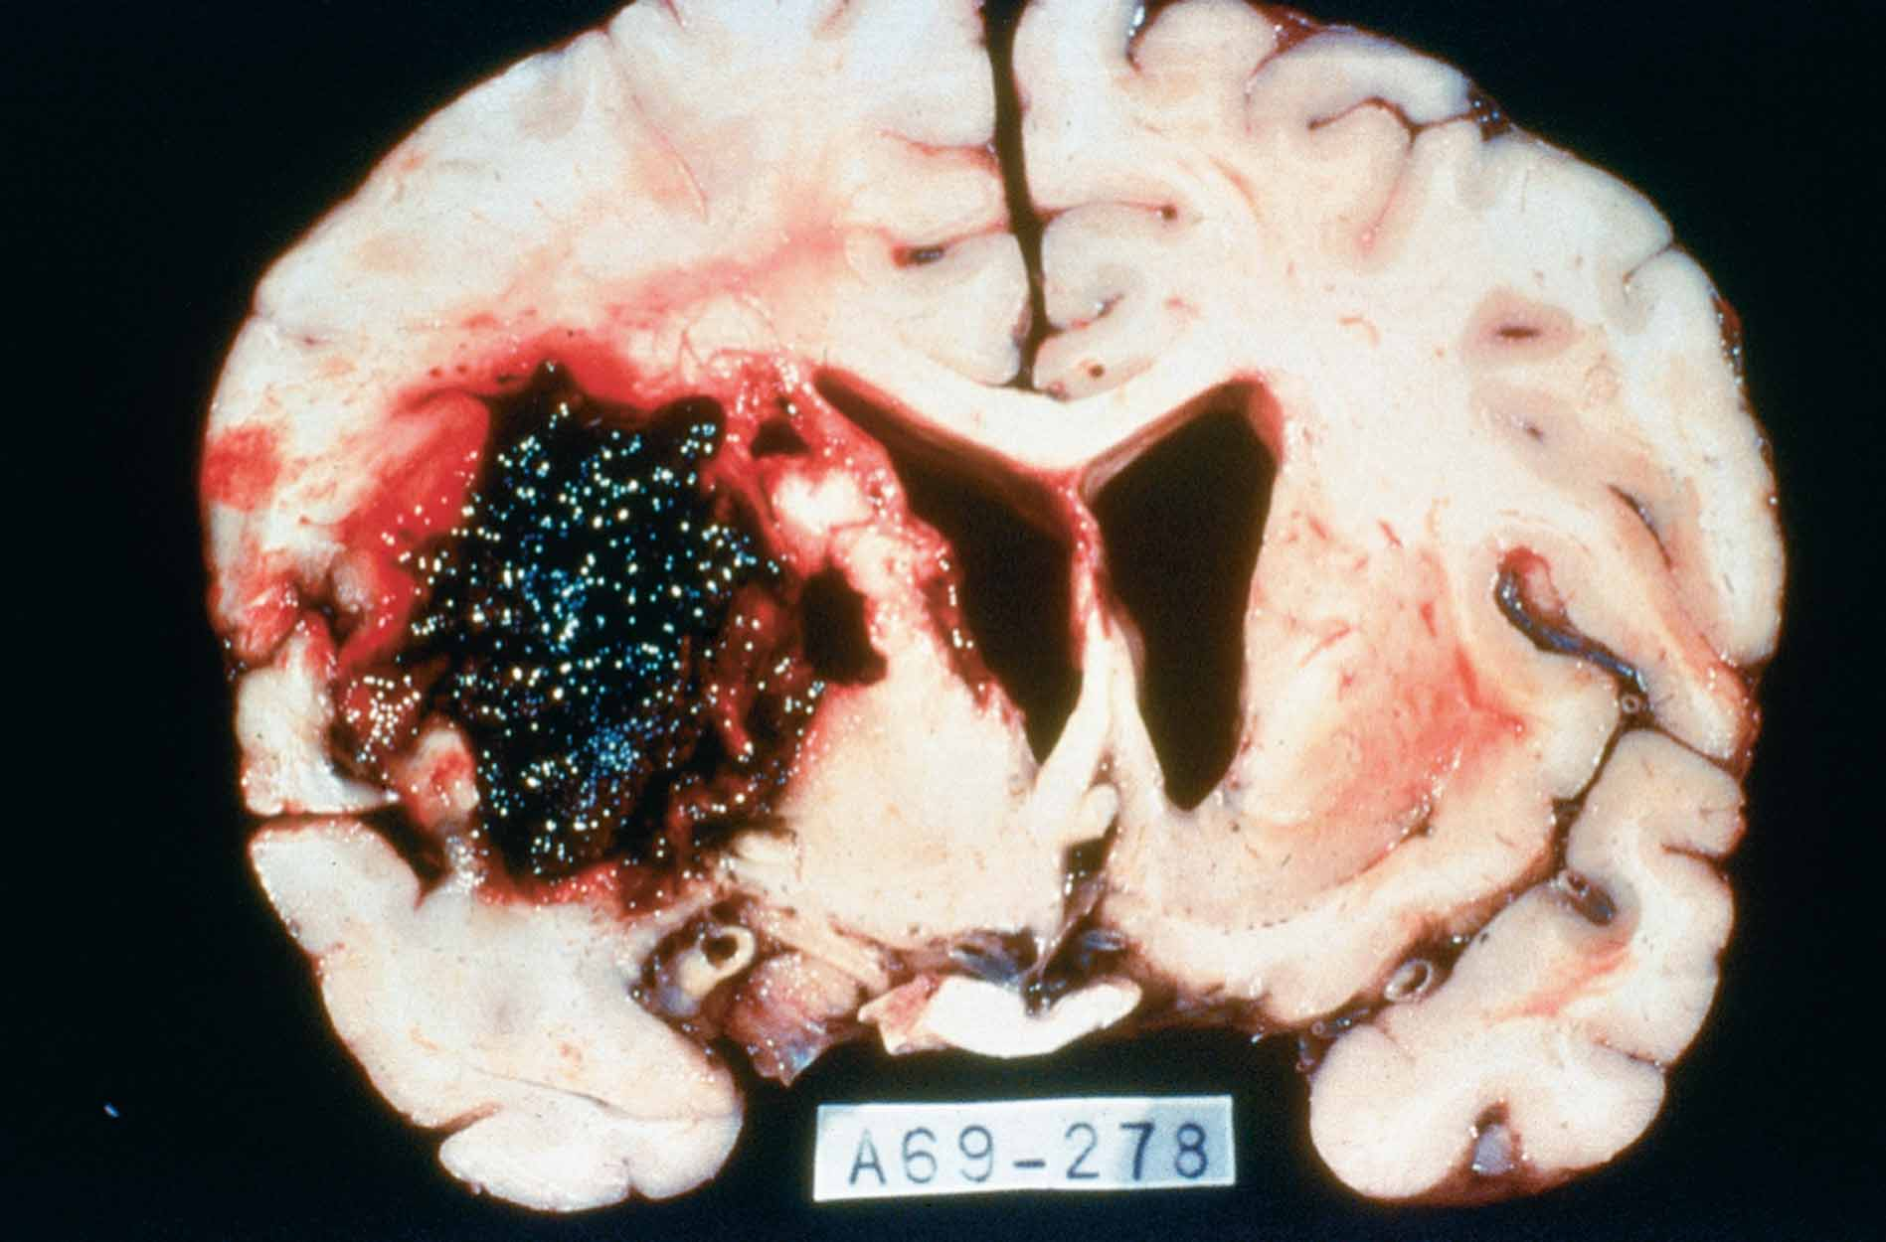
Figure 9-13 (A) Embolus traveling to the brain and (B) cross-section of brain showing cerebrovascular accident (CVA).

Slide 81
Brain Injury: Hematoma
Etiology
Pool of blood between any of layers of meninges and skull
Common locations: epidural (between dura mater and skull), subdural (between dura mater and arachnoid mater) and subarachnoid (in subarachnoid space)
Blow to head can rupture blood vessels in skull, causing them to bleed into space
Stroke or ruptured aneurysm (weak spot in blood vessel inside skull) can cause hematoma

Slide 82
Hematoma (cont.)
DX
Glascow Coma Scale: scale from 3-15 based on patient's ability to open their eyes on command, respond verbally to questions, move limbs when requested; lower number indicates more severe injury
CT, MRI and PET scanning: used to pinpoint location and severity of injury and to monitor its progression

Slide 83
Hematoma (cont.)
RX:
Decrease swelling to prevent further damage
Acute care
Immobilization of head
Stabilization of cardiovascular and respiratory functions
Monitor intracranial pressure
Meds to decrease intracranial pressure
Surgery to remove clots, blood or foreign objects (for example, bullet or bone fragments) from brain

Slide 84
Post-Concussion Syndrome
Occurs several days or weeks after injury in 40% of pts.
S/S: dizziness, headache, memory and concentration problems, irritability, disordered sleep, and anxiety and depression; S/S usually temporary

Slide 85
Glasgow Coma Scale Video

Slide 86
Contracoup Injury Animation

Slide 87
Internal Anatomy of the Brain
Inside of brain has white and gray matter, and hollow cavities containing CSF (cerebral spinal fluid)
White matter surrounded by gray matter
Layer of gray matter surrounding white matter = cortex
In cerebrum = cerebral cortex
In cerebellum = cerebellar cortex

Slide 88
Internal Anatomy of the Brain (cont.)
There are “islands” of grey matter deep inside brain called nuclei
Examples of nuclei
Basal nuclei: motor coordination system
Limbic system: controls emotion, mood, and memory

Slide 89
Internal Anatomy of the Brain (cont.)
Inside of cerebrum reflects external lobes (frontal, parietal, temporal, and occipital) = clearly visible
On either side of central sulcus are two gyri
Precentral gyrus anterior to central sulcus
Postcentral gyrus posterior to central sulcus

Slide 90
Superior View of Brain

Slide 91
Sagittal View of Brain

Slide 92
Superior and Sagittal View of Brain

Slide 93
Internal Anatomy of the Brain (cont.)
Precentral gyrus
Location: frontal lobe
Function: contains primary motor cortex (region that controls body movements)
Each portion controls specific area of body
This creates “map” of body on brain called motor “homunculus” (little man)
Body parts that perform more finely coordinated movements (like hands and lips) require larger area on “map”

Slide 94
Internal Anatomy of the Brain (cont.)
Other frontal lobe structures
Premotor area: plans movements before they occur
Broca’s area: controls movements associated with speech

Slide 95
Primary Motor Cortex and Homunculus

Slide 96
Internal Anatomy of the Brain (cont)
Postcentral gyrus
Location: parietal lobe
Function: contains primary somatosensory cortex (center for processing sensory information)
Each portion gets sensory input from specific area of body
Also creates “map” of body on brain
Size of body parts on “map” is proportional to amount of sensory input provided

Slide 97
Internal Anatomy of the Brain (cont.)
Other areas of parietal lobe
Somatic sensory association area: allows understanding and interpretation of sensory information
Wernicke’s area: controls understanding of speech

Slide 98
Primary Somatic Sensory Area

Slide 99
Internal Anatomy of the Brain (cont.)
Corpus callosum
Collection of white matter that connects left and right hemispheres
Allows for cross-communication between rt. and left sides of brain
Many activities, like walking or driving, require both sides of body, and therefore both sides of brain, to be well coordinated

Slide 100
Internal Anatomy of the Brain (cont.)
Inferior to cerebrum is section of brain not visible from exterior, called diencephalon
Consists of thalamus, hypothalamus, pineal body, and pituitary gland
Glands that interface with endocrine system

Slide 101
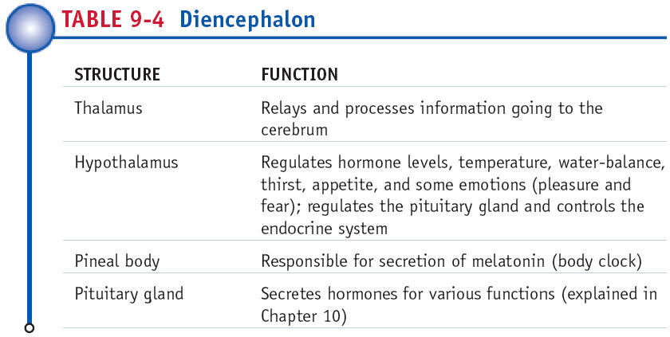

Slide 102
Cerebellum
Has gray matter cortex and white matter center
Fine tunes voluntary skeletal muscle activity and helps in maintenance of balance

Slide 103
Pathology Connection: Alzheimer’s Disease
Progressive degenerative disease, causing memory loss and diminishing cognitive function (dementia)
Etiology: unknown, age is most important risk factor
DX: S/S and history, may do CT or MRI

Slide 104
Alzheimer’s (cont.)
S/S: begin gradually with mild forgetfulness; progresses to severe forgetfulness (such as getting lost in familiar location), and difficulty speaking, reading, writing, and maintaining personal hygiene; patient may experience personality changes, anxiety, and aggressiveness
RX: no cure; some meds may help slow progression of early and middle stages of disease

Slide 105
Cerebrospinal Fluid and Ventricles
Ventricles
Cavities inside brain that are filled with CSF; continuous with central canal of spinal cord, and subarachnoid space
Four ventricles:
Lateral ventricles (ventricles 1 and 2) in cerebrum
Third ventricle is in diencephalon
Fourth ventricle is in inferior part of brain between medulla oblongata and cerebellum

Slide 106
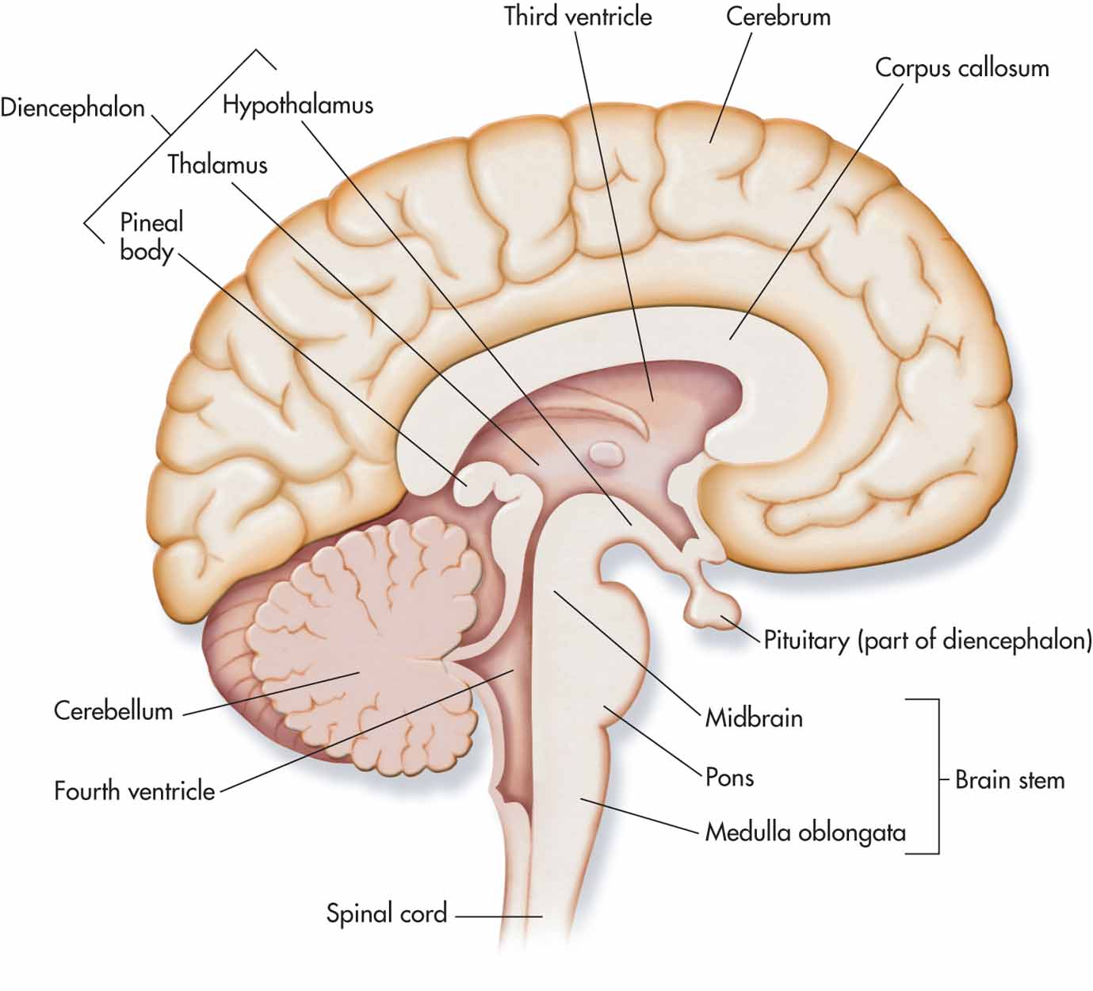

Slide 107
CSF and Ventricles (cont.)
CSF circulation
Filtered from blood in ventricles by tissue called choroid plexus
Made in lateral ventricles
Flows third and fourth ventricle through tiny opening
Flows into central canal of spinal cord and subarachnoid space
Returned to blood via ports between subarachnoid space and blood spaces in dura mater

Slide 108
Pathology Connection: Hydrocephalus
Condition of too much CSF in skull
Etiology: blockage of narrow passages due to trauma, birth defect, tumor, or decreased reabsorption of CSF
Can cause increased intracranial pressure
S/S
Expansion of skull (in infants whose skulls have not fully hardened)
Nausea/vomiting
Irritability
Seizures
Headache
Blurred Vision
Sleepiness

Slide 109
Hydrocephalus (cont.)
S/S
Balance and coordination problems
Personality changes
Dementia
DX
CT or MRI shows enlarged ventricles
Monitoring of intracranial pressure
RX
Medications
Surgical placement of shunt to drain fluid to heart or abdominal cavity

Slide 110
Hydrocephalus

Slide 111
Cranial Nerves
Spinal cord has spinal nerves; brain has cranial nerves
Both are similar in that they are input and output pathways for brain
12 pairs of cranial nerves
some are sensory, some are motor, and some are both

Slide 112
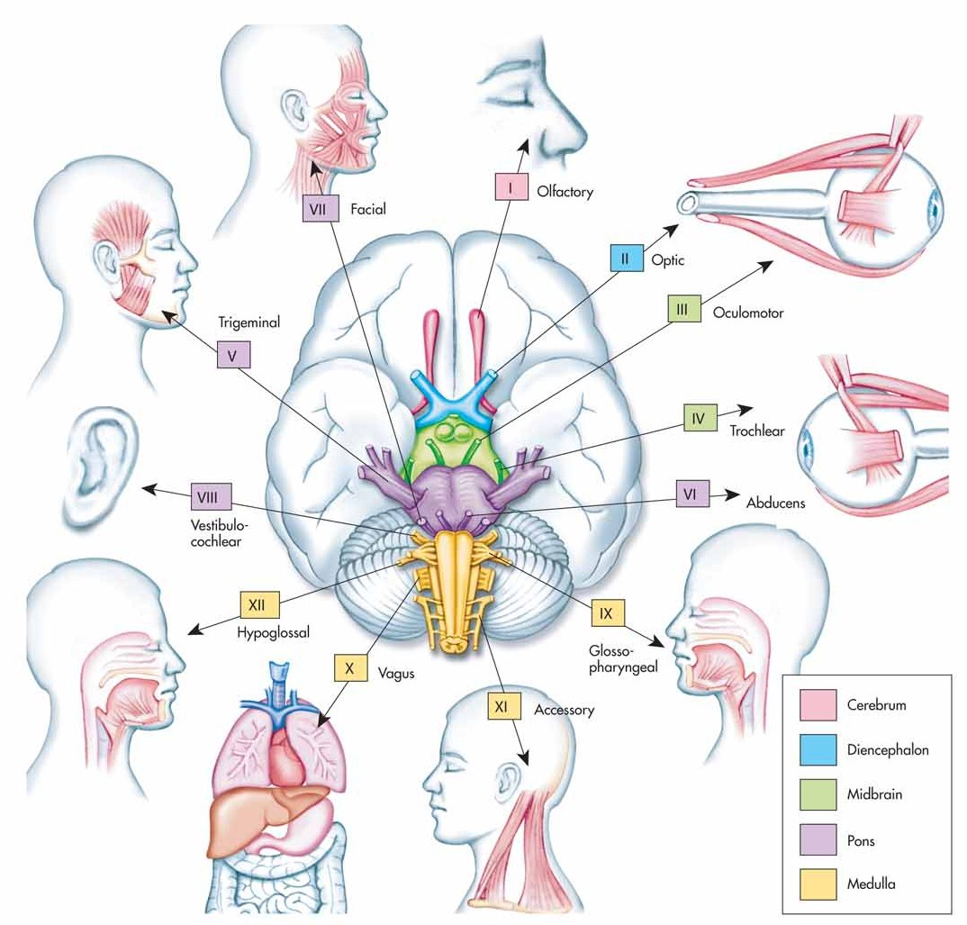

Slide 113
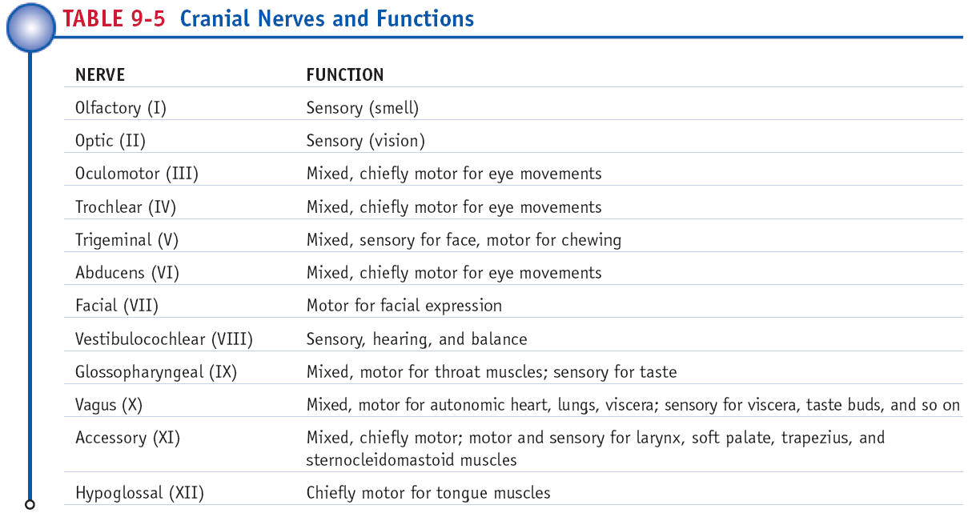

Slide 114
Nervous System Flowchart

Slide 115
The Somatic Sensory System
Provides sensory input
Includes: fine touch, crude touch, vibration, pain, temperature, and body position
Special senses (sight, hearing) are carried on cranial nerves
Somatic sensation comes into both brain and spinal cord
To attach meaning to sensation, it must get to brain for interpretation

Slide 116
Somatic Sensory System (cont.)
Sensory info coming into brain from skin join to portion of cerebrum known as primary somatic sensory cortex
Located in postcentral gyrus of parietal lobe
Info is transported to specific parts of SS cortex that correspond to parts of body

Slide 117
The Motor System
Somatic motor system controls voluntary movements under orders from cerebral cortex
In frontal lobe are premotor and prefrontal areas, which plan movements
Orders are sent to spinal cord and to number of coordination centers, including thalamus, basal nuclei, and cerebellum

Slide 118
Motor System (cont.)
Thalamus, basal nuclei, and cerebellum are part of complicated motor coordination loop
Without this loop, movement would be, at best, jerky and inaccurate, and some impossible
After movement info is processed, it moves to spinal cord and brain stem via corticospinal and corticobulbar tracts

Slide 119
Motor System (cont.)
Function of spinal cord pathways is to send orders from brain to motor neurons in spinal cord and brainstem
Motor neurons in spinal cord connect to skeletal muscles, sending orders to skeletal muscles to carry out movement
Second function of pathways is fine tuning of reflexes

Slide 120
Cerebral Palsy (CP)
Permanent, non-progressive set of motor deficits dx in infants and young children
Etiology: thought to be due to damage to motor cortex
Risk factors: low birth weight, premature birth, multiple births, infection during pregnancy, developmental abnormalities, brain hemorrhage, perinatal brain injury, lack of oxygen, childhood illness

Slide 121
Cerebral Palsy (cont.)
S/S
Increased muscle tone
Overactive reflexes
Lack of coordination of voluntary movements
Foot drag
Drooling
Speech difficulties
Fine motor problems
Tremor or other uncontrollable movements
Many pts. with CP have normal or above normal intelligence

Slide 122
Cerebral Palsy (cont.)
DX
Observing motor skills and developmental milestones
Imaging (CT or MRI)
R/O other causes of motor deficits
RX
PT and OT
Assistive devices
Drugs to control symptoms
No cure

Slide 123
Parkinson’s Disease (PD)
Etiology: Caused by disappearance of dopamine neurons in one of basal nuclei, which later spreads to cerebral cortex; why they disappear is unknown, though toxins, mitochondrial malfunctions, viruses, and genetics may be cause
S/S: Chronic progressive motor disorder
resting tremor
slow movement
impaired balance
rigidity
emotional and cognitive disturbances

Slide 124
Parkinson’s (cont.)
DX based on history and physical exam
Common findings
Shuffling gate
Cogwheel rigidity (muscles that seem to catch and release when moved)
Tremors
Imaging is not helpful, since most early-stage cases of PD will have perfectly normal scans

Slide 125
Parkinson’s (cont.)
RX
Dopamine-enhancing drugs (like L-dopa)
Side effects may include hallucinations and excessive uncontrollable movements
L-dopa treated patients may have “on” and “off” periods that are unpredictable

Slide 126
Parkinson’s Video

Slide 127
Amyotrophic Lateral Sclerosis (ALS)
Etiology
Rapidly progressive, fatal degeneration of motor system
Motor neurons in cerebral cortex, brainstem, and spinal cord self-destruct
Also called Lou Gehrig’s disease
Pts. usually die within 5 years of diagnosis; often due to respiratory failure
Cause is unknown, but toxins, damage from free radicals, and mitochondrial problems may be involved

Slide 128
ALS (cont.)
S/S: Usually begins between ages 40 and 60; first S/S: muscle weakness, twitching, and cramping; progress to complete paralysis including difficultly speaking and swallowing
Eventually diaphragm becomes paralyzed; pt. becomes ventilator-dependant; eye movements, bladder, and bowel control usually retained

Slide 129
ALS (cont.)
DX
No definitive test
Pts. often have both spastic and flaccid paralysis
Imaging, EMG, and blood and urine tests can help rule out other disorders
Neural biopsy may also be helpful to check for increase glutamate

Slide 130
ALS (cont.)
RX
No cure
The medication riluzole can be used to slow progression of disease; drug decreases neurotransmitter glutamate, thereby decreasing cell death

Slide 131
Autonomic Nervous System
Controls blood pressure, heart rate, respiratory rate, digestion, and sweating
Unlike somatic motor neurons, autonomic neurons do not project directly to muscles
There are no autonomic neurons in cervical spinal cord
ANS is divided into two subdivisions:
Sympathetic division
Parasympathetic division

Slide 132
Autonomic Nervous System

Slide 133
The Sympathetic Branch
Controls “flight or fight” response
Effects increase heart rate, BP, and sweating, also causes dry mouth, symptoms of adrenaline rush
Neurons secrete acetylcholine and norepineprine
SNS stimulates adrenal glands to release epinephrine that causes adrenaline rush

Slide 134
The Parasympathetic Branch
Often called “resting and digesting” as it has opposite effect of sympathetic division
Effects include decreased heart rate, respiration, and BP, and increased digestive activity including salivation and stomach activity

Slide 135
Myasthenia Gravis
Etiology: autoimmune attack of acetylcholine receptor at neuromuscular junction
S/S: progressive fluctuating muscle weakness, often starting with facial or eye muscles
DX: blood tests, EMG
RX: steroids, immunosuppressant drugs, plasma exchange, acetylchoinesterase inhibitors

Slide 136
Huntington’s Disease
Etiology: genetic; progressive loss of neurons from basal nuclei and cerebral cortex
S/S: mid-life onset of chorea, mood swings and memory loss, progressing to dementia and paralysis
DX: family history will show pattern of disease, imaging, genetic testing
RX: no cure; meds to control emotional and motor symptoms, no drug treatment for dementia

Slide 137
Charcot Marie Tooth Disorder
Etiology: genetic destruction of PNS myelin and/or axons
S/S: ascending muscle weakness and atrophy, decreased sensation in affected limbs
DX: history, EMG, biopsy, genetic testing
RX: PT, OT, surgery, pain medication, symptom management, no treatment to stop deterioration

