Slide 1
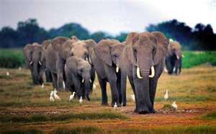
African elephants
Joelle

Slide 2
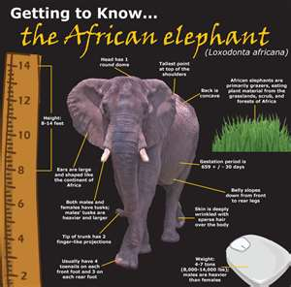
For my animal project I am doing an African elephant
Elephants are the largest land-dwelling mammals on earth. The scientific name for the elephant is Loxodonta.
The Elephant male is bigger than the female and that is how you can tell. It is 5-14 feet high and up to 30 feet long from trunk to tail.

Slide 3
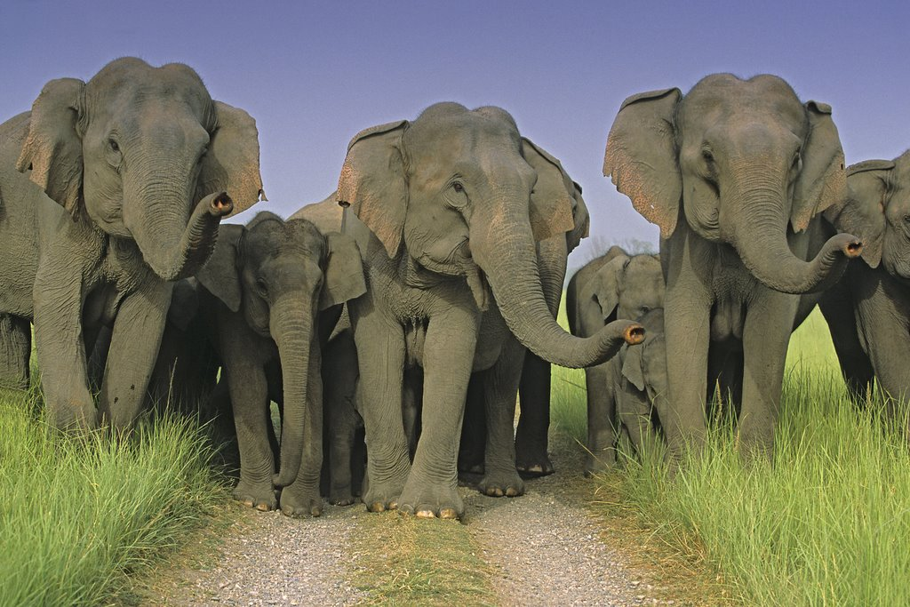
Survival
The African elephant needs to protect itself from the predators and protect the babies. Elephants live in herds and the entire herd helps protect the babies.

Slide 4
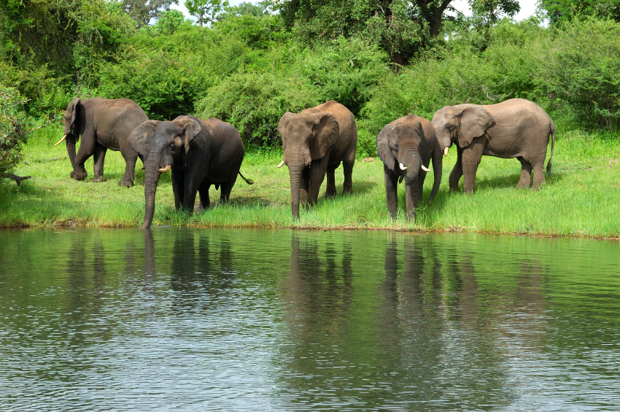
food
The African elephant eats grass and leaves. Adult elephants eat 300-400 lbs of food per day.

Slide 5
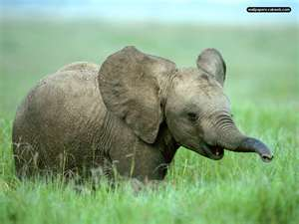
The African elephant facts
The African elephants can walk faster than humans. The baby elephant is smaller than a human its also smaller than an elephant. When the babies are born they are five feet tall. The parents care for their calves by protecting them. The baby elephants likes to play and have fun.

Slide 6
What can a elephant do?
The elephant trunk is very important.
A elephant can take a shower with its trunk.
The elephant can also used its trunk to grab things.
Elephants don't have bones in their trunk, just muscle.
Elephants are extremely intelligent animals and have memories that span many years.

