Slide 1
Please Join us for our
First DELAC Meeting
Wednesday, September 20
5:00-6:30
Dinner and Childcare provided!

Slide 2
Welcome
DELAC
September 20, 2023

Slide 3


Agenda
A
What are we doing?
How are we doing? Bob McGonigal
How can we do better?
Our GOAL
Summative ELPAC SSR
How can you get involved?

Slide 4
Supporting our English Learners
6-year plan for continued support
Developing an English Learner Master Plan
Homework support at every school
Curriculum for our Newcomers
IPADS used for translation
Bilingual Aides at every MS and HS
ELD training including 3 teachers from every site
College and Trade School Tours for our 11th and 12th Grade Emerging Bilingual students.

Slide 5
How are we doing?
Bob McGonigal

Slide 6
What can we do better?
What do you see as your needs?

Slide 7
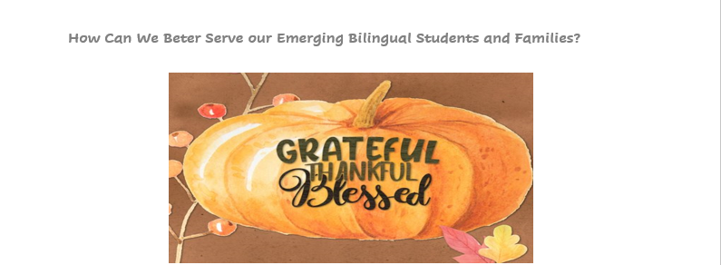
How can we do better?

Slide 8
Understanding Your Student Score Report
Summative ELPAC Spring of 2023
https://youtu.be/t6J0DSyYmCc?si=CUm8fRy4D-S_Srfn

Slide 9
Reclassification
Our GOAL for every English Learner

Slide 10
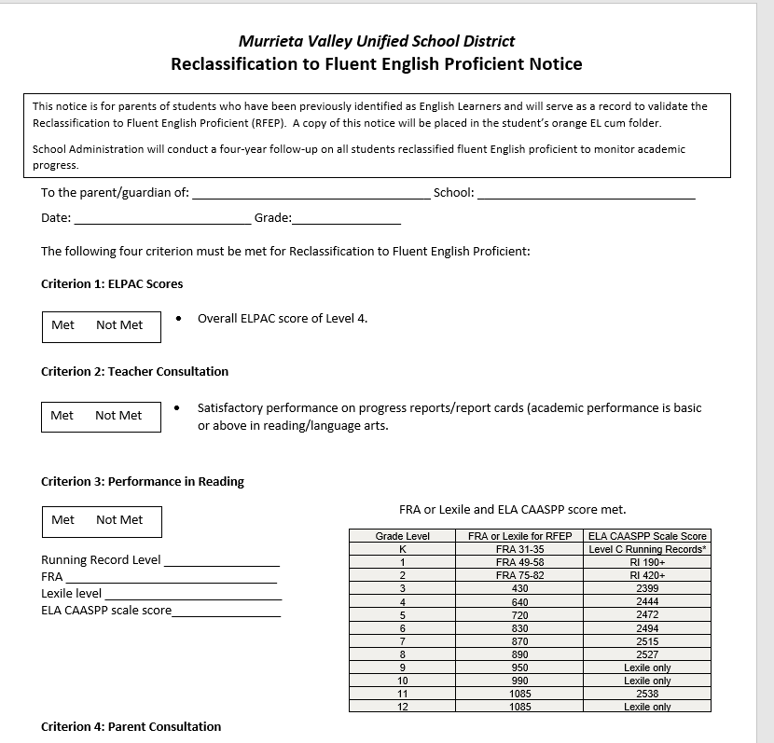

Slide 11
How can you get involved?

Slide 12
  English Learner Advisory (ELAC)
    This meeting is held at your school site.
      Meet specific needs of English Learners and Families
      Provide input in the Site Plan for Student Achievement (SPSA)
  Partnership for Thriving Students and Families (PTSF)
  Joining our EL Master Plan Writing Team
  Helping me plan and present at DELAC

Slide 13
Areas of focus
F
Improving the Outcomes for our
Emerging Bilingual Student
Integrated and Designated English Language Development (TK – 12)
Continued Professional Development to support how BEST to meet the needs of ALL our Emerging Bilingual Learners.
Progress monitoring and responsive practices.
How can you help your Emerging Bilingual Learner?

Slide 14
How We Will Get There
We are COMMITTED to your student’s achievement
2023-24
2024-25
2025-26
English Learner Master Plan
  OUR GUIDE
ELD Training
Support Elementary provide Integrated and Designated ELD
Improve reclassification by 5th Grade
Newcomer Curriculum Modeled Lessons
ELD Training for 3 more teachers from every site
Build capacity with our site administrators to encourage and support Integrated and Designated ELD.
Ensure teachers understand the needs of Newcomers and Long- Term English Learners.
EL Master Plan goes to the BOE for approval.
ELD Training for 3 more teachers from every site
Ensure ALL Emerging Bilingual student needs are met to meet state standards, graduation and beyond.
College and Trade school tours for our 10th – 12th grade Emerging Bilingual students.

Slide 15
Thank you
Jill Buschhausen
jbuschhausen@murrieta.k12.ca.us
951-696-1600 x:1007
Next Meeting
Wednesday, November 29

