Slide 1
Cat Dissection
Basic directions
Cat Dissection: Body Plan
We’ll be talking about the basic body plan and prefixes for identifying basic anatomy of the cat.

Slide 2
Body Plan
The basic unit of life is the CELL
CELLS are then organized into TISSUES (Groups of cells)
TISSUES are organized into ORGANS
ORGANS make up ORGAN SYSTEMS
1. Epithelial Covers surface – lines cavities
2. Connective Connects “stuff” in the body and fills spaces
3. Muscle Contractile tissues
4. Nervous Electrochemical messaging system

Slide 3
Body Plan - Organs
TISSUES are organized into ORGANS
ORGANS are organized into ORGAN SYSTEMS
1. “Myo” Muscle
2. “Neuro” Nerves
3. “Gastro” Stomach intestines
4. “Cardio” Heart
5. “Renal” Kidneys
6. “Osteo” Bones
7. “Pulmonary” Lungs

Slide 4
Body Cavities:
Cavities
Body cavities:
Cavity | Viscera contained in the cavity
Cranial | Brain
Orbital | Eyes
Nasal | Sinuses
Oral | Tongue, teeth, palate
Thoracic Pleural (2) Mediastinum Pericardial | Inside ribcage Lungs Pericardium, esophagus, trachea, heart
Abdominal | Stomach, liver, intestines, spleen
Pelvic | Urinary bladder, rep. organs
Spinal | Spinal cord

Slide 5
Body Plan – Anatomical directions
Anatomical directions.
Inferior and superior are used to describe parts below or above one another
Medial means towards the middle while lateral means towards the side
Ventral describes the belly of an animal while dorsal is the back
Anterior is towards the head, while the posterior lies close to the tail
Proximal is close to the main part of the body while distal is away from the main part of the body

Slide 6
Body Plan – Sections
Sections of the body:
A sagittal section separates left and right
A transverse section separates top from bottom
A frontal (coronal) section separates front (Ventral)
from back (Dorsal)

Slide 7
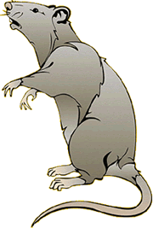
Supine = On back
Pronate = on stomach
Dorsal
Coronal – frontal section
Ventral

Slide 8
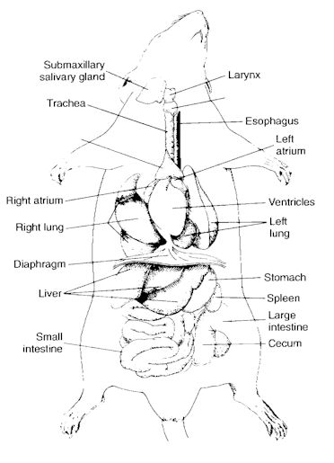
Mid Sagital
Sagital
Anterior end
Coronal – frontal section
Transverse section
Ventral
Posterior end

