Slide 1
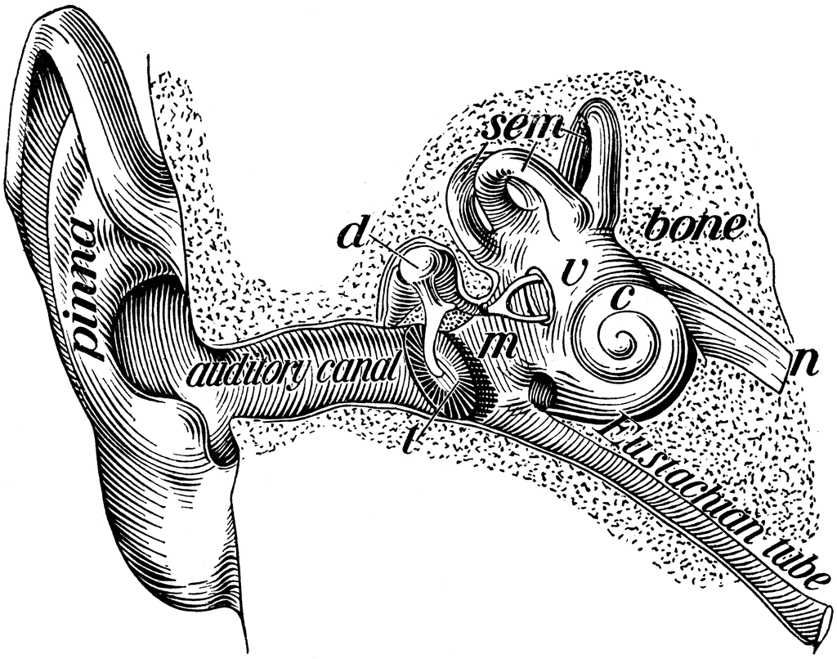
The Ear Parts, Functions and Hearing Process
MMHS
Advanced Biomedical Science

Slide 2
Hearing Attributes
The senses of equilibrium and hearing are provided by the inner ear, a receptor complex located in the temporal bone of the skull.
The basic receptors, or hair cells, are simple mechanoreceptors.

Slide 3
Functions of The Ear
→The Ear provides input for 2 senses:
1. Equilibrium- which informs us of the position of the body in space by monitoring gravity, linear acceleration, and rotation.
2. Hearing- which enables us to detect and interpret sound waves.

Slide 4
Regions of the Ear
The ear is divided into three anatomical regions:
The External ear (gathering sound)
The Middle ear (producing sound)
The Inner ear. (interpreting sound)

Slide 5
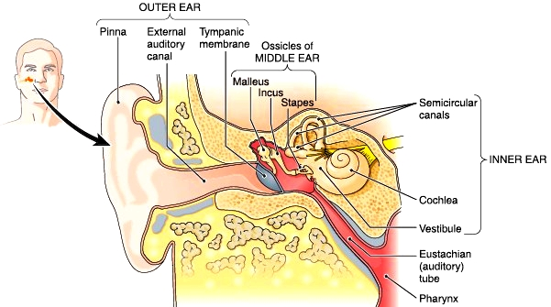
Regions of the Ear

Slide 6
The External Ear
External ear- is the visible portion of the ear.
Fnxn: collects and directs sound waves to the eardrum.
Parts of the External Ear:
Pinna- outer portion of the ear
External auditory canal- the passage way for sound to the ear drum
Tympanic membrane- ear drum

Slide 7
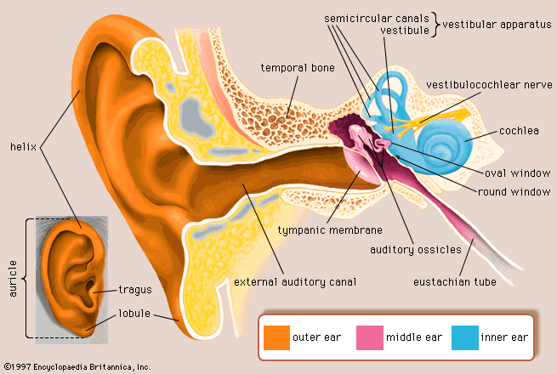

Slide 8
The Middle Ear
Middle ear- is a chamber located in a thickened portion of the temporal bone,
Fnxn: collects and amplifies sound waves and
transmit them to a portion of the inner ear.
Parts of the Middle Ear:
Auditory ossicles- the bones of the middle ear.
Malleus- called hammer, first bone attached to the eardrum.
Incus- called anvil, middle ear bone
Stapes- called the stirrup, attaches to the oval window

Slide 10
The Inner Ear
Inner ear- concerned with hearing and equilibrium. Receives input from the middle ear.
Fnxn: contains the sensory organs responsible for equilibrium sensations.
Parts:
Membranous labyrinth- contains the receptors
Bony labyrinth- is a shell of dense bone that surrounds and protects the membranous labyrinth.
Vestibule- contains two sacs called saccule and utricle that contains receptors that provide sensation of gravity and linear acceleration.

Slide 11
Inner Ear Continued
Parts of the Inner Ear:
2. Semicircular canals- stimulated by rotation of the head or dynamic equilibrium.
3. Cochlea- provides the sensation of hearing.
Hair cells- line the inner ear, communicates with a sensory neuron by continually releasing small quantities of neurotransmitter.

Slide 12
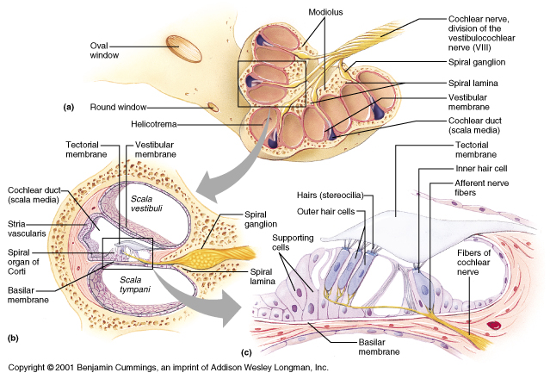
The Internal Cochlea

Slide 13
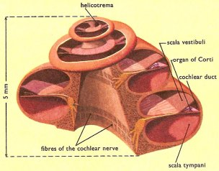
Cochlea and Organ of Corti

Slide 14
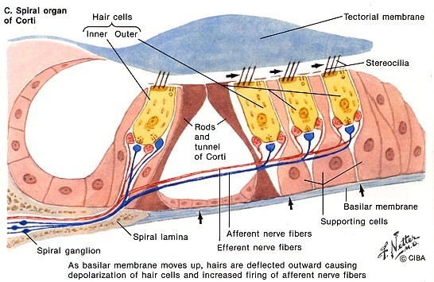
Basilar/Tectorial Membrane

Slide 16
What is Dynamic and Static Equilibrium?
Dynamic equilibrium- refers to when the head and body are moved suddenly.
Static equilibrium- maintains our posture and stability when the body is motionless.

Slide 17
The Process of Hearing
1. Sound waves arrive at the tympanic membrane or eardrum
2. The vibration of the tympanum causes movement of the auditory ossicles.
3. The movement of the stapes at the oval window establishes pressure waves in the perilymph of the vestibular duct.
4. The pressure waves distort the basilar membrane on their way to the round window of the tympanic duct.
5. The vibration of the basilar membrane causes the vibration
of hair cells against the tectorial membrane.
6. Information about the region and intensity of stimulation is relayed to the CNS over the cochlear branch of the cranial nerve VIII.

Slide 18
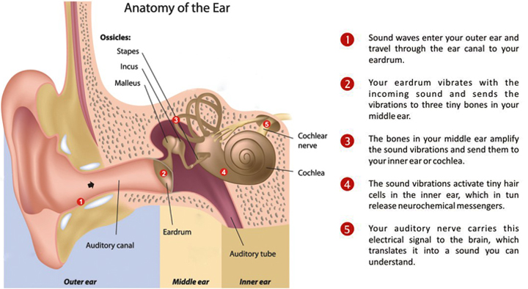
The Process of Hearing

Slide 19
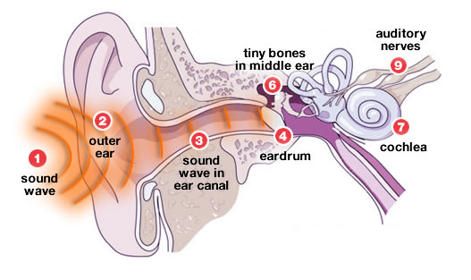
The Process of Hearing

