Slide 1
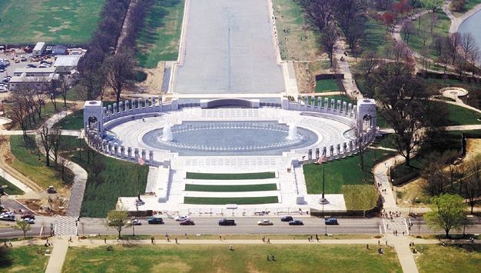
World War II
1939-1945

Slide 2
Adolf Hitler’s Rise to Power
The Beer Hall Putsch
Nov 1923, Hitler has 55,000 Nazi followers
Nov 8, 1923, Hitler hatches plot to kidnap leaders of the Bavarian Government at a beer hall in Munich
Hitler stormed in and told the leaders the government offices and police barracks were already taken over and they needed to pledge their loyalty to the Nazis (this was a lie)
After getting the government leaders to agree, Hitler learned that his storm troopers (soldiers) failed to take the barracks so he left the beer hall to assist.
Again, Hitler failed to convince the police to surrender and returned to the beer hall to find that the three government leaders had escaped
Hitler’s allies turned on him and he was a wanted man.
Hitler was eventually arrested after a violent clash with the Munich Police

Slide 3
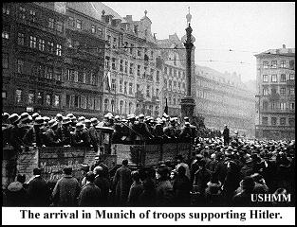

Slide 4
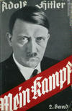
Mein Kempf 1925
Hitler did not physically write the book but rather dictated it to Rudolph Hess
The original title was Four and a Half Years of Struggle against Lies, Stupidity and Cowardice
Hitler divides humans into four categories based on physical appearance with white Germans (or Aryans) as the master race
Claims the struggle for world domination is a constant battle between Aryans and Jews
He accused the Jews of conducting an international conspiracy to control world finances, controlling the press, inventing liberal democracy as wells as Marxism, promoting prostitution and vice, and using culture to spread disharmony
Aryans must acquire more land to spread out and dominate all the races and cultures of the world
At first the book sold poorly, but after Hitler became Chancellor it was a gift for all occasions: weddings, graduations, etc.

Slide 5
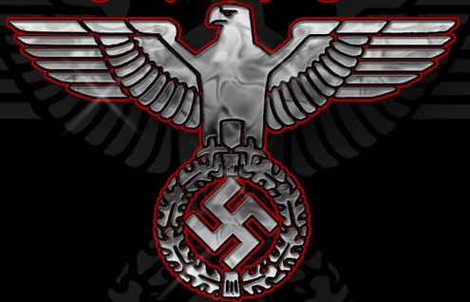
1926—Germany admitted into the League of Nations
1929—US Stock Market crashes
1930—Nazi party electoral success makes them the 2nd largest Political Party in Germany

Slide 6
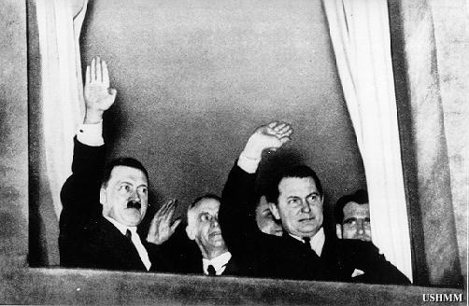
On the night of January 30, 1933, the Nazis organized a massive torchlight parade in Berlin to celebrate the appointment of Hitler as Chancellor of Germany.

Slide 7
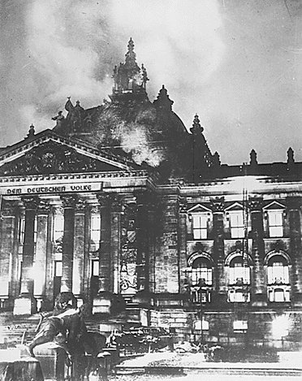
February 27, 1933
Nazis burn the Reichstag building, seat of the German government
This enabled Adolf Hitler to seize power under the pretext of protecting the nation from threats to its security

Slide 8
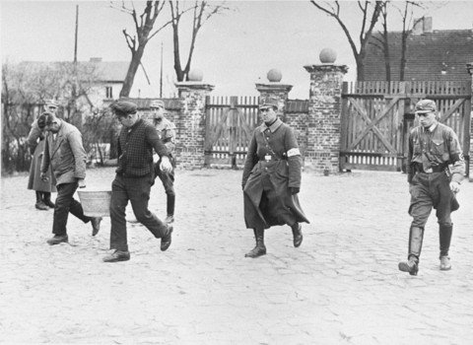
March 12, 1933: The first Concentration Camp Opens
The camp at Oranienburg was opened to begin housing political opponents of Hitler and Jews.
They were arrested and imprisoned without trial or due process.
Other early camps were located in Dachau in southern Germany near Munich, Buchenwald in central Germany near Weimar, and Sachsenhausen near Berlin in the north

Slide 9
Hitler’s Enabling Act
March 23, 1933—Newly elected members of parliament meet to discuss passing an enabling act handing over a legal dictatorship to Hitler
The act was officially called the 'Law for Removing the Distress of the People and the Reich.‘
Of course all of the “distress” had been manufactured by the Nazis
Nazi storm troopers surrounded the hall where the members were meeting shouting "Full powers - or else! We want the bill - or fire and murder!!“
Hitler made false promises to secure the votes he needed
Only one man rose in opposition, Otto Wells, stating "We German Social Democrats pledge ourselves solemnly in this historic hour to the principles of humanity and justice, of freedom and socialism. No enabling act can give you power to destroy ideas which are eternal and indestructible."
Hitler responded by saying "You are no longer needed! - The star of Germany will rise and yours will sink! Your death knell has sounded!"
Thus ended democracy in Germany…

Slide 10
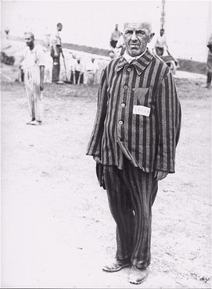
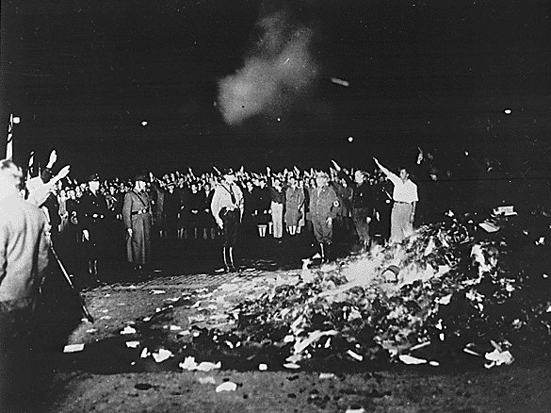
Also in 1933
April 1 – Nazis boycott Jewish owned shops
Their signs read: "Germans, defend yourselves against the Jewish atrocity propaganda, buy only at German shops!" and "Germans, defend yourselves, buy only at German shops!"
May 10 – Nazis burn “non-Aryan” books
In June – Nazis open Dachau concentration camp
July 14 - Nazi party declared only party in Germany.
Oct 14 - Germany quits the League of Nations.

Slide 11
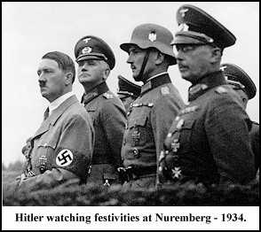
1934
June 30: “ The Night of the Long Knives”—Hitler and the SS murder military political opponents and take complete control of military forces in Germany
July 25 - Nazis murder Austrian Chancellor Dollfuss.
Aug 2 - German President Hindenburg dies.
Aug 19-Hitler becomes Fuhrer of Germany—all public officials swore an oath of allegiance to Hitler

Slide 12
1935
March 16 - Hitler violates the Treaty of Versailles by introducing military conscription.
Sept 15—Jews stripped of rights by Nuremburg Race Laws
Deprived German Jews of their rights of citizenship, giving them the status of "subjects" in Hitler's Reich.
The laws also made it forbidden for Jews to marry or have sexual relations with Aryans or to employ young Aryan women as household help. (An Aryan being a person with blond hair and blue eyes of Germanic heritage.)
They were called "The Law for the Protection of German Blood and German Honor" (regarding Jewish marriage) and "The Reich Citizenship Law" (designating Jews as subjects).

Slide 13
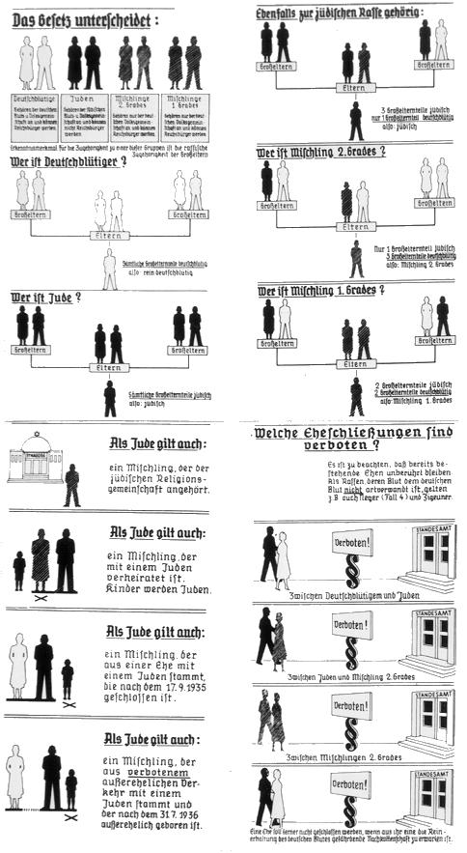
Explanation of what constituted a Jew

Slide 14
1936
Feb 10 - The German Gestapo (secret police) is placed above the law.
March 7 - German troops occupy the Rhineland.
May 9 - Mussolini's Italian forces take Ethiopia.
July 18 - Civil war erupts in Spain.
Aug 1 - Olympic games begin in Berlin.
Oct 1 - Franco declared head of Spanish State.

Slide 15
November 5, 1937: The Hossbach Memorandum
On November 5, 1937, Adolf Hitler held a secret conference in the Reich Chancellery during which he revealed his plans for the acquisition of Lebensraum, or living space, for the German people at the expense of other nations in Europe.
Hitler said military action was to be taken by 1943-1945 at the latest, to guard against military obsolescence, the aging of the Nazi movement, and "it was while the rest of the world was still preparing its defenses that we were obliged to take the offensive.“
The primary objective would be to seize Czechoslovakia and Austria to protect Germany's eastern and southern flanks

Slide 16
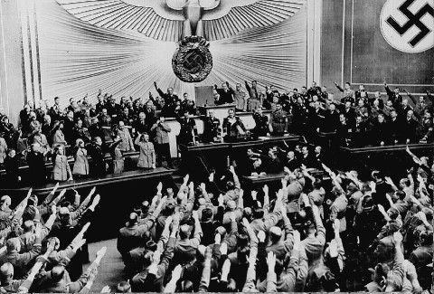
1938
March 12/13 – Germany announces Anschluss with Austria
Aug 12 - German military mobilizes.
Sept 30 - British Prime Minister Chamberlain appeases Hitler at Munich.
Oct 15 – German troops occupy the Sudetenland; Czech government resigns.
Hitler announces Anschluss

Slide 17
1939
Jan 30, 1939 – Hitler threatens Jews during Reichstag speech
March 15/16 - Nazis take Czechoslovakia.
March 28, 1939 - Spanish Civil war ends.
May 22, 1939 - Nazis sign 'Pact of Steel' with Italy.
Aug 23, 1939 – Nazis and Soviets sign pact
Aug 25, 1939 - Britain and Poland sign a Mutual Assistance Treaty. Aug 31, 1939 - British fleet mobilizes; Civilian evacuations begin from London. Sept 1, 1939 - Nazis invade Poland. Sept 3, 1939 - Britain, France, Australia and New Zealand declare war on Germany. Sept 4, 1939 - British Royal Air Force attacks the German Navy.
Sept 5, 1939 - United States proclaims neutrality; German troops cross the Vistula River in Poland. Sept 10, 1939 - Canada declares war on Germany; Battle of the Atlantic begins. Sept 17, 1939 - Soviets invade Poland.
Sept 27, 1939 – Warsaw (Poland) surrenders to Nazis
Sept 29, 1939 - Nazis and Soviets divide up Poland.
Oct 1939 – Nazis begin euthanasia of sick and disabled in Germany
Nov 8, 1939 - Assassination attempt on Hitler fails. Nov 30, 1939 - Soviets attack Finland. Dec 14, 1939 - Soviet Union expelled from the League of Nations.

Slide 18
Britain & France ask the Soviet Union (Russia) to join them in stopping Hitler’s aggression. Negotiations proceed slowly because France & Britain do not trust the Communist government of Russia. And Stalin resented having been left out of the Munich Conference.
While Stalin talked with France & Britain, he also bargained with Hitler. Both Hitler & Stalin reached an agreement. They publicly commit to never attack one another. On Aug. 23, 1939, they sign a 10 year non-aggression pact.
Secretly Hitler promised Stalin territory and they agree that they would divide Poland between them. They also agree that the USSR could take over Finland and the Baltic countries (Lithuania, Latvia, and Estonia)

Slide 19
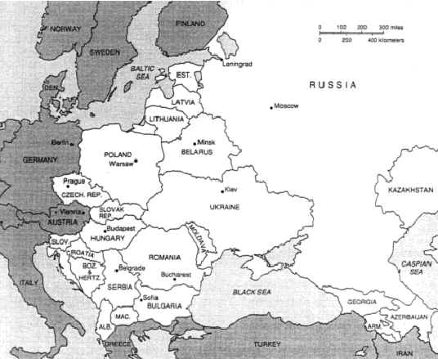

Slide 20
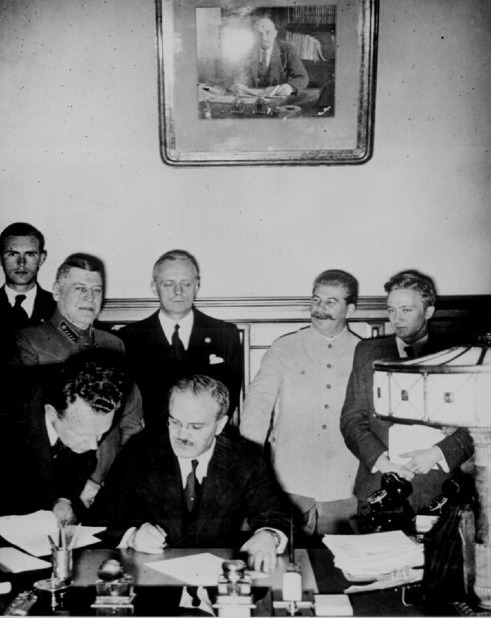
The signing of the non-aggression pact removed the threat of Germany being attacked by the Soviet Union from the east.
Stalin
Hitler then quickly moved ahead with his plans to conquer Poland. His surprise attack took place at dawn (4:45 a.m.) on September 1, 1939.
The German invasion was the first test of Germany’s newest military strategy – THE BLITZKRIEG

Slide 21
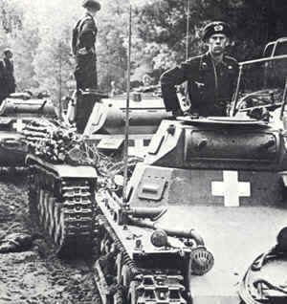
The Blitzkrieg or “Lightning War” involved using fast moving planes and tanks, followed by massive infantry forces, to take the enemy by surprise. Then, blitzkrieg forces swiftly crush all opposition with overwhelming force.
German tanks cross into Poland
To Hitler, the conquest of Poland would bring Lebensraum, or "living space," for the German people. According to his plan, the "racially superior" Germans would colonize the territory and the native Slavs would be enslaved.

Slide 22
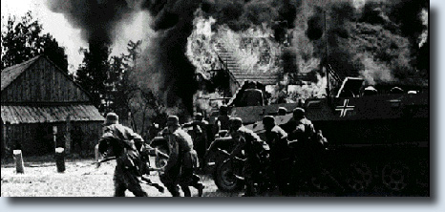
Shortly after noon on August 31, Hitler ordered hostilities against Poland to begin at 4:45 a.m. the next morning. At 8 p.m. on August 31, Nazi S.S. troops wearing Polish uniforms staged a phony invasion of Germany, damaging several minor installations on the German side of the border. They also left behind a handful of dead concentration camp prisoners in Polish uniforms to serve as further evidence of the supposed Polish invasion, which Nazi propagandists publicized as an unforgivable act of aggression.

Slide 23
In Poland, German forces advanced at a dizzying rate. German warplanes invaded Polish airspace, raining bombs and terror on the Poles. At the same time, German tanks and troop trucks rumbled across the Polish border. The trucks carried more than 1.5 million soldiers into the assault. German aircraft and artillery then began a merciless bombing of Poland’s capital, Warsaw. Simultaneously, German warships and U-boats attacked Polish naval forces in the Baltic Sea. The Polish army was able to mobilize one million men but was hopelessly outmatched in every respect. Rather than take a strong defensive position, troops were rushed to the front to confront the Germans and were systematically captured or annihilated. By September 8, German forces had reached the outskirts of Warsaw, having advanced 140 miles in the first week of the invasion.
Hitler claimed the massive invasion was a defensive action, but Britain and France were not convinced. On September 3, they declared war on Germany, initiating World War II.

Slide 24
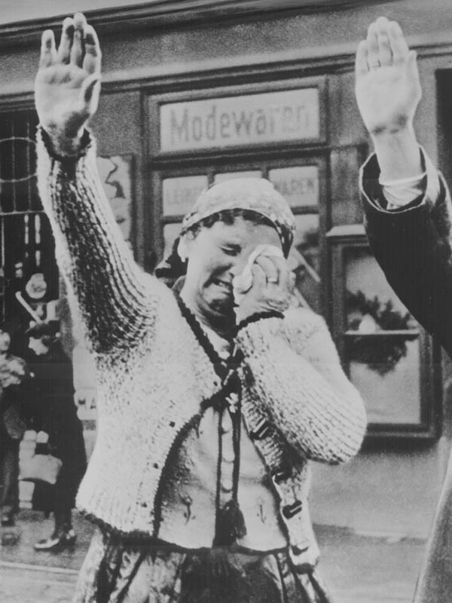
Many historians point to the invasion of Poland as the beginning of World War II
The Polish people are forced to salute the Germans after the takeover of Poland

Slide 25
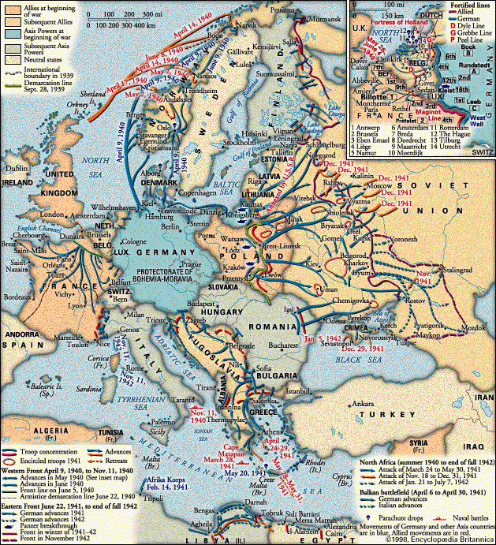
The Soviets Make Their Move
On Sept. 17th, Stalin sent Soviet troops to occupy the eastern half of Poland. He then moved to annex countries to the north of Poland. Lithuania, Latvia, & Estonia fell without a struggle, but Finland resisted. Stalin sends 1million troops into Finland expecting to win a quick victory, but they were not prepared for the winter fighting. This was a crucial mistake.

Slide 26
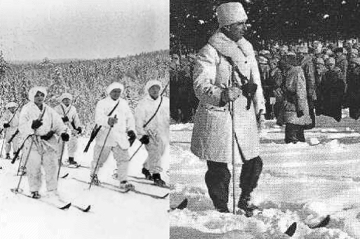
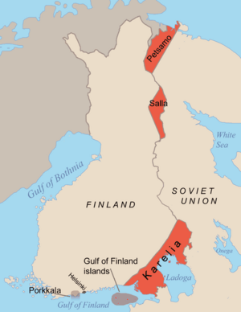
The Finns were outnumbered & outgunned, but they fiercely defended their country. In the freezing weather, soldiers on skis attacked Soviet positions. The Soviets struggled to make progress through the deep snow. The Soviets suffered heavy losses, but they finally won through sheer force of numbers. By March 1940, Stalin had forced the Finns to accept his surrender terms.

Slide 27
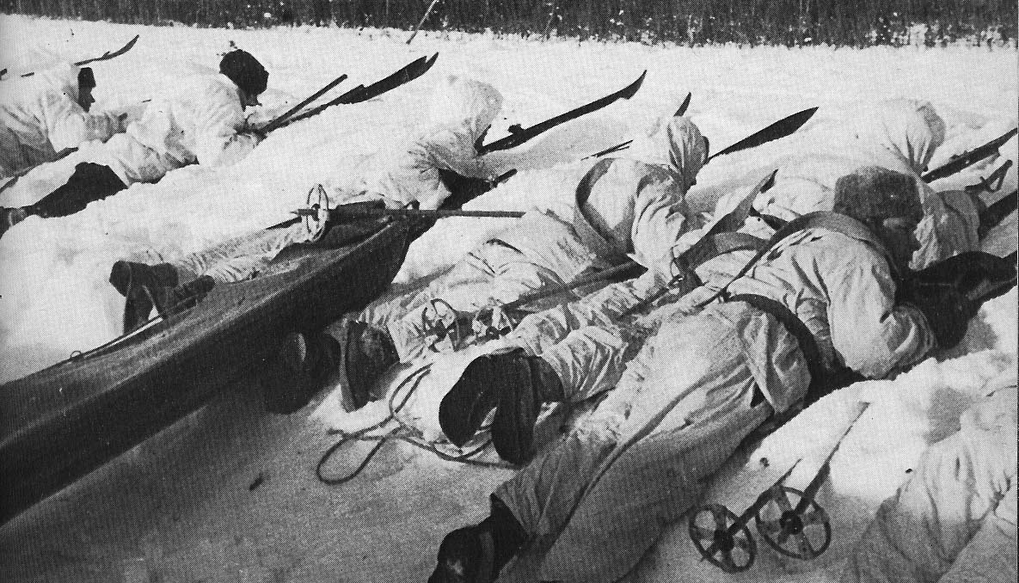

Slide 28
Despite their declaration of war against Germany, Britain and France did little militarily to aid Poland. Britain bombed German warships on September 4, but Chamberlain resisted bombing Germany itself. Though Germans kept only 23 divisions in the west during their campaign in Poland, France did not launch a full-scale attack even though it had mobilized over four times that number. There were modest assaults by France on its border with Germany but these actions ceased with the defeat of Poland. The French and British troops were stationed along the famous Maginot Line- A system of fortifications along France’s border with Germany. There they waited for the Germans to attack – but nothing happened. During the subsequent seven months, some observers accused Britain and France of waging a "phony war," because, with the exception of a few dramatic British- German clashes at sea, no major military action was taken.

Slide 29
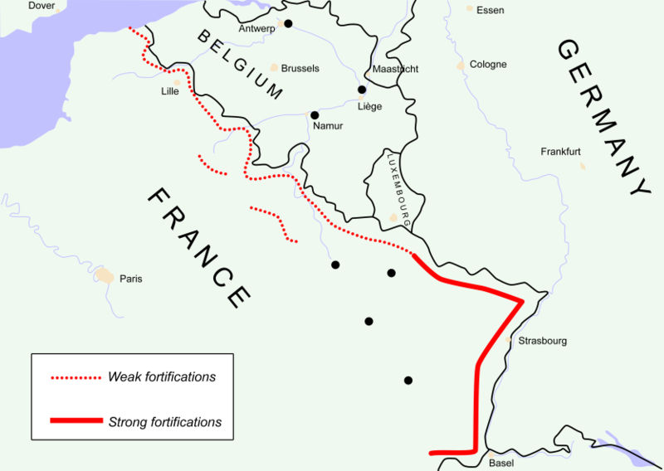
Ardennes Forest

Slide 30
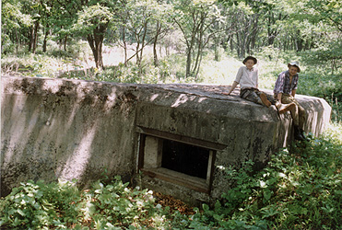
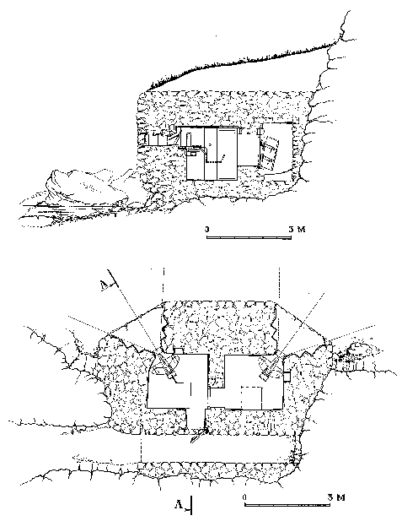
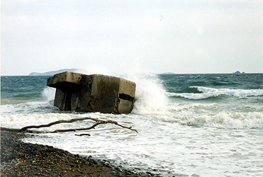
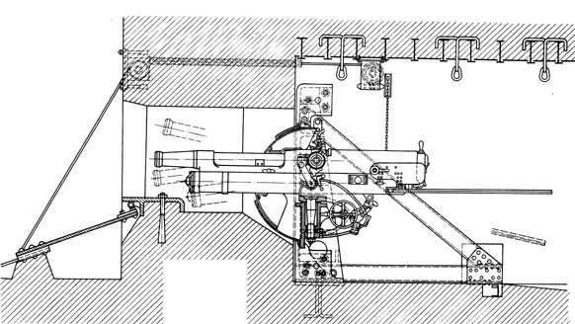
The Maginot Line

Slide 31
Suddenly, on April 9th, 1940, Hitler launched a surprise invasion of Denmark & Norway. In Just 4 hours after the attack, Denmark fell. 2 months later, Norway surrenders. The Germans begin building bases along the Norwegian & Danish coasts to launch strikes on Britain.
The Fall of France
Next, in May of 1940, Hitler begin a dramatic sweep through the Netherlands, Belgium & Luxembourg to get at France. With the Allies focusing their attention on those countries, Hitler sends an even larger force of tanks & troops through the Ardennes – a heavily wooded area in northern France, Luxembourg & Belgium. Moving through the forest, the Germans managed to squeeze between the Maginot Line. From there they moved across France & reached the country’s northern coast in 10 days.

Slide 32
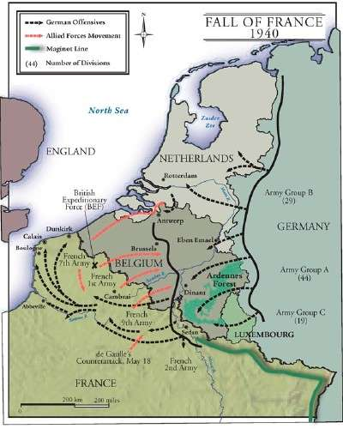
Rescue at Dunkirk – After reaching the French coast, the German forces swung north again & joined with German troops in Belgium. By the end of May 1940, the Germans had trapped the Allied forces around the northern French city of Lille (Leel). Outnumbered, outgunned, and pounded from the air, the Allies retreated to the beaches of Dunkirk, a French port city near the Belgian border. They were trapped with their backs to the sea.

Slide 33
Rescue at Dunkirk Cont:
In one of the most heroic acts of the war, Great Britain set out to rescue the army. It sent a fleet of about 850 ships across the English channel to Dunkirk. Along with Royal Navy ships, civilian craft – yachts, lifeboats, motorboats, paddle steamers & fishing boats-joined the rescue effort. From May 26 to June 4, this amateur armada, under heavy fire from German bombers, sailed back and forth from Britain to Dunkirk. The boats carried some 338,000 battle-weary soldiers to safety.

Slide 34
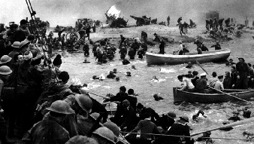

Slide 35
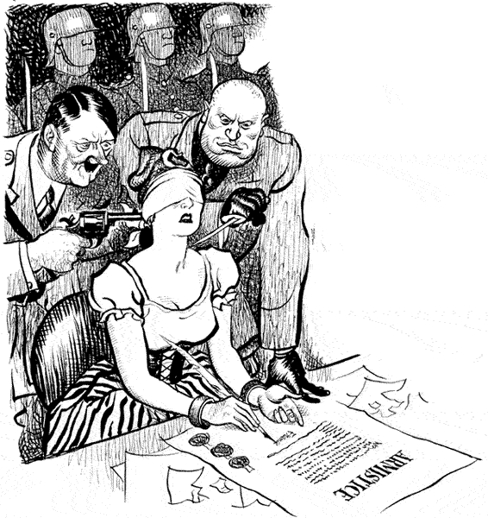
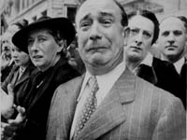
France Falls:
Following Dunkirk, resistance in France began to crumble. By June 14, the Germans had taken Paris. Accepting the inevitable, French leaders surrendered on June 22, 1940. The Germans took control of the northern part of the country. They left the southern part to a puppet Gvmt. Headed by Marshal Philippe Petain (PayTAN), a French hero from WWI. The headquarters of this Gvmt. Was in the city of Vichy (VEESH ee).

Slide 36
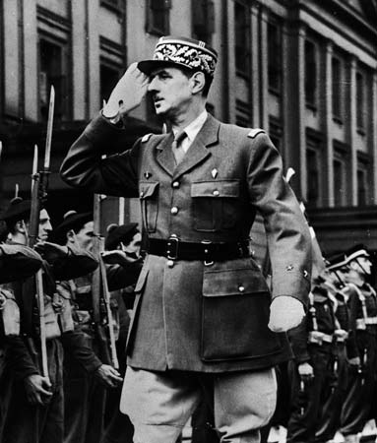
After France fell, Charles de Gaulle, French general, set up a government-in-exile in London. He committed all his energy to reconquering France. In a radio broadcast from England, he called on the people of France to join him in resisting the Germans:
“It is the duty of all Frenchmen who still bear arms to continue the struggle. For them to lay down their arms, to evacuate any position of military importance, or agree to hand over any part of French territory, however small, to enemy control would be a crime against our country.”

Slide 37
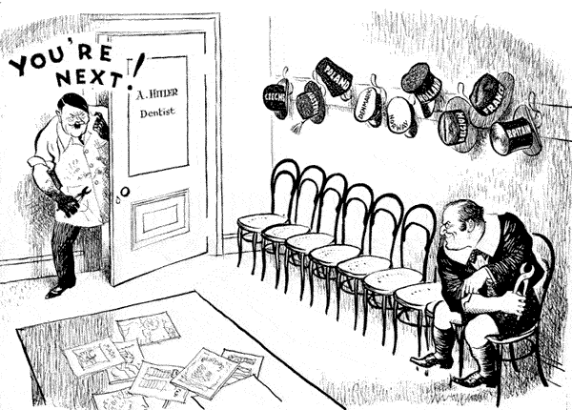
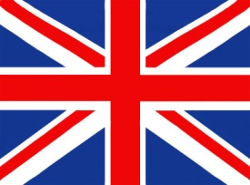
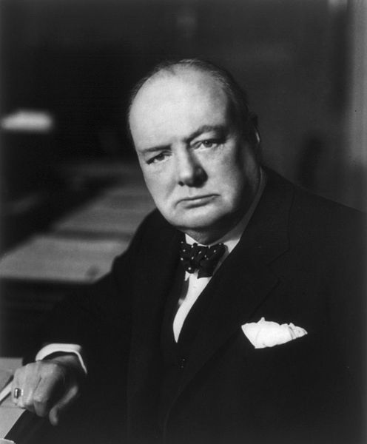
The Battle Of Britain
With the fall of France, Great Britain stood alone against the Nazis. Winston Churchill, the new British Prime Minister, had already declared that his nation would never give in.
“We shall fight on the beaches, we shall fight on the landing grounds, we shall fight in the fields and in the streets…we shall never surrender.”

Slide 38
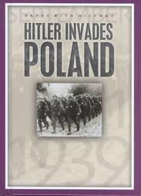
America Moves Toward War
In late Aug. 1939, FDR sends Hitler a cable urging him to settle his differences with Poland peacefully. In response, Hitler invades Poland on Sept. 1.
“Hitler is a madman, and his counselors, some of whom I personally know, are even madder than he is.”
On Sept. 8, 1939, FDR announced that he was calling a special session of Congress to revise the Neutrality Acts. When congress met 2 weeks later, the president asked for a “cash-and-carry” provision, which would permit nations to buy U.S. arms as long as they paid cash & carried the goods home in their own ships. FDR believed that providing arms to Britain & France would be the best way to keep the U.S. out of war.
After 6 weeks of heated debate, Congress passed the Neutrality Act of 1939 & cash and carry went into effect.

Slide 39
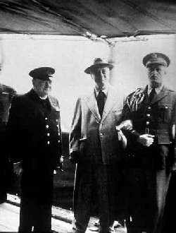
When the U.S. received news that Japan, Germany & Italy signed the pact making them the Axis Powers they were in disbelief. They believed that the pact was aimed at keeping the U.S. out of the war. Under the treaty, each Axis nation agreed to come to the defense of the other in case of attack. This meant that if the U.S. were to declare war on any one of the Axis powers, it would face its worst military nightmare…a two ocean war, with fighting in both the Atlantic & the Pacific.
Hoping to avoid a war on 2 fronts, Roosevelt provided the British with all aid short of war. In 1940 the U.S. sent 500,000 rifles & 80,000 machine guns. The U.S. also traded 50 old destroyers for leases on British military bases in the Caribbean & Newfoundland.
Churchill
FDR
After years of isolationism, the U.S. was militarily weak. Critics pointed out that there were 18 countries that had larger armies. So, FDR asked Congress to increase spending for national defense. Congress boosted defense spending in 1940 & it passed the nations first peacetime military draft.

Slide 40
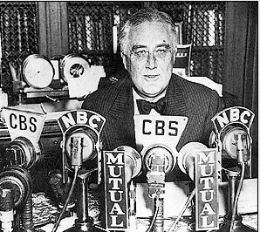
Not long after the election, FDR held another fireside chat. There was no hope of negotiating a peace with Hitler, he told the nation. “No man can tame a tiger into a kitten by stroking it.” He also warned that if Britain fell, the Axis powers would be left unchallenged to conquer the world, at which point, he said, “All of us in all the Americas would be living at the point of a gun.” To prevent such a situation, the U.S. had to help defeat the Axis threat by turning itself into “The great arsenal of Democracy.”
Because Britain had no more cash to spend, FDR suggested replacing cash-and-carry with a new plan that he called lend-lease. Under this plan the president would lend or lease arms and other supplies to any country whose defense was vital to the U.S. After bitter argument, Congress passed the Lend-Lease Act in 1941 & supported it with about $50 billion.

Slide 41
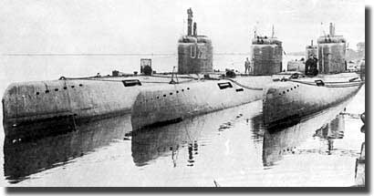
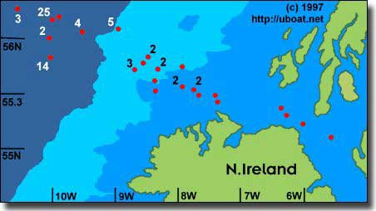
German Wolf Packs
To prevent delivery of lend-lease shipments, Hitler deployed hundreds of German subs or U-boats in the North Atlantic. There, groups of 15 to 20 subs, known as wolf packs, searched shipping lanes for cargo ships.
During 5 weeks in April & May 1941, the Germans sank 1.2 million tons of British shipping. They were sinking ships faster than the British could replace them.
Something had to be done to stop the Attacks, so in June of 1941, FDR ordered the U.S. navy to protect lend-lease shipments as far east as Iceland. He also gave U.S. warships permission to attack German U-boats in self-defense.
Map showing where U-Boats were scuttle in Operation Deadlight; the numbers indicate the U-Boats sunk at each location.

Slide 42
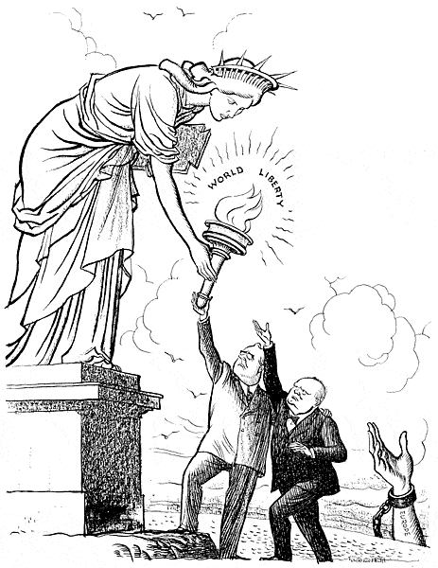
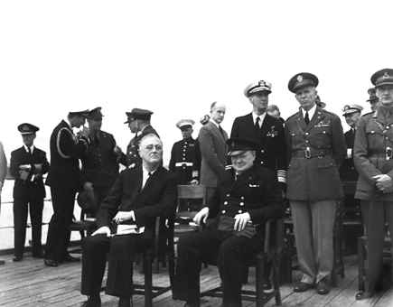
The Atlantic Charter
FDR & Churchill met secretly aboard a warship off the coast of Newfoundland where they settled for a declaration of principles called the Atlantic Charter. The charter spelled out the causes for which WWII was fought & what the goals were for opposing the Axis Powers. Later in 1941, the Atlantic Charter became the basis of a new document called “A Declaration by the United Nations.” The declaration was signed by 26 nations including the Soviet Union & China.
Together observed Churchill, these nations represented 4/5ths of the human race.

Slide 43
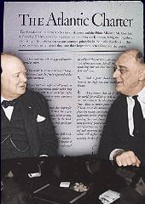
“How near is the United States to war?”
That was the question Churchill asked rhetorically after his August 1941 meeting with FDR.
On Sept. 4th, a German u-boat fired 2 torpedoes at the U.S. destroyer Greer. FDR responds with the announcement that the U.S. Navy had been ordered to fire on German ships on sight. 2 weeks later, the Pink Star, a U.S. merchant ship, was sunk off Greenland & in mid-October, the U.S. destroyer Kearny was torpedoed near Iceland killing 11. A few days later, German U-boats sink the U.S. destroyer Reuben James in the same waters, killing at least 100 sailors.
“America has been attacked, Roosevelt announced grimly. “The shooting has started & history has recorded who fired the first shot.”
As the death toll mounted, the Senate finally repealed the ban against arming merchant ships. But FDR knew that something far more dramatic than German attacks on U.S. ships would be needed to persuade Congress to declare war.

Slide 44
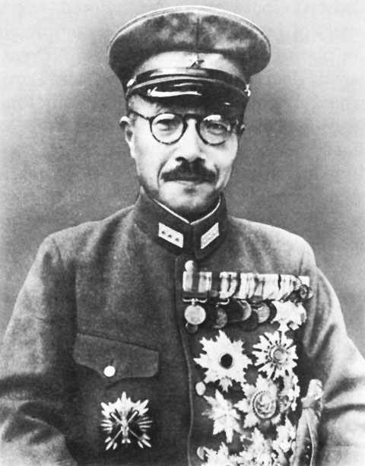
The attack that finally brought the U.S. into the war came from an unexpected country…Japan.
Since Japan dreamed of creating a vast colonial empire including China and the entire south pacific, they felt that the only thing standing in their way was the U.S.
The Japanese began their southward push in July of 1941 by taking over French military bases in Indochina (now Vietnam, Cambodia, & Laos). The U.S. protested this new act of aggression by cutting off trade with Japan. The embargoed goods included the one thing Japan could not live without – oil to fuel its war machine. Japanese military leaders warned that, without oil, Japan could be defeated without its enemies ever striking a blow. The leaders declared that Japan must either persuade the U.S. to end its oil embargo or seize the oil fields in the Dutch East Indies.
In October, the Japanese general Hideki Tojo became the new prime minister of Japan. Shortly after taking office, Tojo met Hirohito (Japan’s emperor) and promised that the Japanese government Would make a final attempt to preserve peace with the U.S. If peace talks failed, Japan would have no choice but to go to war.
On Nov. 5^{th,} 1941, the day that Tojo’s envoy flew to Washington for peace talks, Tojo orders the Japanese navy to prepare for an attack on the U.S.

Slide 45
The Attack on Pearl Harbor
Early the next morning, a Japanese dive-bomber swooped low over the U.S. naval base in the Pacific. The bomber was followed by more than 180 Japanese warplanes launched from six aircraft carriers. As the first Japanese bombs found their targets, a radio operator flashed this message: “Air raid on Pearl Harbor. This is not a drill.”
For an hour and a half, the Japanese planes were barely disturbed by U.S. antiaircraft guns & blasted target after target. By the time the last plane soared off around 9:30 a.m.
For Japan, the attack on Pearl Harbor was a stunning victory. The Japanese navy all but crippled the entire U.S. Pacific Fleet in one blow. Its own casual ties numbered only 29 planes. In Tokyo, the elated Tojo visited a shrine to thank the spirits of his ancestors of the favorable opening of Japan’s campaign to rule East Asia.
The surprise raid had sunk or badly damaged 18 ships. About 350 planes had been destroyed or severely damaged. Some 2,400 people had died, & another 1,178 had been wounded. These losses constituted more damage than the U.S. Navy had suffered in all of World War I.

Slide 46
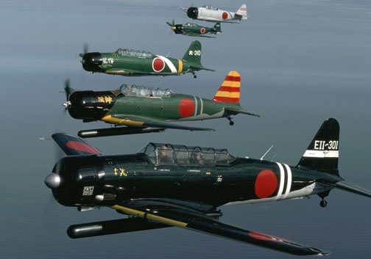
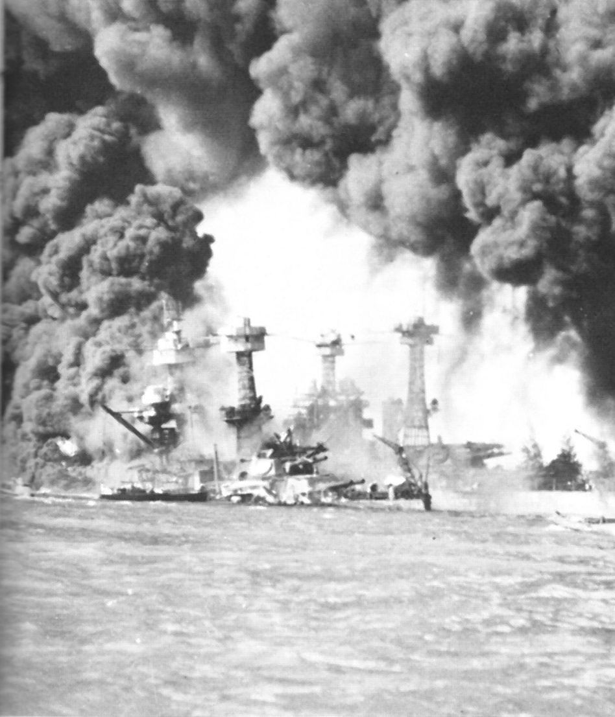
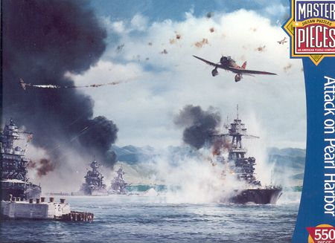

Slide 47
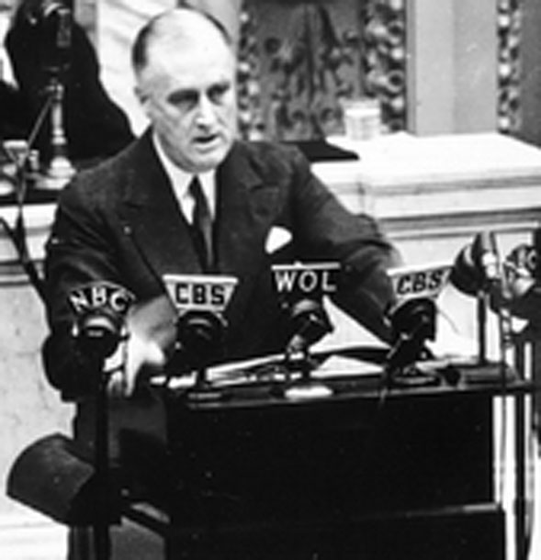
The Next day President Roosevelt addressed Congress.
“Yesterday, December 7, 1941, a date which will live in infamy,” he said, “…the Japanese launched an unprovoked & dastardly attack on American soil.”
He asked for a declaration of war against Japan, which Congress quickly approved.
Note: Three days later, Germany & Italy declare war on the United States.

Slide 48
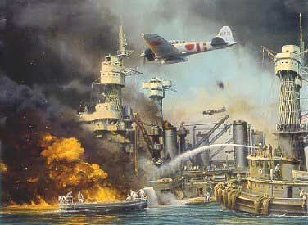
After the bombing at Pearl Harbor, the Japanese seized Guam & Wake island in the western Pacific. Then they launched an attack on the Philippines. In Jan. 1942, the Japanese marched into the Philippine capital of Manila, where they overwhelmed U.S. & Filipino defenders on the Bataan Peninsula in April & in May, on the island of Corregidor.
The Japanese also hit the British, seizing Hong Kong & invading Malaysia. By Feb. 1942, the Japanese had reached Singapore. By March, the Japanese had conquered more than 1 million sq. miles of land with about 150 million people.
After a string of victories, the Japanese seemed unbeatable. Nonetheless, the Allies, mainly the U.S. & Australians were anxious to strike back in the Pacific. In April 1942, the U.S. wanted revenge for Pearl Harbor. So, the U.S. sent 16 B-25 bombers under the command of Lieutenant Colonel James H. Doolittle to bomb Tokyo & other major Japanese cities. The bombs did little damage. The attack, however, made an important psychological point, the Japanese could be attacked.

Slide 49
The Battle of Midway: Japan next targeted Midway island, west of Hawaii. The island was home to a key U.S. airfield. By June 1942, a Japanese code had been broken and as a result, the new commander in chief of the U.S. Pacific Fleet, Admiral Chester Nimitz, knew that a force of over 150 ships was heading toward Midway. The Japanese fleet was the largest naval force ever assembled. It could also boast the world’s largest battleship, carrying Admiral Yamamoto himself.
Yamamoto planned to seize Midway & finish off the U.S. Pacific Fleet. He hoped the U.S. force would come from Pearl Harbor to defend the island.
Nimitz was outnumbered 4 to 1 in ships & planes. Even so, he was preparing an ambush for the Japanese at Midway. On June 3, with U.S. forces hidden beyond the horizon, Nimitz allowed the enemy to launch the first strike. As Japanese planes roared over Midway island, U.S. carrier planes attacked Japanese ships. Many Japanese planes were still on the decks of the ships. The strategy was a success. U.S. pilots destroyed 322 Japanese planes, all 4 aircraft carriers & one support ship.
Yamamoto ordered his fleet to withdraw. By June 6, 1942, the battle was over.
The Battle of Midway had turned the tide of war in the Pacific against the Japanese.

Slide 50
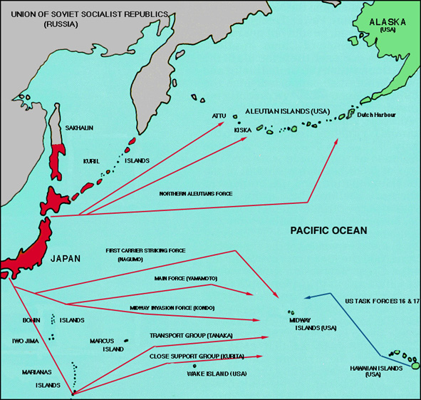
Midway Island

Slide 51
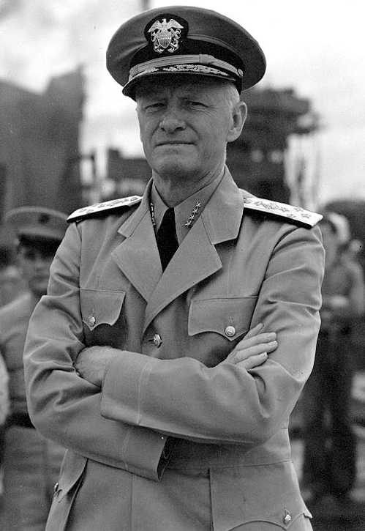
Admiral Chester Nimitz
Admiral Yamamoto

Slide 52
The Holocaust
The systematic murder of 11 million people across Europe, more than half of whom were Jews.

Slide 53
Jews were not the only victims of the Holocaust, but they were at the center of the Nazis’ target. For decades, many Germans looking for a scapegoat, or someone to blame for their failures & frustrations had targeted the Jews. As a result, when Hitler blamed the Jews for Germany’s defeat in WWI & for its economic problems following the war, many Germans were more than ready to support him.
In 1935, the Nuremberg Laws stripped Jews of their civil rights & property if they tried to leave Germany. To make identification easier, Jews over the age of six had to wear a bright yellow Star of David on their clothing

Slide 54
On November 9, 1938, a night that came to known as Kristallnacht, or “crystal night” - the night of broken glass. Hitler's Nazis burned synagogues all over Germany and Austria, smashed shop windows, looted stores, ransacked Jewish homes, and killed dozens of Jews. Twenty thousand Jews were arrested.
Two days later, the German government imposed an "atonement fine" of a billion marks on the Jews to pay for the property damage and, several weeks after that, announced that Jewish assets would be confiscated. A few days later, the government forbade Jews to drive cars or use public transportation, visit public parks and museums, or attend plays or concerts. It was a prelude to the horrors of the Nazi concentration camps to come and is often considered the beginning of the Holocaust.

Slide 55
Beginning in 1933, about 60,000 refugees – including such distinguished people as Albert Einstein – fled to the U.S. More could have come if the U.S. had been willing to relax its strict immigration quotas. This was not done, partly because of widespread anti-Semitism among Americans and partly because many Americans feared that letting in more refugees during the Great Depression would mean competition for scarce jobs. Americans also feared that this might open doors to “enemy agents”
The Final Solution
Unable to rid Germany of its Jews by forcing them to emigrate, the Nazis adopted a new approach following Kristallnacht. Jews healthy enough to work were sent to labor camps to perform slave labor. The rest sent to extermination camps, which amounted to genocide, or the deliberate and systematic killing of an entire people.

Slide 56
A pile of the victims shoes at Maidanek.

Slide 57
After stripping their victims of life and dignity, the Nazis took whatever articles of value the victims had possessed , such as wedding rings & gold fillings from teeth. This is a pile of glasses.

Slide 58
German soldiers cutting the beard of an elderly Jew in Poland.

Slide 59
Children subjected to medical experiments in Auschwitz.

Slide 60
In addition to Jews, Nazis had concentrated on silencing their political opponents – Communists, socialists, liberals and anyone else who spoke out against the government.
In addition to Jews, these groups included:
Gypsies – Nazis believed them to be an inferior race
Freemasons – Whom the Nazis charged to be supporters of the “Jewish conspiracy” to rule the world.
Jehovah’s Witnesses – who refused to join the army or salute Hitler.
Homosexuals
The mentally retarded
The insane
The disabled
The incurably ill
All of which they found to be unfit to be part of the “Master Race”.

Slide 61
The gas chambers of Krema IV in Auschwitz. As opposed to Kremas II and III, these gas chambers were above ground, and the Zyklon-B was introduced through small openings in the wall, which had shutters on them (visible in the photograph).
In the camps the Germans used various killing tactics on the prisoners. They shot, hanged, gassed, injected with poison, burned alive, used medical experiments & starved the prisoners. After which, they used huge crematoriums to burn the bodies or they simply threw the bodies into pits and burned them.

Slide 62
A mass execution of Jews in Nazi occupied Soviet Union. The SS man is firing at a Jewish woman who is wounded and trying to get up.

Slide 63
A mass execution of Jews in Nazi occupied Soviet Union. Naked Jews, including a young boy, just before their murder.

Slide 64
Scenes of horror at Nazi concentration camps, were people were subjected to medical experiments.
A mass execution of Jews in Nazi occupied Ukraine.

Slide 65
Thousands of unburied bodies found by U.S. soldiers

Slide 66
The First U.S. army found skeleton-like bodies when they entered Dora

Slide 67
Survivors found by American soldiers

Slide 68
Victims moving towards the gas chamber in Auschwitz

Slide 69
This is the crematoria at Buchenwald. The remains left inside are women who were murdered.

Slide 70
Jews Killed Under Nazi Rule
Original Jewish Population
Jews Killed
Percent Surviving
Poland
3,300,000
2,800,000
24%
U.S.S.R (area occupied by Germans
2,100,000
1,500,000
29%
Hungary
404,000
200,000
49%
Romania
850,000
425,000
50%
Germany/Austria
270,000
210,000
22%

Slide 71
The Tide of the War Begins To Turn

Slide 72
After the attack on Pearl Harbor, Hitler ordered submarine raids against ships along America’s East Coast. In the first 4 months of 1942, the Germans sank 87 U.S. ships off the Atlantic shore. 7 months into the year, the Germans sank a total of 681 Allied ships in the Atlantic.
The Allies respond by organizing their cargo ships into convoys, or groups for mutual protection.
The Battle Of The Atlantic
The convoys were escorted across the Atlantic by destroyers equipped with sonar for detection subs underwater & by airplanes that used radar to spot subs on the oceans surface. With this improved tracking, the Allies were able to find & destroy German U-boats faster than the Germans could build them.
At the same time, the U.S. launched a crash shipbuilding program. By early 1943, 140 ships were being produced each month and for the first time in the war, launchings of Allied cargo ships began to outnumber sinkings. By mid 1943, the tide of the Battle of the Atlantic had turned in the Allies favor.

Slide 73
The North African Front
In November 1942, some 107,000 Allied troops – most of them American - commanded by the U.S. general Dwight D. Eisenhower, landed in Casablanca, Oran & Algers in North Africa. From there they sped eastward, chasing the Afrika Korps led by General Erwin Rommel. After months of heavy fighting, the last of the Afrika Korps surrendered in May 1943.
British general Harold Alexander sent a message to Churchill, reporting that “All enemy resistance has ceased. We are masters of the North African shores.”

Slide 74
The Battle of Stalingrad
Hitler sends his troops to capture Stalingrad (A major industrial center on the Volga River) in The Soviet Union on August 23, 1942.
By early Nov. 1942, Germans controlled 90% of the ruined city. Then the infamous Russian winter set in. On Nov. 19th, Soviet troops outside the city launch a counterattack. Closing around Stalingrad, they trapped the Germans inside & cut off their supplies.
On February 2, 1943, some 90,000 frostbitten, half-starved German troops surrendered to the Soviets. The survivors were all that remained of an army of 330,000. Stalingrad’s defense had cost the Soviets over a million soldiers. The city was 99% destroyed. However, the Germans were now on the defensive, with the Soviets pushing them steadily westward.

Slide 75
The Italian Campaign:
Even before the battle in North Africa was won, FDR, Churchill & their commanders met in Casablanca to decide where to strike next. The Americans argued that the best approach to victory was to assemble a massive invasion fleet in Britain and to launch it across the English Channel, through France, and into the heart of Germany. Churchill, however, thought it would be safer to first attack Italy. The Allies compromised. They would push ahead with plans for the cross-channel invasion; meanwhile, Allied troops would invade Italy.
The Italian campaign got off to a good start with the capture of Sicily in the summer of 1943. By then, the Italians were weary of war. On July 25, 1942, King Victor Emmanuel III summoned the Fascist dictator Mussolini to his palace & stripped him of power. Mussolini was arrested and Italians began celebrating the end of the war.
Hitler responded by seizing control of Italy, reinstalling Mussolini as its leader & ordering German troops to dig in & hold firm. It took 18 months of fighting in the mud & mountains for the Allies to drive the Germans from Italian soil.
King Victor Emmanuel III

Slide 76
One of the hardest fought battles the Allies encountered in Europe was fought less than 40 miles away from Rome. This battle, “Bloody Anzio,” lasted 4 months and left about 25,000 Allied and 30,000 Axis soldiers dead. During the struggle, the Allies were aided by 50,000 Italian partisans – members of underground resistance movements. The partisans harassed the Germans by cutting telephone wires, derailing trains and dynamiting bridges and roads.
On April 28, 1945, partisans who had ambushed a Nazi convoy found Mussolini disguised as a German soldier in one of the trucks.
Mussolini & his mistress, Clara Petacci, as well as other Fascist leaders are caught by partisans near Lake Como as they attempt to escape to Switzerland. They are shot & their bodies transported to Milan and hung up by the heels in the main square, where a mob then mutilates the corpses.

Slide 77
The Allies Liberate Europe
As Allied troops pushed northward through Italy, the Soviet army moved westward into Poland. Meanwhile, in England, General Eisenhower organized Operation Overlord, the planned invasion of Hitler’s “fortress Europe.”
D-Day: For two years the U.S. & Britain had been building an invasion force of ships, landing craft & nearly 3 million troops to attack Axis forces on the other side of the English Channel. Eisenhower hoped to take the Axis by surprise & pinpointed the relatively lightly fortified Normandy peninsula as the focus of the assault. To make reinforcement of the German forces more difficult once the invasion began, the Allies bombed northern France’s supply routes – roads, bridges, & rail lines – for a month & a half before the planned assault.

Slide 80
The day of the invasion, had originally been set for June 5, but bad weather forced a delay. Banking on a forecast for clearing skies. Eisenhower gave the go-ahead for the next day & June 6, 1944, became a day that will live in history.
3 divisions parachuted down behind German lines during the night, & British, U.S. & Canadian troops fought their way ashore at 5 points along the 60-mile wide stretch of beach. With 156,000 troops, 4,000 landing craft, 600 warships & 11,000 planes, it was the largest land-sea-air operation in history.
Despite the massive air & sea bombardment by the Allies before the invasion, German retaliation was brutal, particularly at Omaha Beach. “People were yelling, screaming, dying, running on the beach, equipment was flying everywhere, men were bleeding to death, crawling, lying everywhere, firing coming from all directions. We dropped down behind anything that was the size of a golf ball.” – Soldier Felix Branham

Slide 81
Despite heavy casualties, the Allies held the beachheads. Within a month, they had landed a million troops, 567,000 tons of supplies & 170,000 vehicles in France. On July 25, General Omar Bradley unleashed massive air & land bombardment against the enemy at St.-Lo. Giving General George Patton & his 3rd army the gap they needed to advance. On Aug. 23, they reached the Seine River south of Paris. 2 days later, French Resistance troops & U.S. troops liberated the French capital from 4 years of German occupation.
By September 1944, the Allies had freed France, Belgium, Luxembourg & much of the Netherlands. This good news along with the American people’s desire not to “change horses in midstream” helped elect Roosevelt to an unprecedented 4th term in November, along with his new moderate running mate, Senator Harry S. Truman.

Slide 82
Germany’s Unconditional Surrender:
After the battle of the Bulge, the war in Europe drew to a close. In late March 1945, the Allies rolled across the Rhine River into Germany.
By the middle of April, about 3 million soldiers approached Berlin from the Southwest and another 6 million Soviet troops approached from the east. By April 25, 1945, the Soviets had surrounded the capital & were pounding the city with artillery fire.
While Soviet shells burst over Berlin, Hitler prepared for his end in an underground bunker beneath the crumbling city. On April 29, he married his long-time companion Eva Braun. The next day, they committed suicide. Their bodies were then carried outside and burned.
On May 7, 1945, General Eisenhower accepted the unconditional surrender of the third Reich from the German military. President Roosevelt, who suddenly died due to a stroke did not see the surrender of Germany.
Roosevelt’s successor, Harry Truman, received the news of the Nazi Surrender. On May 9th, the surrender was officially signed in Berlin. The U.S. and other Allied powers celebrated V-E Day - Victory in Europe Day. After 6 yrs of fighting, the war was over.

Slide 83
Although the war was over in Europe, the Allies were still fighting the Japanese in the Pacific. With the Allied victory at Guadalcanal, however, the Japanese advances in the Pacific had been stopped. For the rest of the war, the Japanese retreated before the counterattack of the Allied powers
Victory in the Pacific
By the fall of 1944, the Allies were moving in on Japan. In Oct. Allied Forces landed on the island of Leyte (LAY tee) in the Philippines.
General Douglass MacArthur
General Douglass MacArthur waded ashore at Leyte with his troops. On reaching the beach, he declared, “People of the Philippines, I have returned.”

Slide 84
The Battle of Leyte Gulf Continued:
The Japanese had devised a bold plan to halt the Allied advance. They would destroy the U.S. fleet, thus preventing the Allies from resupplying their ground troops. This plan, however, required risking almost the entire Japanese fleet. They took this gamble on Oct. 23. Within 4 days, the Japanese NAVY had lost disastrously – eliminating it as a fighting force in the war. Now, only the Japanese ARMY & the feared kamikaze stood between the Allies & Japan.
Japanese Suicide Pilots aka Kamikazes

Slide 85
In March 1945, after a month of bitter fighting and heavy losses, U.S. Marines took Iwo Jima, an island 760 miles from Tokyo. On April 1, U.S. troops moved onto the island of Okinawa, only about 350 miles from southern Japan. The Japanese put up a desperate fight. Nevertheless, on June 21, one of the bloodiest land battles of the war ended. The Japanese lost over 100,000 troops and the Americans 12,000.

Slide 86
Mobilization of scientists – In 1941, Roosevelt created the Office of Scientific Research & Development (OSRD) to bring scientists into the war effort. They made improvements in both radar & sonar, a new technology for locating submarines underwater. They also pushed the development of drugs such as penicillin, that saved countless lives on & off the battlefield.
The greatest scientific achievement of the OSRD, was the secret development of a new weapon, the atomic bomb. Interest in such a weapon began in 1939, after German scientists succeeded in splitting uranium atoms, which released enormous amounts of energy. This news prompted physicist & German refugee Albert Einstein to write a letter to President Roosevelt, warning that the Germans could use their discovery to construct a weapon of enormous destructive power.
Roosevelt responded by creating a National Committee on Uranium to study the new discovery. In 1941, the committee reported that it would take from 3 to 5 years to build an atomic bomb.
Hoping to shorten that time, the OSRD set up a crash program in 1942 to develop a bomb as quickly as possible. Because its offices were located in New York City, the atomic bomb program came to be know as the Manhattan Project.
Roosevelt did not live to see the final battles of the war. On 4/12/45, while posing for a portrait in Warm Springs, Ga. The president had a stroke & died. That night, Harry S. Truman became the nations president.

Slide 87
Harry S. Truman
As the world mourned Roosevelt’s death, an inexperienced Truman began to grapple with his new job as president & commander in chief of the armed forces.
Not long after Truman took office, Secretary of War Henry Stimson handed him a memo that began, “Within four months we shall in all probability have completed the most terrible weapon ever known in human history, one bomb of which could destroy a whole city.”
Over the next hour, the president learned that the Manhattan Project was not only the most ambitious scientific enterprise in history but also the best-kept secret of the war.

Slide 88
The Manhattan Project
At its peak, more than 600,000 Americans were involved in the project, although few of them knew its ultimate purpose – the creation of an atomic bomb.
Work on the bomb began in 1942, after a group of scientists under the direction of physicist Enrico Fermi successfully achieved a controlled nuclear reaction at the University of Chicago. General Leslie Groves, the organizer of the Manhattan Project, had two gigantic atomic reactors built at Oak Ridge, Tennessee & another at Hanford, Washington, to produce uranium 235, a rare form of the element, along with the even rarer element plutonium, to fuel the explosive device. Meanwhile, a group of U.S., British, & European refugee scientists headed by J. Robert Oppenheimer worked in a secret laboratory in Los Alamos, New Mexico, to build the actual bomb.
Enrico Fermi

Slide 89
As the time to test the bomb drew near, the air around Los Alamos crackled with rumors and fear. At one end of the scale were fears that the bomb wouldn’t work at all or, if it did, would not produce enough punch to amount to much. At the other end was the prediction that the explosion would set fire to the atmosphere, which would mean the end of the earth.
On the night of July 16, 1945, the first atomic bomb was detonated in an empty expanse of desert near Alamogordo, New Mexico.
A blinding flash, which was visible 180 miles away, was followed by a deafening roar as a tremendous shock wave rolled across the trembling desert.
One scientist on the project described the huge mushroom cloud as a red-hot elephant standing balanced on its trunk.
The bomb not only worked, but it was more powerful than most had dared hope.

Slide 90
On July 25, 1945, Truman ordered the military to make final plans for dropping the only two atomic bombs then in existence on Japanese targets. A day later, the U.S. warned Japan that it faced “prompt and utter destruction” unless it surrendered at once. Japan refused.
Truman later wrote:
“The final decision of where and when to use the atomic bomb was up to me. Let there be no mistake about it. I regarded the bomb as a military weapon and never had any doubt that it should be used.”

Slide 91
On Aug, 6th, a B-29 bomber named Enola Gay released an atomic bomb, code-named Little Boy, over Hiroshima, an important Japanese military center. 43 seconds later, almost every building in the city collapsed into dust. Hiroshima had ceased to exist. Still Japan’s leaders hesitated to surrender. 3 days later, a second bomb, code-named Fat Man, was dropped on Nagasaki, leveling half the city. By the end of the year, an estimated 200,000 people had died as a result of injuries and radiation poisoning caused by the atomic blasts.
This shows the "Little Boy" weapon in the pit ready for loading into the bomb bay of Enola Gay.

Slide 92
Hiroshima
Nagasaki
Fat Man
Before and after photo of Nagasaki

Slide 94
A burned school girl
A child with his face arms and legs burnt
Another burn victim
A girl who lost her hair to radiation sickness

Slide 95
World War II ends with the surrender of Germany on May 8th and the surrender of Japan on Sept. 2nd 1945
Wartime conferences w/ THE BIG 3 (U.S., Britain, Soviet Union)
Yalta Conference – Feb. 1945
Potsdam Conference – July 1945 - (Began under a cloud of mistrust)
Establishment of the UN (United Nations) First Meeting April 1945,
The first session was convened on January 10, 1946 in the Westminster Central Hall in London and included representatives of 51 nations. 1946 & again in June 1946. By June they had agreed on a charter. The charter created the General Assembly, which was made up of all member nations & was expected to function as a “town meeting of the world.” The charter also set up administrative, judicial, & economic governing bodies.
An 11 member Security Council held the real power, though the 5 main wartime Allies - The U.S., Great Britain, France, China & The Soviet Union were given permanent seats on the Security Council. At the insistence of the USSR & the U.S., each permanent member had the power to veto any council action. The other six seats rotated to countries elected by the General Assembly.

Slide 96
The Devastation of WWII
By the end of WWII, Europe lay in ruins. Close to 40 million Europeans had died – 2/3 of them civilians. Constant bombing & shelling had reduced hundreds of cities to rubble. The ground war had destroyed much of the countryside. Displaced persons from many nations were struggling to get home.
A few of the great cities of Europe (Paris, Rome, Brussels) remained undamaged by war. Many however, had suffered terrible destruction. London was left in ruins by the German Blitz. Eastern Europe & Germany were far worse off. Warsaw, the capital of Poland, was almost wiped from the face of the earth. In 1939, Warsaw had a population of 1,289,000. When the Russians entered the city in January 1945, only 153,000 remained, or 11%.
In Berlin, 95% of the central city was demolished. One U.S. officer stationed in Berlin reported, “Wherever we looked, we saw desolation. It was like a city of the dead.”

Slide 97
A City in Great Britain
After the war, many civilians stayed where they were & tried to get on with their lives. Some lived in partially destroyed homes or apartments. Others huddled in caves & cellars beneath the rubble. They had no water, no electricity, and very little food. With factories destroyed or damaged, most people had no earnings to buy the food that was available.

Slide 98
Although many remained in the cities, a large number of city dwellers fled. Many people ended up wandering Europe. These people included the survivors of concentration camps, prisoners of war and refugees fleeing the Soviet army.
Millions found themselves in the wrong country when the postwar treaties changed national borders. They jammed the roads trying to get home, hoping to find their families or to find a safe place
After the war, agriculture was disrupted. Most able-bodied men fought in the war & the women worked in war production, so there were very few to tend to the fields.
Also the transportation systems were destroyed, so the little agriculture that there was often did not reach the cities. Thousands died of famine & disease spread through the bombed-out cities. In August 1945, 4,000 citizens of Berlin died every day! To get a few potatoes, people would barter any valuable items they had left. The first winter after the war brought more suffering as people went without shoes & coats.

Slide 99
Costs of WWII: Allies & Axis
Direct War Costs
Military Killed/Missing
Civilians Killed
United States
Great Britain
France
USSR
Germany
Japan
$288 billion
$117 billion
$111.3 billion
$93 billion
$212.3 billion
$41.3 billion
292,131
271,311
205,707
13,600,000
3,300,000
1,140,429
0
60,595
173,260*
7,720,000
2,893,000*
953,000
Note: *Of the 173,260 French civilians that were killed, 65,000 were murdered Jews.
Of the 2,893,000 German civilians who were killed, about 170,000 were murdered Jews & 56,000 were foreign civilians in Germany.

Slide 100
The Nuremberg War Trials
On 20 November 1945 the first trial against the principal war criminals of the “Third Reich“ begins at the International Military Court in Nuremberg. The indictment includes war crimes, “crimes against humanity“ & “crimes against peace“. Not all major Nazis could be brought before the Allies: Hitler, Joseph Goebbels and Heinrich Himmler committed suicide.
The trial, which lasts over a year, reveals for the first time the extent of the National Socialist reign of terror.
On 1 October 1946 12 of the 22 accused are condemned to death. Göring escapes the hangman by committing suicide. Seven of the accused receive sentences of many years or life sentences. In only three cases were defendants acquitted. In later trials of lesser leaders, nearly 200 more Nazis were found guilty of war crimes. For the first time in history a nation’s leaders had been held legally responsible for their actions during wartime.

Slide 101
The Occupation of Japan
Japan was occupied by U.S. forces under the command of General Douglass MacArthur. To ensure that fighting would end, he disbanded the Japanese armed forces, leaving the Japanese with only a small police force. In the early months of the occupation, more than 1,100 Japanese, from former prime minister Hideki Tojo, lowly prison guards, were arrested & put on trial. Seven including Tojo, were sentenced to death by hanging. In the Philippines, in China, & other Asian battlegrounds, additional Japanese officials were tried for atrocities against civilians or prisoners of war.
During the 6 year U.S. occupation, MacArthur reformed Japan’s economy by introducing free-market practices that led to a remarkable economic recovery. MacArthur also worked to transform Japan’s government. He called for a new constitution that would provide for woman suffrage & guarantee basic freedoms. To this day, their constitution is known as the MacArthur Constitution.

