Slide 1
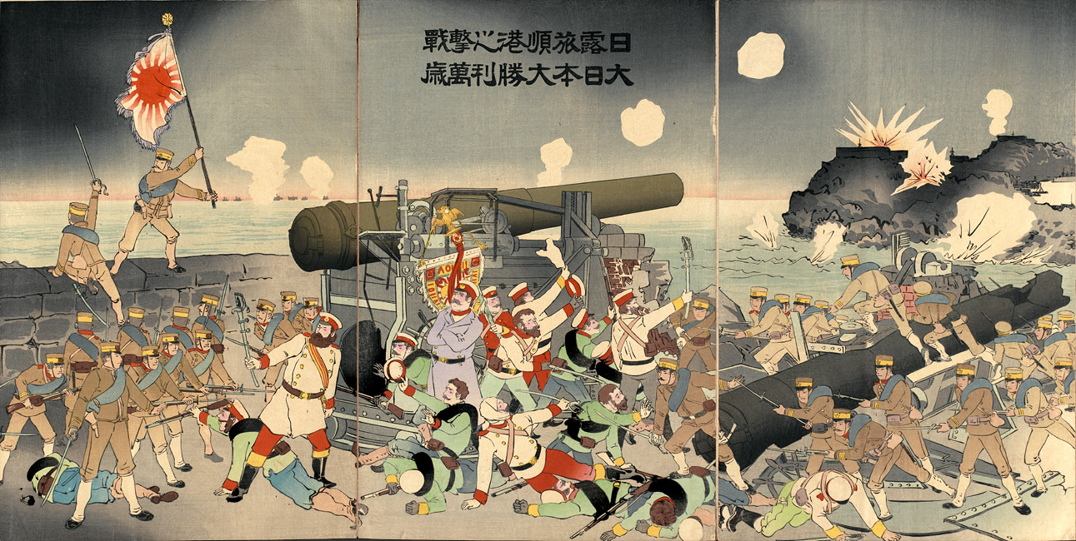
How and why did Japan become an Imperial Power?
L/O – To understand the causes and effects of Japanese Imperialism, from the Sino-Japanese War (1894-5) to the Russo-Japanese War (1904-5)

Slide 2
1871 – New Imperial Army created, 10,000 Samurai
1873 – Mass Conscription Introduced, men 20+ for 3 years
1876 – Treaty of Kanghwa – Unfair treaty imposed on Korea
1882 – Imperial Rescript to Soldiers & Sailors, Indoctrination
1894-5 – Sino-Japanese War – Japan wins, gains Taiwan
1890s – Ending of the Unfair Treaties on Japan
1902 – Anglo-Japanese Alliance
1904-5 – Russo-Japanese War – Japan wins!
1910 – Japan annexes Korea

Slide 3
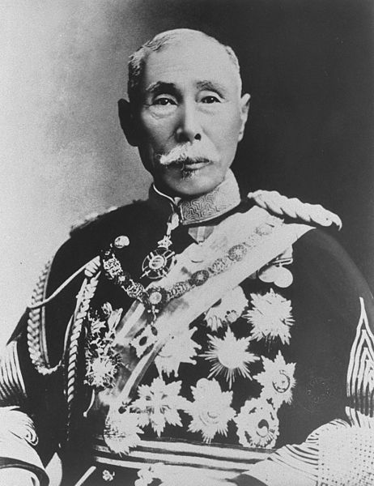
Reasons for Japanese Imperialism
The desire of the Meiji Reformers to resist domination by Western Powers had always been one of the main goals of the Meiji Restoration.
Therefore alongside economic reforms came military reforms - fukoku kyō nei (rich country, strong army).
Yamagata Aritomo, an ex-Samurai from Choshu, became the founding father and pioneer of the modern Japanese army, serving as War Minister 1873, Prime Minister 1889 and Field Marshall 1898. He was also one of the original Genrō.
Yamagata Aritomo (1838-1922)

Slide 4
Reasons for Japanese Imperialism
Yamagata had learnt his lessons from the Western nations – the strong eat up the weak, i.e. survival of the fittest (Social Darwinism).
In the age of empires, Japan realised that an Imperial Power needed an empire of its own to survive.
This idea became the rationale for building a huge military establishment capable of overseas missions.
In the West there is England,
In the North, Russia.
My countrymen, be careful!
Outwardly they make treaties,
But you cannot tell
What is at the bottom of their hearts.
There is a Law of Nations, it is true,
But when the moment comes, remember,
The Strong eat up the Weak.
(Popular Japanese song, 1880s)

Slide 5
Story from the Sino-French War (1884) by Utagawa Kunisada III
Notes:
China in particular appeared to be the perfect negative example of this ruthless power struggle. In 1884, for example, a Japanese official published an account of recent travels in China that captured this sentiment in the harshest imaginable terms. The Chinese, Sugita Teiichi wrote, were narrow-minded and obstinate and “do not know the great trends of the world.”

Slide 6
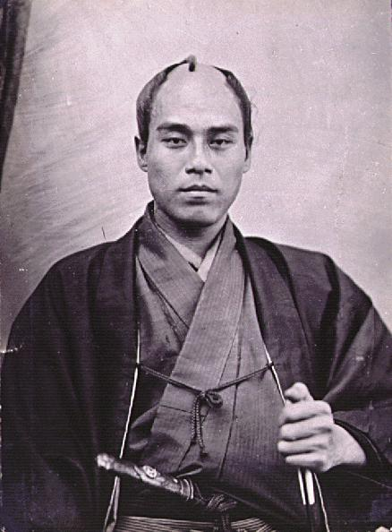
Reasons for Japanese Imperialism
To the Japanese, China appeared to be the perfect negative example. The Japanese criticised China for not adapting to the changing world.
Japan believed it had a right and duty to use force to make China and Korea adopt the path of ‘progress’ before they were taken over by the West.
This would make all of Asia stronger. However some Japanese would come to resent the weakness of their neighbours and called for Japan to ‘throw off Asia’.
Fukugawa Yukichi
(1835-1901)

Slide 7
We must not wait for neighbouring countries to become civilized so that we can together promote Asia’s revival. Rather we should leave their ranks and join forces with the civilized countries of the West. We don’t have to give China and Korea any special treatment just because they are neighbouring countries. We should deal with them as Western people do. Those who have bad friends cannot avoid having a bad reputation. I reject the idea that we must continue to associate with bad friends in East Asia. From ‘On Throwing off Asia’ by Fukuzawa Yukichi, Quoted in Oka Yoshitake’s excellent “Prologue” to Marlene Mayo, ed.,The Emergence of Imperial Japan

Slide 8
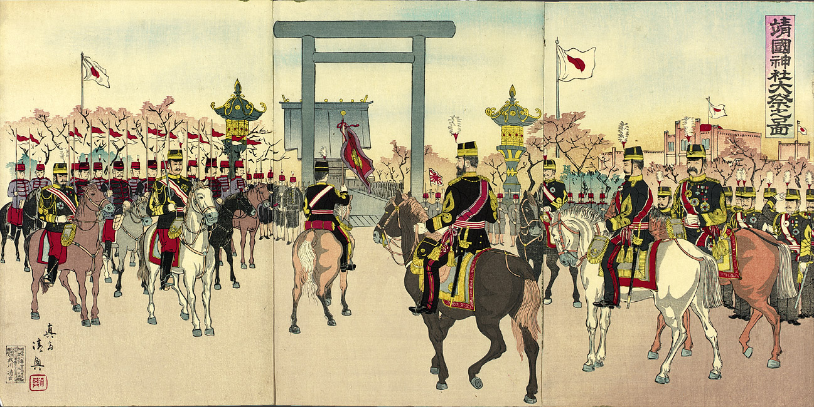
The Spiritual Glory of dying for the Emperor was promoted through Shinto Shrines like the Yasukuni in Tokyo

Slide 9
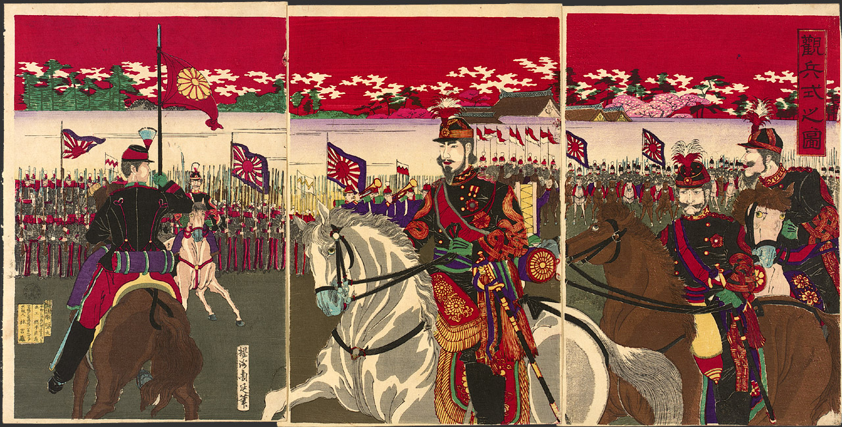
Illustration of a Military Review (1887) by Toyohara Chikanobu

Slide 10
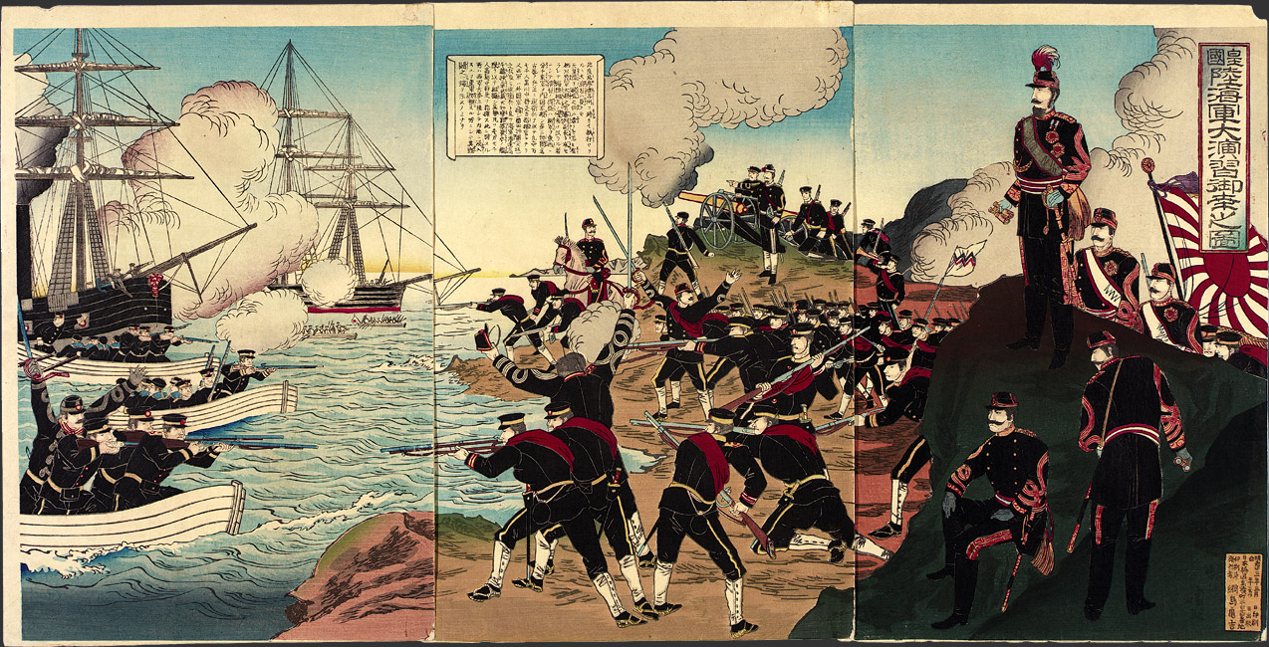
Observance by His Imperial Majesty of Military Maneuvers of Combined Army and Navy Forces (1890) by Toyohara Chikanobu

Slide 11
Growing Imperialism
In order to become an imperial power, the Japanese military needed reforming. Yamagata Aritomo led the changes, having decided to follow the Prussian model after visiting Germany as part of the Iwakura mission in 1872.
1871 – Imperial Army created by Yamagata Aritomo, 10,000 Samurai.
1873 – Mass Conscription introduced, all men over 20 years for 3 years.
Yamagata Aritomo (1838-1922)

Slide 12
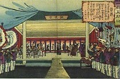
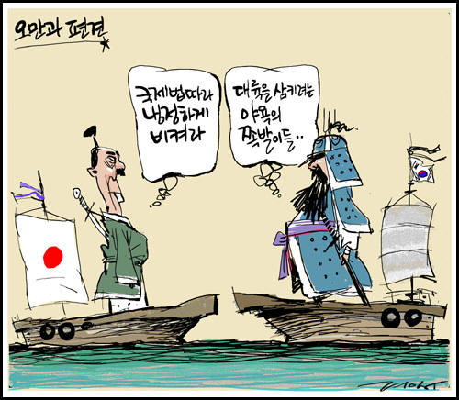
1876 – The Treaty of Kanghwa
The Japanese navy led a military mission to Korea. After some minor battles, the Korean government was forced to sign the Treaty of Kanghwa.
This recognised Korean independence but opened Korea to trade on preferential terms with Japan. Japan was also exempt from customs duties.
This angered China who saw Korea as its ‘protectorate’ and vassal state.

Slide 13
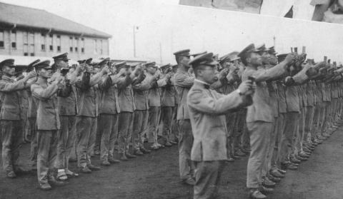
1882 – Imperial Rescript…
‘Duty is weightier than a mountain, while death is lighter than a feather’.
The emperor releases the Imperial Rescript to Soldiers and Sailors. This was the official code of ethics for military personnel.
They were instructed to be personally loyal to the emperor, avoid politics, live simply and respect civilians.
Military personnel had to memorise the document, strengthening the unquestioning bond between soldier and emperor.

Slide 14
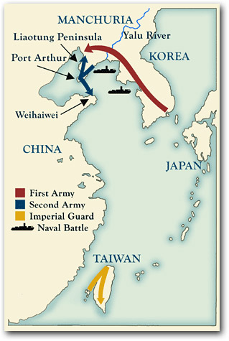
1894-95: Sino-Japanese War
The Tonghak Rebellion in Korea, partly against Japanese influence begins. China sends troops in support of government.
Japan sent over 200,000 troops to protect its ‘zones of influence’. In reality, Japan was trying to cement its control of Korea and Manchuria.
Fighting spills out into Manchuria and Taiwan, with Japan completely defeating China.

Slide 17
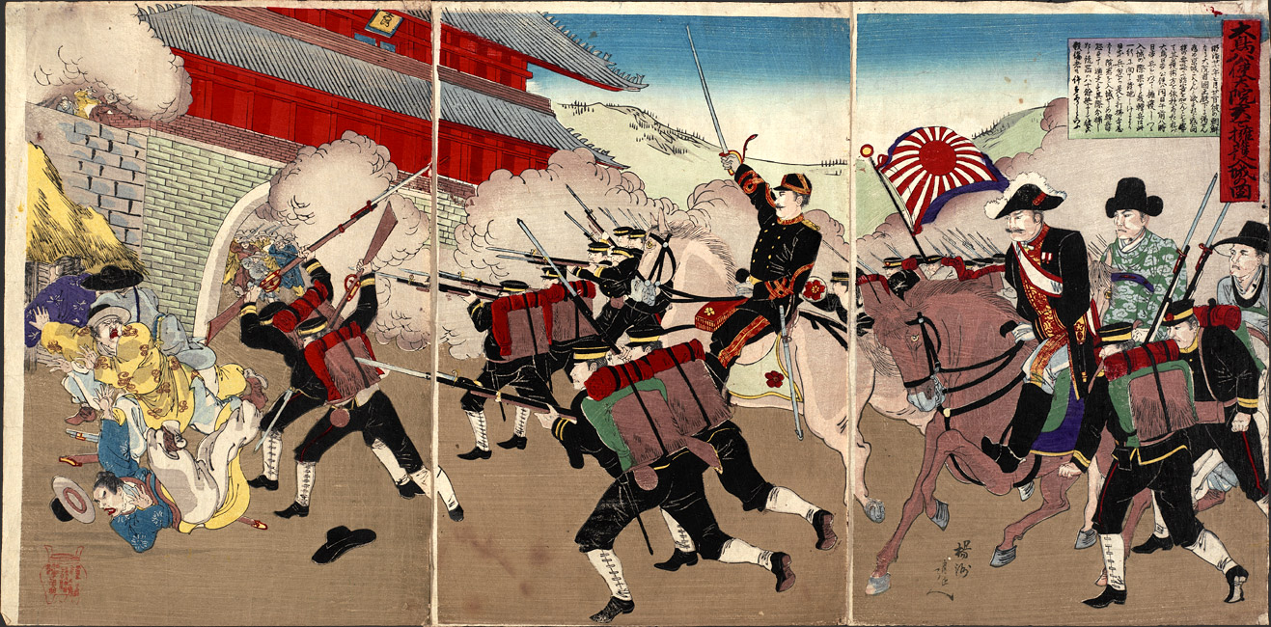
Minister Otori escorting the Korean Regent as they enter the Palace at Keijo (1894) by Toyohara Chikanobu
Notes:
A number of Sino-Japanese War prints, such as this one, depicted Korean digitaries in the company of the Japanese. This served the purpose of reinforcing the Japanese argument that they were fighting to protect Korea against Chinese encroachment and had the support of more progressive Korean leaders in doing so.

Slide 18
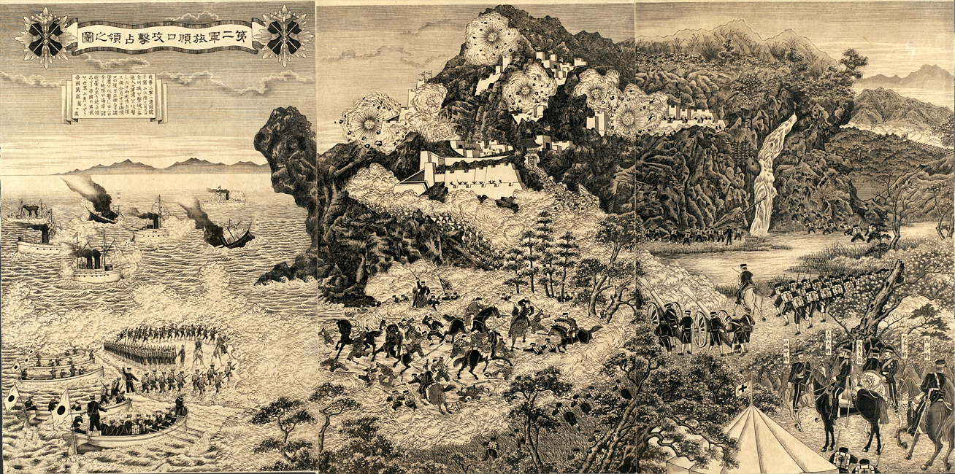
Illustration of the Second Army attacking and occupying Port Arthur (1894)
Notes:
As it happens, there does exist a rare, anonymous Japanese woodcut engraving of one of the greatest battles of the Sino-Japanese War, the capture of Port Arthur in November 1894. Identical in size with a standard-size woodblock triptych (14 x 28 inches), this suggests how Japanese graphic artists might have depicted the war if they had adopted the Western practice of detailed black-and-white renderings. The detail is, indeed, meticulous—so obsessively fine that the overall impression is almost clinical. The contrast to the animated multi-colored woodblock prints could hardly be greater.

Slide 19
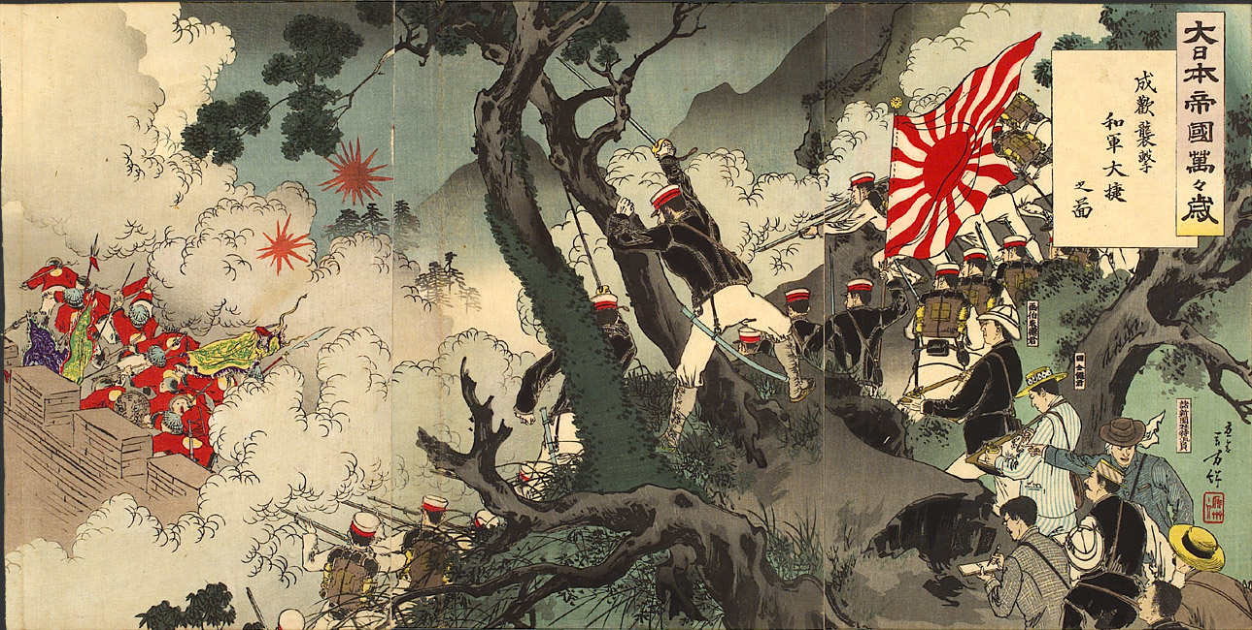
Hurrah, Hurrah for the Great Japanese Empire! Picture of the Assault on Songhwan, a Great Victory for Our Troops (1894) by Mizuno Toshikata
Notes:
In Toshikata’s rendering, stalwart Japanese soldiers with a huge “Rising Sun” military flag in their midst advance against a Chinese force in utter disarray. Can we trust the veracity of this artistic rendering? Surely we can, for on the right-hand side of Toshikata’s print we see a delegation of Japanese “newspaper correspondents” that includes at its head not one but two artists, identified by name. Depictions such as this very print, Toshikata seems to be assuring his audience—and right at the start of the war—could be trusted to be accurate.

Slide 20
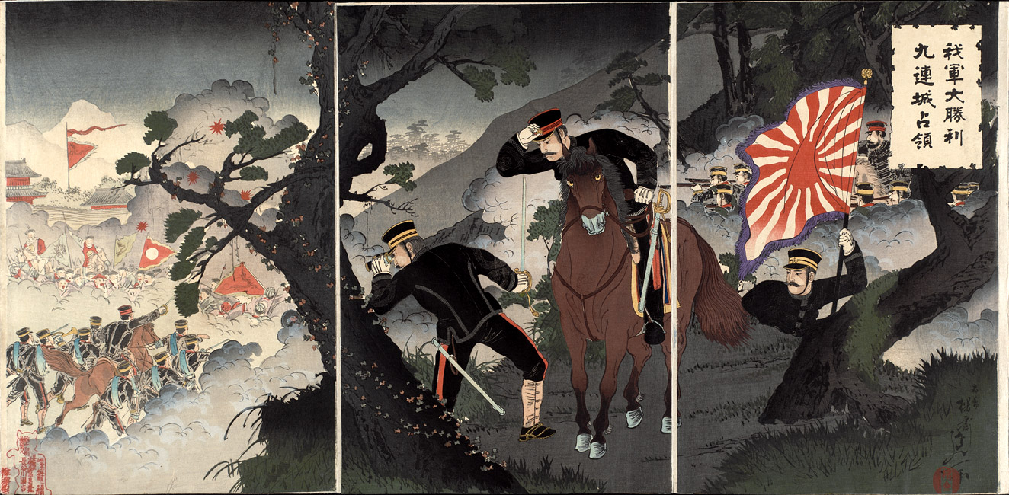
Our Forces’ Great Victory and Occupation of Jiuliancheng (1894) by Watanabe Nobukazu
Notes:
prints often simply “quoted” other prints. In early November 1894, for example, Toshikata’s colleague Watanabe Nobukazu produced a rendering of “Our Forces’ Great Victory and Occupation of Jiuliancheng” that bore close resemblance to Toshikata’s “Hurrah, Hurrah” of over three months earlier. Disciplined soldiers looked down from on high, other troops advancing below them. The same military flag fluttered in the same right hand panel of the triptych; a bent and gnarled pine, so beloved in Japanese art, was again rooted in the center of the image; the foe retreated in the far distance.

Slide 21
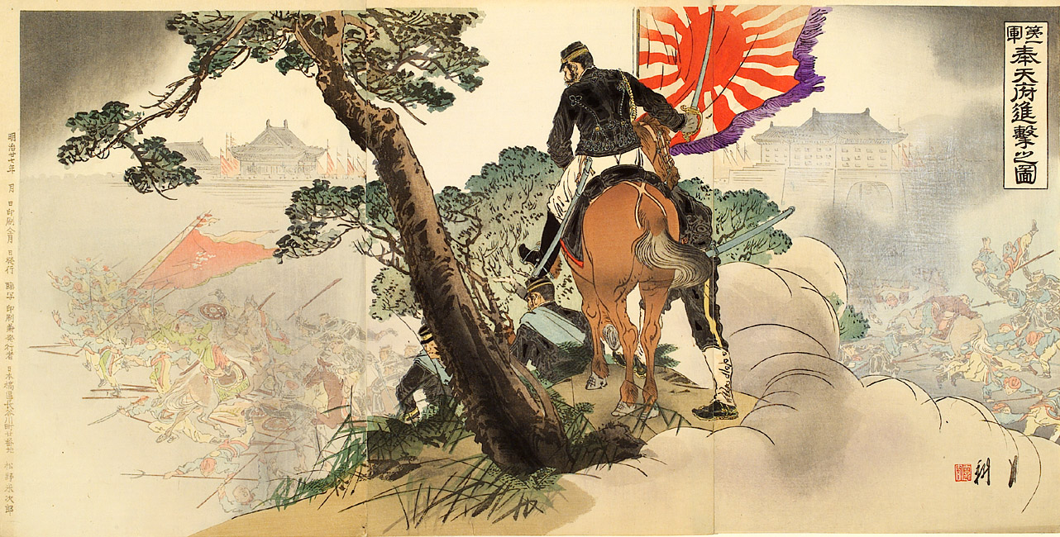
Picture of the First Army Advancing on Fengtienfu (1894) by Ogata Gekko
Notes:
That same November, Ogata Gekkō used much the same flag, pine, and craggy bluff to illustrate the army’s advance on Mukden.

Slide 22
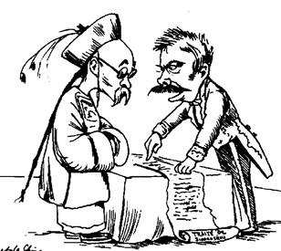
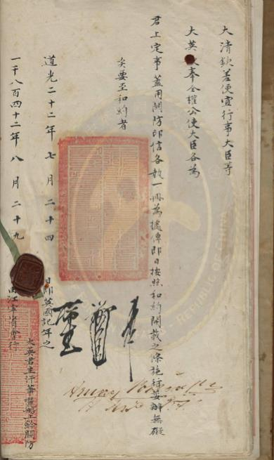
1894-95: Sino-Japanese War
In the resulting Treaty of Shimonoseki, Japan cements its influence over Korea, wins control of Taiwan and the Liaodong Peninsula in Manchuria. Also received cash reparations amounting to $170 million gold from China.
However Russia, France and Germany protest and Japan is forced to give up control of the Liaodong Peninsula to Russia.
Despite ‘throwing off Asia’ and defeating China, Japan is still not treated as an equal by the West.

Slide 23
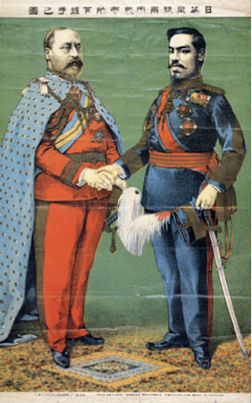
1902: Anglo-Japanese Alliance
The Sino-Japanese War was significant not just because Japan gained an empire. It also led to Western Powers ending the unfair treaties in the late 1890s.
Japan even signed a defensive military alliance with Great Britain, against Russia.
Japan had now become respected by the most powerful nation on earth but with imperialism came racist attitudes:

Slide 24
The real birthday of the new Japan … began with the conquest of China. The war is ended; the future, though clouded, seems big with promise; and, however grim the obstacles to loftier and more enduring achievements, Japan has neither fears nor doubts. Perhaps the future danger is just in this immense self-confidence. It is not a new feeling created by victory. It is a race feeling, which repeated triumphs have served only to strengthen. Quoted from Lafcadio Hearn’s book: Kokoro, by Shumpei Okamoto in Impressions of the Front.

Slide 25
1904-5: Russo-Japanese War
Fired by their victory over China, tensions between Russia and Japan over Manchuria and Korea continued.
On 8th February 1904, the Japanese naval launched a surprise attack on the Russian Far Eastern Fleet at Port Arthur. Japan declared war 3 hours later!
Japan mobilises over 1 million men and defeats the Russians in Manchuria after a series of land battles. 90,000 Japanese die.

Slide 26
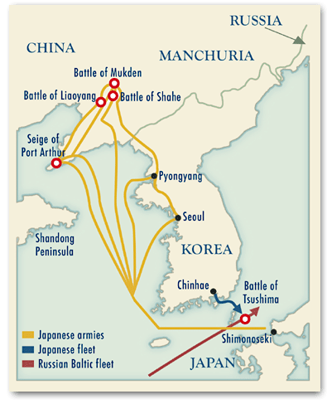

Slide 28
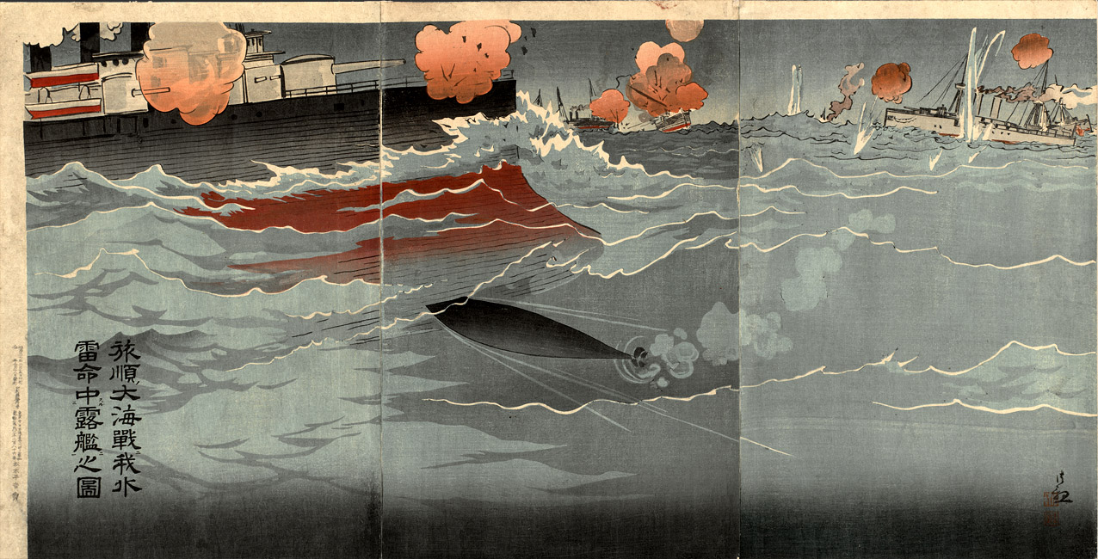
Illustration of Our Torpedo Hitting Russian Ship at Great Naval Battle of Port Arthur (1904) by Kobayashi Kiyochika
Notes:
That same November, Ogata Gekkō used much the same flag, pine, and craggy bluff to illustrate the army’s advance on Mukden.

Slide 29
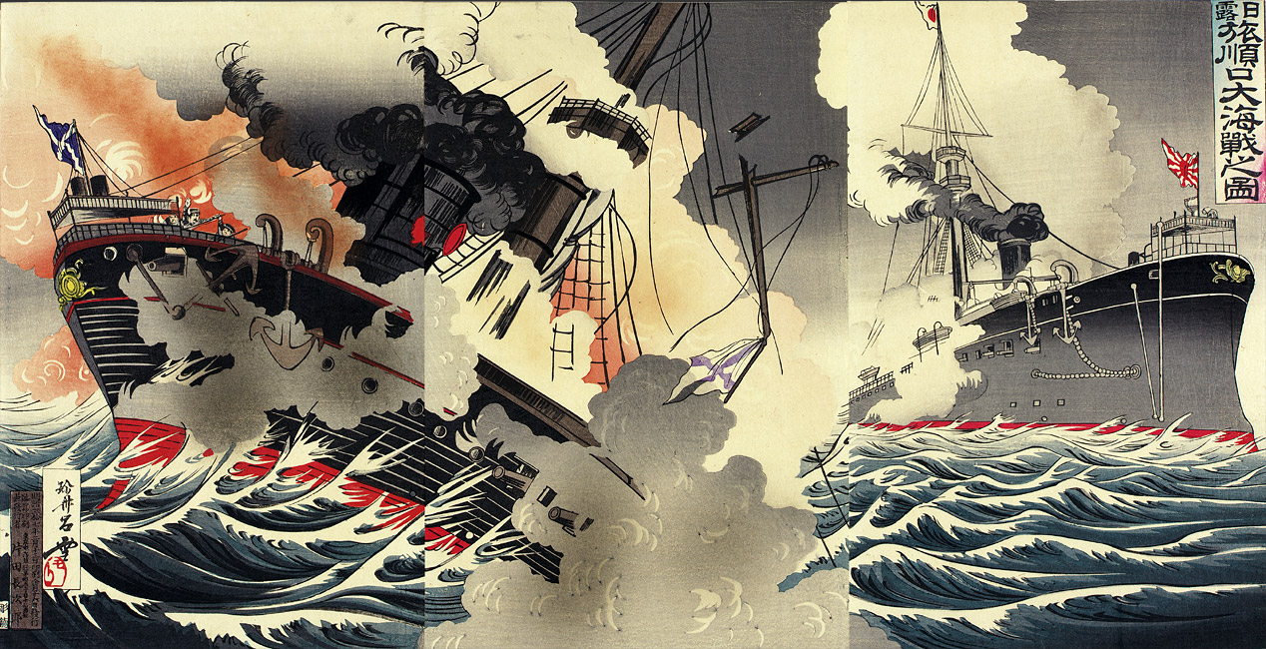
Illustration of the Great Naval Battle at the Harbor Entrance to Port Arthur in the Russo-Japanese War (1904) by Rosetsu
Notes:
That same November, Ogata Gekkō used much the same flag, pine, and craggy bluff to illustrate the army’s advance on Mukden.

Slide 30
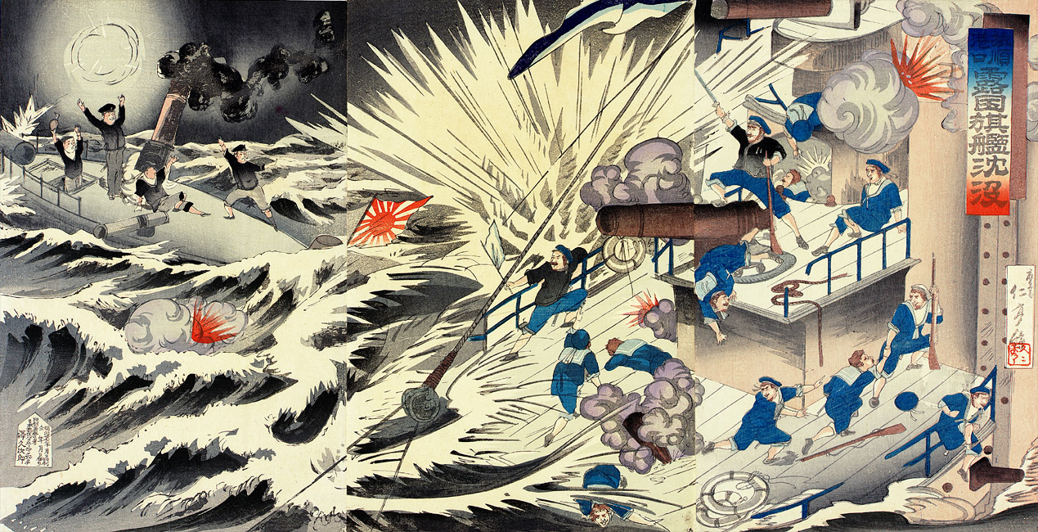
Harbor Entrance of Port Arthur: Russian Flagship Sinking at Port Arthur (1904) by Nitei

Slide 31
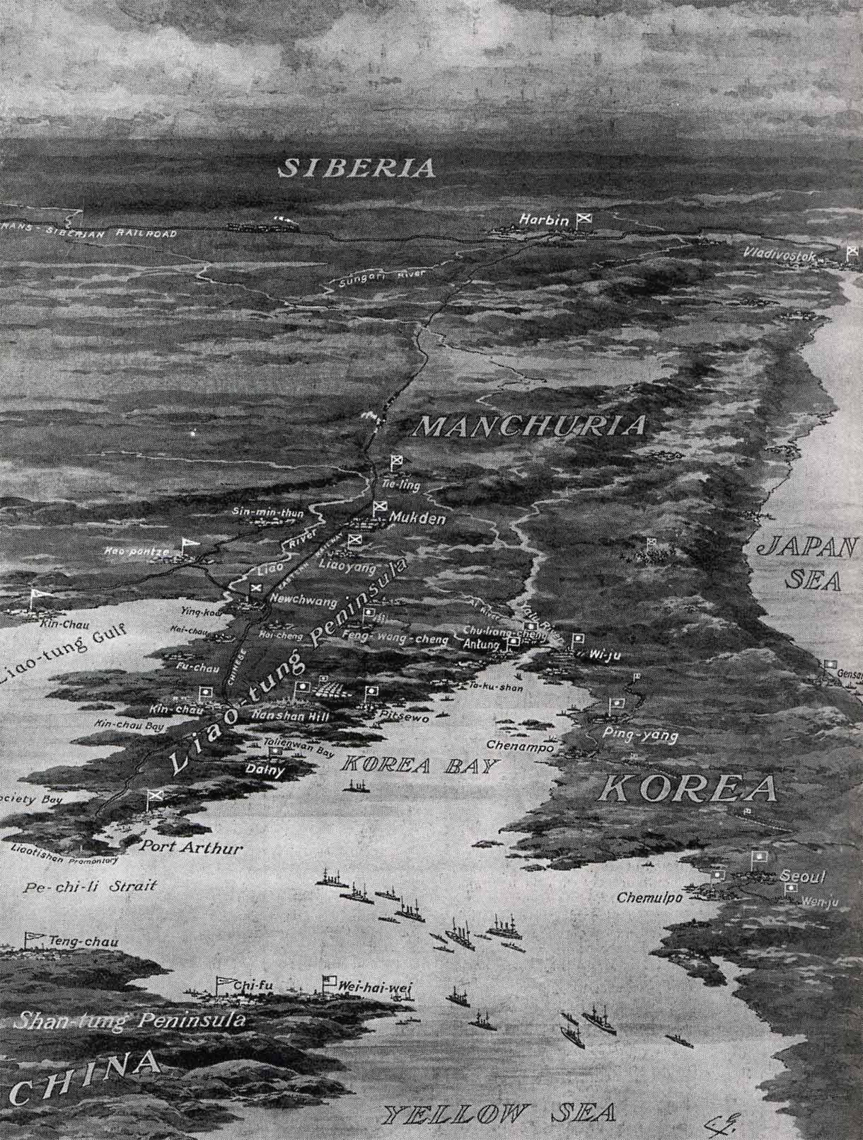
1904-5: Russo-Japanese War
In the Battle of Mukden, 250,000 Japanese confronted a Russian army of 320,000 and won.
The final blow came when the Russian Baltic Fleet of 45 ships, who had sailed round the world, were completely annihilated by Admiral Togo in the Straits of Tsushima.
Japan became the first Asian nation to defeat a Western Power and had established itself as a major world power.

Slide 33
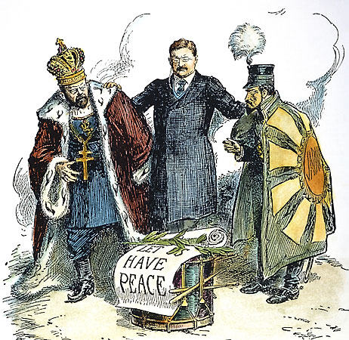
1904-5: Russo-Japanese War
In the resulting Treaty of Portsmouth, Russia was forced to recognise Japanese claims over Korea and gave Japan a 25-year lease over Port Arthur in Manchuria.
Russian itself was humiliated and the defeat in the war was one of the major causes of the later Russian Revolution in 1917.

Slide 35
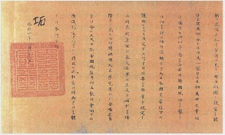
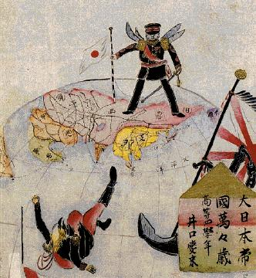
1910: Japan annexes Korea
In 1910 Korea was formally handed over to the Emperor of Japan and became part of the Japanese empire.
Japan had officially become an Imperial Power. They had ‘thrown off Asia’, defeated the hated Unequal Treaties and had defeated a major Western Power. The goals of the Restoration had been achieved, but at what cost to Japan itself?

Slide 36
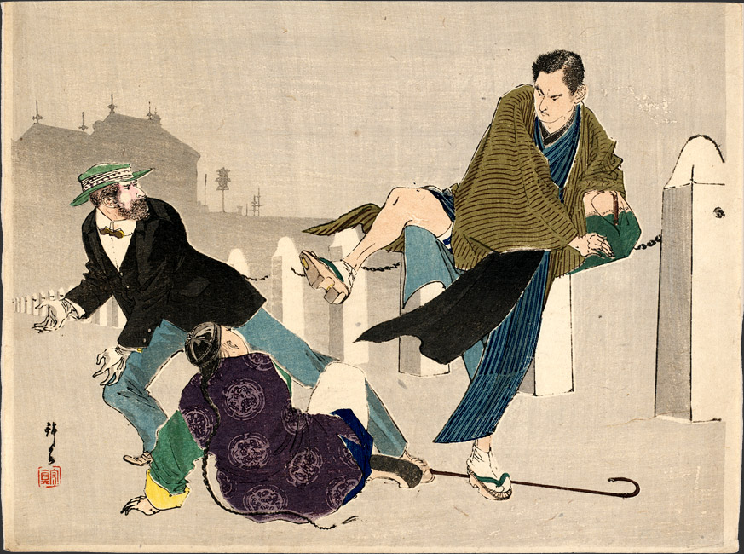
Allegory of Japanese Power: Japanese Man Kicking a Cowering Chinaman and a Fearful Westerner (1906?) – Artist Unknown

Slide 37
Questions
Explain the reasons why Japan wanted a strong military.
What rationale did Japan have for needing an overseas empire?
What did Fukugawa Yukichi mean by ‘throwing off Asia’?
How did the Treaty of Kanghwa increase tensions between China and Japan?
What was the purpose of the 1882 Imperial Rescript to Soldiers & Sailors?
What did Japan gain from the Sino-Japanese War?
Why was Japan angered by the Treaty of Shimonoseki?
What was so significant about the Anglo-Japanese Alliance?
What did Japan gain from the Russo-Japanese War?
When did Japan annex Korea?

Slide 38
Questions
Research the Sino-Japanese War and Russo-Japanese War. For each war, make a note of the causes, events and effects on Japan.
For this task, make sure to organize the information in a structured way. For example:
Sino- Japanese War
A. Causes
B. Events
C. Effects on Japan
Finally, make sure to cite all your sources at the bottom of the page

